Slide 1
Policies Approved by the 2025
ASHP House of Delegates
March-June 2025

Slide 2
The ASHP House of Delegates
Ultimate authority over ASHP professional policies
One annual session consisting of 2 in-person meetings at the June House of Delegates and 3 virtual meetings (March, May, and November)
The House considers professional policy proposals that have been approved by the Board of Directors
Most of these professional policy proposals are contained in reports from ASHP councils but may come from other component bodies, delegates, or ASHP members

Slide 3
March Virtual House of Delegates
The policy recommendations in the following slides were approved at the March virtual House of Delegates.

Slide 4
CEWD: Professional Development as a Retention Tool (March)
To recognize that pharmacy workforce development is an essential component of staff recruitment, retention, and well-being; further,
To recognize that pharmacy workforce development encompasses more than formal education programs and includes informal learning among colleagues, mentoring, participation in activities of professional organizations, and other types of learning; further,
To encourage healthcare executives to support pharmacy workforce development programs, including leadership succession planning, as an important benefit that aids in recruiting and retaining qualified staff; further,
To support healthcare executives with pharmacy workforce development by providing educational programs, services, and resources.
To encourage organizations to assess the effectiveness of professional development initiatives by evaluating their impact on recruitment and retention outcomes.
Note: This policy supersedes ASHP policy 2103.

Slide 5
CPM: Pharmacy Access to Payer Networks (March)
To oppose pharmacy access criteria that impose discriminatory requirements or qualifications on participation in insurance payer networks that interfere with patient continuity of care or patient site-of-care options; further,
To advocate for laws and regulations that require healthcare payers to disclose to pharmacies applying to participate in payer networks the criteria and the clinical and operational outcome data reporting requirements used to include, retain, or exclude pharmacies; further,
To encourage healthcare payers to standardize network access criteria and eliminate those reporting requirements already imposed by accrediting bodies or regulatory agencies.
Note: This policy supersedes ASHP policy 2031.

Slide 6
CPuP: Care-Commensurate Reimbursement (Discontinuation) (March)
To discontinue ASHP policy 2020, Care-Commensurate Reimbursement, which reads:
    To advocate that reimbursement for healthcare services be commensurate with the level of care provided, based on the needs of the patient.

Slide 7
CPuP: Patient Adherence Programs as Part of Health Insurance Coverage (Discontinuation) (March)
  To discontinue policy 1504, Patient Adherence Programs as Part of Health Insurance Coverage, which reads:
    To advocate for the pharmacist's role in patient medication adherence programs that are part of health insurance plans; further,
    To advocate those programs that (1) maintain the direct patient pharmacist relationship; (2) are based on the pharmacist's knowledge of the patient's medical history, indication for the prescribed medication, and expected therapeutic outcome; (3) use a communication method desired by the patient; (4) are consistent with federal and state regulations for patient confidentiality; and (5) permit dispensing of partial fills or overfills of prescription medications in order to synchronize medication refills and aid in medication adherence.

Slide 8
CPuP: Nonproprietary Naming of Biological Products (Discontinuation) (March)
  To discontinue policy 1535, Nonproprietary Naming of Biologic Products, which reads:
    To advocate that originator biological products, related biological products, and biosimilar products share the same global nonproprietary name as defined by the United States Adopted Name Council, the World Health Organization Programme on International Nonproprietary Names, and United States Pharmacopeial Convention; further,
    To oppose unique nonproprietary naming for originator biological products, related biological products, and biosimilar products.

Slide 9
CPuP: Employee Testing (Discontinuation) (March)
  To discontinue policy 9108, Employee Testing, which reads:
  To oppose the use of truth-verification testing such as polygraphs as routine employment practices because of the possible interference with the rights of individuals; further,
  To recognize the limited use of such testing during employment where such testing may protect the rights of individuals against false witness.

Slide 10
COT: Generic Substitution of Narrow Therapeutic Index Drugs (Discontinuation) (March)
  To discontinue ASHP policy 0817, Generic Substitution of Narrow Therapeutic Index Drugs, which reads:
  To support the current processes used by the Food and Drug Administration (FDA) to determine bioequivalence of generic drug products, including those with a narrow therapeutic index, and to recognize the authority of the FDA to decide if additional studies are necessary to determine equivalence; further,
  To oppose a blanket restriction on generic substitution for any medication or medication class without evidence from well-designed, independent studies that demonstrate inferior efficacy or safety of the generic drug product.

Slide 11
June 2025 House of Delegates
The policy recommendations in the following slides were approved at the June House of Delegates.

Slide 12
CPuP: Funding, Expertise, and Oversight of State Boards of Pharmacy
To advocate appropriate oversight of pharmacy practice and the pharmaceutical supply chain
through coordination and cooperation of state boards of pharmacy and related agencies whose mission it is to protect the public health; further,
To advocate adequate representation on state boards of pharmacy and related agencies by pharmacists and pharmacy technicians representing hospitals and health systems; further,
To advocate for the dedicated funds for the exclusive use by state boards of pharmacy and related agencies to carry out expected duties; further,
To advocate for consistent application of state boards of pharmacy regulations by inspectors with demonstrated competency in diverse pharmacy practice areas and the implementation of adequate inspection schedules to ensure the effective oversight and regulation of pharmacy practice; further,
To advocate state boards of pharmacy develop quality assurance processes for evaluating the performance of inspectors to ensure consistency.
Note: This policy supersedes ASHP policy 2021.

Slide 13
CPuP: Payment Parity for Pharmacists’ Services
To advocate pharmacists, as healthcare providers, receive payment that is commensurate with services provided within their scope of practice.
Note: This policy supersedes ASHP policy 1502.

Slide 14
CPuP: Pharmacists Cross-State Licensure
  To advocate for improved timeliness of the pharmacist licensure application approval process; further,
  To advocate for interstate pharmacist licensure; further,
  To support streamlined reciprocity processes, including temporary licensure mechanisms, as progress toward interstate licensure.
  Note: This policy supersedes ASHP policy 1621.

Slide 15
CPuP: Patient’s Right to Choose
  To acknowledge that patients or their representative have the right to be fully informed about their medication options and to be involved in the decision-making process; further,
  To support the right of patients or their representative to have their preferences considered respectfully, within the limits of clinical appropriateness, formulary considerations, safety, and legal requirements; further,
  To recognize the right of the patient or their representative to refuse care and have those decisions respected.
  Note: This policy supersedes ASHP policy 0013.

Slide 16
CPuP: Support of Global Health Organizations
  To strongly support the mission and work of global health organizations in their role in public health preparedness, prevention, and control to improve the health and well-being of people globally.
  Note: This policy supersedes ASHP Policy 2037

Slide 17
CPM: Recovery and Assistance Programs for Healthcare Workers with Substance Use Disorder
To advocate that hospitals and health systems support and promote recovery and assistance programs for healthcare personnel with substance use disorders, including those who have diverted controlled substances to support their own drug addiction; further,
To encourage state licensing boards to support structured rehabilitation programs that demonstrate a clear pathway for recovery and hospitals and health systems to support the return to practice upon successful completion of the program.

Slide 18
CPM: Cellular and Gene Therapies
To affirm that the pharmacy workforce serve key roles in the use of cellular and gene therapies (CGTs), spanning supply chain management, operational oversight, and clinical consultation on individual patients; further,
To recognize that CGTs are managed in the medication-use process; further,
To assert that health-system decisions on the selection, use, and management of CGTs are made through the formulary system; further,
To advocate for payment models that facilitate patient access, coverage, and reimbursement for CGTs with consideration of total cost of care; further,
To advocate for manufacturer processes that decrease the burden and resources required for hospitals and health systems to use CGTs.
Note: This policy supersedes ASHP policy 1802.

Slide 19
CPM: Interstate Pharmacist Licensure (Discontinuation)
  To discontinue ASHP policy 2030, Interstate Pharmacist Licensure, which reads:
  To advocate for interstate pharmacist licensure to expand the mobility of pharmacists and their ability to practice.

Slide 20
CPhP: Safe and Secure Transfer of Controlled Substances
To advocate for the standardization of policies, procedures, and practices in the handling of controlled substance medications throughout the care process, including transfers involving emergency medical services and during interfacility transport; further,
To promote closed loop communication and chain of custody documentation processes related to controlled substance medication management during patient transfers; further,
To collaborate with emergency medical services and other stakeholders involved in pre- and post-hospital and interfacility transfers of controlled substances to improve patient safety, increase standardization, and ensure compliance.

Slide 21
CPhP: Addressing and Preventing Moral Distress and Injury in the Healthcare Workforce
To acknowledge the acute and chronic exposure of the healthcare workforce to potentially morally injurious events across the continuum of care; further,
To recognize the risk of moral distress and moral injury when a healthcare worker is unable to provide ethical, safe, and effective care; further,
To advocate for consistent support for equitable and transparent allocation of resources across care teams and health systems to ensure that healthcare workers can provide safe and comprehensive patient care services; further,
To advocate organizations prevent and address moral distress and moral injury among healthcare workers.

Slide 22
CPhP: Pharmacy Services to Optimize Patient Throughput
To support the integration of pharmacy services to improve safe and efficient throughput and patient flow throughout the health system; further,
To advocate for pharmacists to serve as key decision-makers in improving medication management to optimize patient flow throughout the continuum of care.

Slide 23
COT: Accurate and Timely Height and Weight Measurements
To encourage the pharmacy workforce to participate in interprofessional efforts to ensure accurate and timely patient height and weight measurements are recorded in the patient medical record to provide safe and effective drug therapy; further,
To advocate that clinical decision support systems and other information technologies be structured to incorporate height and weight to facilitate prescribing, dispensing, and monitoring of drugs for safe and effective dosing; further,
To advocate for laws and regulations that prescribers include either height and weight or weight alone, and date obtained, as a required component of prescriptions for medications that are dosed based on that information.

Slide 24
COT: Clinical and Safety Considerations of Naming Drug Moieties and Complexes
To encourage regulatory agencies to incorporate pharmacists when considering clinical, operational, access, and safety factors when approving and classifying medications with different moieties or complexes that are used to deliver the active drug; further,
To oppose the consolidation of existing drug classes that include drugs that have distinct pharmacologic effects and pharmacokinetic/pharmacodynamic profiles; further,
To foster increased public notification when changes in approved drug products with therapeutic equivalence occur.

Slide 25
COT: Clinical, Operational, and Safe Use of Manipulated Drug Products and Alternate Administration Routes
To support clinically appropriate, evidence-based use of manipulated drug-products or alternate drug administration routes when it supports optimal patient care; further,
To promote research that includes pharmaceutics, pharmacokinetics, pharmacodynamics, safety, and efficacy of drugs when manipulated or when given through alternate administration routes; further,
To encourage manufacturers to develop drug products in ready-to-use devices and diverse formulations; further,
To foster pharmacist-led interdisciplinary teams to provide institutional guidance, best practices, and safety recommendations regarding drug products that are manipulated or administered through alternative routes.
Note: This policy supersedes ASHP policies 2041, 2242, and 2314.

Slide 26
COT: Expedited Partner Directed Therapy
To affirm that the pharmacy workforce improves patient access to therapies that prevent and treat sexually transmitted infections in all settings; further,
To support legislation that authorizes pharmacists to provide expedited partner therapy (EPT) while addressing barriers; further,
To encourage dispensing entities and payers to adopt internal policies that facilitate dispensing of EPT medications in alignment with public health guidance; further,
To advocate and affirm that drug products for EPT should be provided to individuals in a manner that ensures safe and appropriate use; further,
To encourage surveillance of EPT as a public health effort.

Slide 27
COT: Quality Consumer Medication Information
To support efforts by the Food and Drug Administration (FDA) and other stakeholders to improve the quality, consistency, accessibility, targeting, and simplicity of consumer medication information (CMI); further,
To encourage the FDA to work in collaboration with patient advocates and other stakeholders to create evidence-based models and standards, including establishment of a universal literacy level and standardized, patient-focused templates for CMI; further,
To advocate that research be conducted to validate these models in actual-use studies in pertinent patient populations; further,
To advocate that the FDA explore alternative models of CMI content development and maintenance that will ensure the highest level of accuracy, consistency, currency, and conformity with health literacy requirements; further,
To advocate that the FDA maintain a highly structured, publicly and easily accessible central repository of CMI in a format that is suitable for ready export; further,
To advocate for laws and regulations that would require all dispensers of medications to comply with FDA-established standards for content, format, and distribution of CMI.
Note: This policy supersedes ASHP policy 2005.

Slide 28
CEWD: Support for Caregiving Responsibilities in the Pharmacy Workforce
To affirm that an individual’s life circumstances can change and influence their workplace needs; further,
To foster psychologically safe environments that promote dialogue around individual workplace needs; further,
To advocate for organizational policies and resources that reduce disparities caused by caregiving responsibilities such as eldercare, lactation support, and other life circumstances; further,
To empower individuals to advocate for their own needs related to work-life integration.

Slide 29
CEWD: Cultural Competency and Trauma Informed Care
To foster the ongoing development of cultural humility and competency within the pharmacy workforce and promote a whole-person-health approach to care; further,
To educate the pharmacy workforce on how to interact with patients, caregivers, and other healthcare professionals in a manner that demonstrates respect for and responsiveness to all; further,
To educate healthcare providers on the importance of providing culturally congruent and trauma-informed care to achieve quality care and patient engagement.
Note: This policy supersedes ASHP policy 2231.

Slide 30
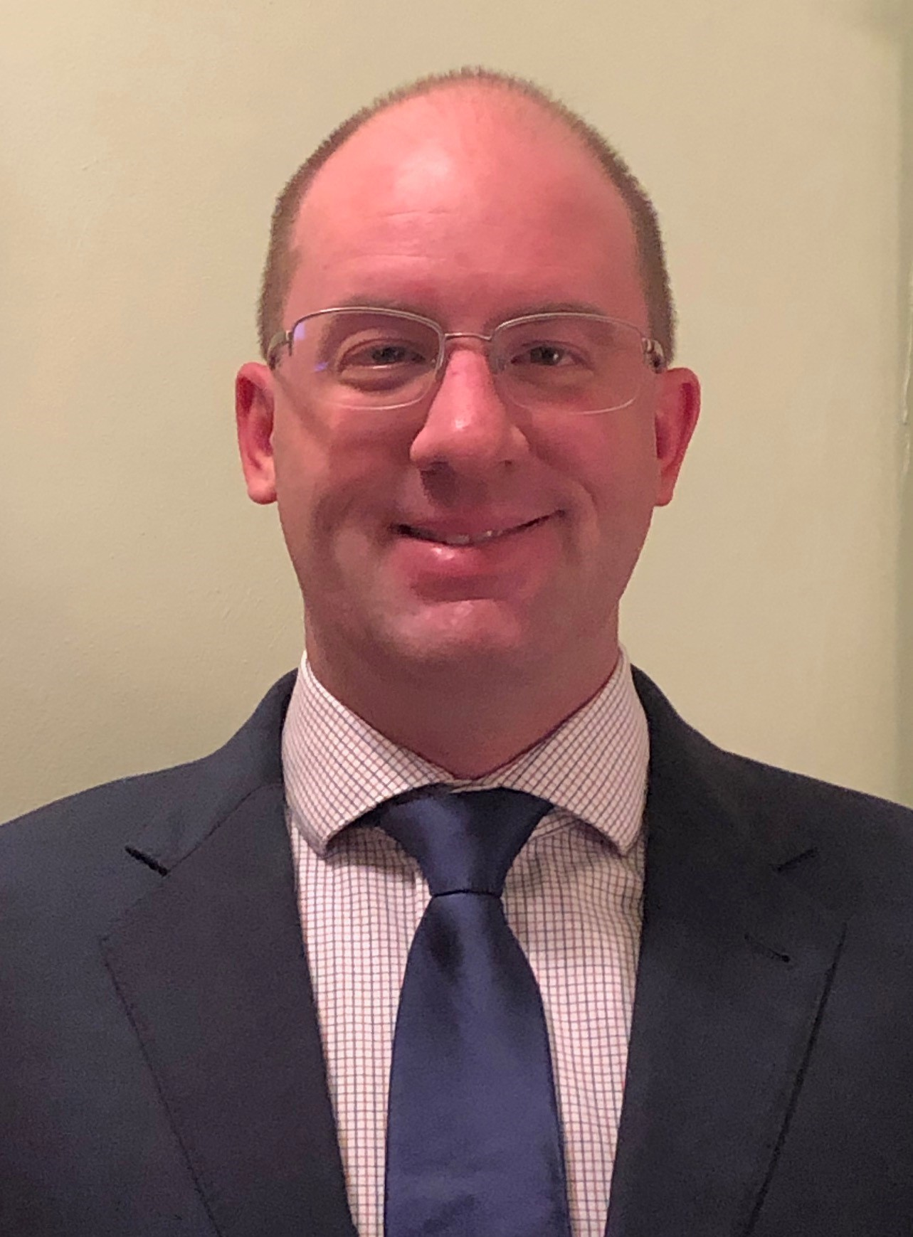
Questions or Suggestions?
Feel free to contact:
Jesse Hogue, Chair, ASHP House of Delegates:
hodchair@ashp.org
ASHP policy website: https://www.ashp.org/Pharmacy-Practice/Policy-Positions-and-Guidelines/

