Slide 1
Policies Approved in the June 2026 ASHP House of Delegates
July 2026

Slide 2
The ASHP House of Delegates
Ultimate authority over ASHP professional policies
One annual session consisting of 2 in-person meetings at the June House of Delegates and 3 virtual meetings (March, May, and November)
The House considers professional policy proposals that have been approved by the Board of Directors
Most of these professional policy proposals are contained in reports from ASHP councils but may come from other component bodies, delegates, or ASHP members

Slide 3
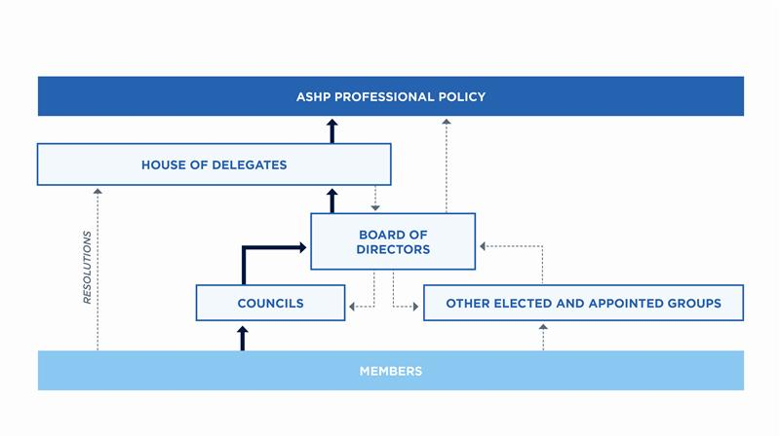
ASHP Policy Process

Slide 4
June 2026 House of Delegates
The policy recommendations in the following slides were approved at the June House of Delegates.

Slide 5
CEWD: Optimizing Career Fulfillment in Pharmacy
To recognize that fostering career fulfillment strengthens patient care and advances the profession by promoting a resilient, engaged, and purpose-driven workforce; further,
To advocate for dedicated organizational priorities focused on career fulfillment that integrate recognition strategies, structured development guidance, and individualized support and mentoring across the care continuum; further,
To encourage the pharmacy workforce to align their professional development plans with their personal definitions of career fulfillment and core values to help support sustainable engagement and well-being throughout their careers.

Slide 6
CEWD: Quality Of Pharmacy Education
To support the Accreditation Council for Pharmacy Education’s continuing role of promulgating accreditation standards and guidelines and engaging in sound accreditation processes to ensure quality in the education provided by colleges of pharmacy; further,
To advocate that pharmacy education should proactively incorporate established and emerging practice advancements, practice standards, and innovative technology; further,
To acknowledge that, in addition to a robust curriculum, access to quality experiential educational sites and the availability of qualified faculty (including preceptors) are essential determinants of the ability to provide a quality pharmacy education.
This policy supersedes ASHP policy 1108.

Slide 7
CPM: Advancing Technology Innovation and Vendor Accountability in Health-system Pharmacy
To urge hospitals and health systems to actively engage pharmacy departments in prospective assessment, governance, competitive procurement, ongoing performance monitoring, and evaluation of technologies impacting patient care, inclusive of pharmacy informatics leadership; further,
To encourage pharmacy leaders to take ownership of pharmacy’s role in implementing, maintaining, and optimizing medication-related technologies, including associated processes and governance; further,
To support collaboration between pharmacy leaders and technology vendors in the design, implementation, maintenance, and ongoing optimization of technologies that improve patient-care outcomes and the user experience, consistent with appropriate procurement and contracting requirements; further,
To encourage technology vendors to provide transparent estimates of the resources required for implementation, integration, training, maintenance, and long-term support; further,
To advocate for federal laws and regulations that establish appropriate oversight mechanisms and define technology vendors’ responsibilities for safety, performance transparency, and timely remediation of identified risks.
This policy supersedes ASHP Policy 2406.

Slide 8
CPM: Standard of Care Regulatory Model
To promote the adoption of a standard of care regulatory model for pharmacy practice.

Slide 9
CPhP: Promoting Environmental Sustainability in Healthcare
To acknowledge the importance of environmental sustainability in promoting and preserving public health; further,
To encourage implementation of environmentally conscious practices that reduce waste within the healthcare system; further,
To advocate for legislation and regulation that enables waste-minimization efforts in medication-use practices across all points of the pharmacy supply chain; further,
To advocate for environmentally sustainable drug manufacturing processes that minimize the environmental impact across the full medication and supply life cycle; further,
To encourage members of the pharmacy workforce to seek out opportunities that promote environmental sustainability and health.

Slide 10
CPhP: Body Size Inclusivity
To recognize that body size bias influences health outcomes, social interactions, and decisions across workplaces and healthcare settings; further,
To promote the use of body size inclusivity in practice to ensure a comprehensive, patient-centered approach to care; further,
To encourage adoption of best practices that minimize body size bias across professional and healthcare settings.

Slide 11
CPhP: Pharmacy Workforce Leadership in Improving Vaccine Access
To affirm the pharmacy workforce is the leader in increasing patient access to vaccinations to improve public health; further,
To collaborate with key stakeholders to support the public health role of the pharmacy workforce in the initiation, preparation, and administration of all adult and pediatric vaccinations; further,
To advocate that state and federal health authorities establish required centralized databases for timely documentation of vaccine administrations that are interoperable and accessible to all healthcare providers; further,
To advocate for payer coverage guarantees without cost sharing of evidence-based vaccines; further,
To work with federal, state, and local governments and others to improve the vaccine development and supply system in order to ensure an adequate supply of vaccines; further,
To foster public vaccine confidence through consistent, evidence-based, and culturally sensitive engagement with individuals and communities.

Slide 12
CPhP: Pharmacy Workforce Right of Conscience and the Patient’s Right of Access to Therapy
To support processes that protect patients’ access to legally prescribed treatments while reasonably accommodating members of the pharmacy workforce exercising rights of conscience; further,
To affirm the value of shared decision-making that protects patient well-being and continuity of care while balancing the rights of conscience held by members of the pharmacy workforce and other healthcare professionals; further,
To recognize the right of pharmacy workforce members to decline participation in non-emergency care delivery activities they consider morally, religiously, or ethically objectionable; further,
To support the principle that a member of the pharmacy workforce exercising rights of conscience must remain respectful of, and responsive to, and serve the legitimate health care needs and preferences of the patient and shall provide appropriate referral or transfer of care without any actions to persuade, coerce, or otherwise impose personal values, beliefs, or objections on the patient.
This policy supersedes ASHP policy 0610.

Slide 13
CPhP: Safe and Effective Compounding
To affirm that compounding of medications, when done to meet immediate or anticipatory patient needs, is part of the practice of pharmacy and is not manufacturing; further,
To support preferential use of commercially manufactured products in ready-to-administer dosage forms where barriers do not exist; further,
To encourage the pharmacy workforce members who compound medications to use only drug substances that have been manufactured in Food and Drug Administration-registered facilities and that meet official United States Pharmacopeia (USP) compendial requirements; further,
To advocate that all compounding activities meet applicable USP standards and federal and state regulations; further,
To support the principle that the pharmacy workforce be adequately trained and have sufficient facilities, equipment, automation, and technology to ensure the quality of compounded medications; further,
To encourage USP to develop compounded preparation monographs for commonly compounded preparations; further,
To educate prescribers, other healthcare professionals, and patients about the potential risks associated with the use of compounded preparations.
This policy supersedes ASHP policy 2139.

Slide 14
CPhP: Role of the Pharmacy Workforce to Combat Public Health Disinformation and Misinformation
To affirm that disinformation and misinformation undermine public health and trust in health care professionals, increasing risk of potential harm and adverse patient outcomes; further,
To educate individuals on how to recognize and counter disinformation and misinformation; further,
To oppose and actively dispel the dissemination of disinformation and misinformation by members of the pharmacy workforce; further,
To collaborate with key partners to combat disinformation and misinformation.

Slide 15
CPuP: FDA’s Public Health Role
To affirm that the Food and Drug Administration’s public health role is to ensure the safety and effectiveness of drugs, biologics, and medical devices through risk assessment, appropriate product approval and labeling, manufacturing oversight, maintaining consumer confidence in medications, and consultation with health professionals, while deferring to state regulation and professional self-regulation on matters related to the use of drugs, biologics, and medical devices; further,
To support the allocation of sufficient federal resources to allow FDA to meet its defined public health mission; further,
To support the appointment of practicing pharmacists to FDA advisory committees as one mechanism of ensuring that decisions made by the agency incorporate the unique knowledge of the profession of pharmacy for the further benefit of the patient; further,
To support an ongoing dialogue between FDA and ASHP for the purpose of exploring ways to advocate the best use of FDA-regulated products by consumers and health care professionals.
This policy supersedes ASHP policy 0012.

Slide 16
CPuP: Protecting the Pharmacy Workforce Against Unauthorized Synthetic Media
To advocate for federal and state laws, regulations, public education efforts, and enforcement mechanisms that protect the pharmacy workforce and healthcare organizations from liability and other harms arising from unauthorized, nonconsensual, or deceptive synthetic media generated or materially manipulated content; further,
To advocate for standardized, accessible, and timely methods and frameworks at the federal, state, and local levels addressing the hazards associated with and mitigating the dangers posed by such content.

Slide 17
COT: Tobacco and Nicotine Cessation and Control
To support pharmacists’ practice in providing nicotine cessation counseling and comprehensive medication management, including the appropriate use of FDA-approved nicotine replacement therapy, and to promote pharmacist prescriptive authority; further,
To discourage the use and oppose the distribution and sale of tobacco, tobacco products, and non-tobacco nicotine (NTN) delivery systems not approved as cessation therapies; further,
To support efforts to expand patient access to tobacco cessation medications, including availability of affordable tobacco cessation medication (including zero-cost options); further,
To advocate for healthcare environments to be free of tobacco and NTN.
This policy supersedes ASHP Policy 2125.

Slide 18
COT: Safe and Effective Use of Long-acting Injectable Antipsychotics
To advocate for the development and implementation of standardized, pharmacist-led processes to ensure the safe, effective, and coordinated use of long-acting injectable (LAI) antipsychotics across the continuum of care; further,
To advocate for a centralized health information exchange that collects real-time and standardized information of LAI antipsychotic administrations accessible to all healthcare providers engaged in the care of the patient; further,
To collaborate with key stakeholders on the development of best practices for the safe use and management of LAI antipsychotics, regardless of site of care.

Slide 19
COT: Dosing of Combination Antibiotics
To advocate for Food and Drug Administration-approved standardized labeling of combination antibiotics with dosing instructions that include each component in a clear and unambiguous manner; further,
To support the continuous evaluation and streamlining of combination antibiotic formulation ratios; further,
To advocate for information system vendors to incorporate discrete data fields and for drug reference resources to reflect each antibiotic component; further,
To encourage healthcare organizations to adopt strategies that ensure appropriate dosing of combination antibiotics; further,
To educate stakeholders and the public regarding the safe dosing and administration of combination antibiotics for pediatrics and adults.

Slide 20
COT: Evidence-based Medicine
To define evidence-based medicine as the conscientious, explicit, and judicious appraisal and application of the best-available current data integrated with clinician expertise and patient values to inform the development and implementation of professional policies, standards, and clinical practice decisions; further,
To affirm evidence-based medicine as a foundational principle of pharmacy practice, patient care, and the development of ASHP professional policies and advocacy positions, including clinical decision-making and public health guidance.

Slide 21

Questions or Suggestions?
Feel free to contact:
Jesse Hogue, Chair, ASHP House of Delegates:
hodchair@ashp.org
ASHP policy website: https://www.ashp.org/pharmacy-practice/policy-search

