Slide 1
ASHP Pharmacy Forecast Workshop:
PLANNING GUIDE

Slide 2
Workshop Planning – 3.0Hr Presentation
Full Workshop Presentation: 126 slides
  Discuss all survey themes and results from each domain
  Present and discuss case studies
  Ideal for students and residents

Slide 3
Workshop Planning – 1.5Hr Presentation
Abridged Workshop Presentation: approx. 60 slides
  Discuss selected survey themes and results from their respective domains
  Select and discuss case studies
  The presenter decides audience participation
  Ideal for a targeted employer/workplace workshop

Slide 4
Workshop Planning – 1.0Hr Presentation
Lecture (35-40 slides)
  Discuss 2-3 survey themes and results from their respective domains
  Focus on Forecast Workshop overview and summary
  Ideal for state affiliate presentations or other targeted meetings

Slide 5
Workshop Planning – Presentation Cadence
Theme overview
Survey question(s)
Executive summary
Survey results (Forecast response)
Strategic recommendations
REPEAT

Slide 6
ASHP Pharmacy Forecast Workshop:
Trends that Will Shape
Your Future
Presented by ASHP’s Section of Pharmacy Practice Leaders

Slide 7

Special Acknowledgements
Forecast 2024 Advisory Committee
Chapter authors
Forecast Panelists (FPs) who responded to the survey
Notes:
Can you please replace the ASHP Foundation logo? This one is blurry on a big screen.

Slide 8
Acknowledgements for Preparing Workshop Slides:
Section of Pharmacy Practice Leaders’ Advisory Group on New and Emerging Leaders
Courtney Graziano, PharmD, MBA, BCPS
Clinical Quality Pharmacist, PGY1 Pharmacy Residency Director
Alaska Native Medical Center – Anchorage, AK
Alice Callahan, PharmD, MPH, MS
Clinical Pharmacy Manager
Mercy Medical Center – Cedar Rapids, IA
Parker Knueppel, PharmD, BCPS
Pharmacy Supervisor Montage Health, Community Hospital of the Monterey Peninsula - Monterey, CA
Noah Franz, PharmD, MHA Director of Pharmacy Froedtert Health – Milwaukee, WI
Carlie Wilke, PharmD, MS, BCPS Pharmacy Manager East Madison Hospital and Rehab Hospital –Madison, WI
Zachary Hitchcock, PharmD, MHA Associate Director of Pharmacy – Inpatient Operations
Chandler Central Pharmacy – Lexington, KY

Slide 9

Objectives
Introduce and provide background on the Pharmacy Forecast Report
Discuss survey questions and results from each domain of the report
Apply key trends to case study activities

Slide 10
Pharmacy Forecast
Purpose
To improve the effectiveness of leaders in hospital and health-system pharmacy practice
ASHP Foundation. http://https://www.ashpfoundation.org/pharmacyforecast (accessed 2024 Feb 14).

Slide 11
Pharmacy Forecast: Overview
Predicts developments in general themes likely to challenge pharmacy leaders in hospitals and health-systems over the coming 5 years
Presents authoritative, actionable strategic recommendations to pharmacy practice leaders
Reports survey results of trend watchers and leaders in health-system pharmacy and analyzes predicted trends
Trend reports from ASHP Research and Education Foundation’s Center for Health-System Pharmacy Leadership
ASHP Foundation. http://https://www.ashpfoundation.org/pharmacyforecast (accessed 2024 Feb 14).

Slide 12
Pharmacy Forecast Methodology
Appointed Forecast Panel (FP) completes a questionnaire
Survey asks likelihood of certain trends occurring over next five years
Experts recruited to write a brief chapter for each domain
Each chapter presents the survey results, authors assessment of predictions and strategic recommendations
ASHP Foundation. http://https://www.ashpfoundation.org/pharmacyforecast (accessed 2024 Feb 14).

Slide 13
Pharmacy Forecast: Representation
53% of Forecast Panelists (FPs) employed by hospitals with 500 or more beds
24% of FPs were from hospitals of less than 500 beds
Region | Response Rate from FPs
Midwestern | 32%
Southern | 32%
Western | 18%
Eastern | 19%
ASHP Foundation. http://https://www.ashpfoundation.org/pharmacyforecast (accessed 2024 Feb 14).

Slide 14
2024 Forecast Themes
Urgent Public Health Priorities
Responding to the Mental Health Crisis
Achieving Care Equity
New Disease Paradigms and Treatment Innovations
Workforce: Focus on Culture for the Future Artificial
Intelligence: Can Ethics and Regulators Catch Up?

Slide 15
Professional Development
How is the forecast relevant for pharmacy students?
Recognizing emerging trends in pharmacy
Providing insights into expected challenges in pharmacy
Promote thought-provoking discussion and research
Serve as topics for journal clubs, topic discussions, presentations, and interview questions

Slide 16
Theme 1:
Urgent Public Health Priorities

Slide 17
Public Health Priorities Identified
Coronavirus disease 2019 (COVID-19) pandemic became a catalyst to implement a reform for health systems to re-center around patients, families, and communities
Emphasizing health, not just healthcare, to help achieve a broader good for the community
Health systems helping to address the following public health priorities:
  Gun violence
  Climate change
  Gap between Urban and Rural Populations

Slide 18
Theme 1:
Forecast Question 5
How likely is it that the following will occur, by the year 2028, in the geographic region where you work?
Health systems will invest in comprehensive prevention programs to reduce gun violence in their communities (e.g., violence prevention efforts, screening for risk, and support of victims, including mental health support).
Very Likely
Somewhat Likely
Somewhat Unlikely
Very Unlikely

Slide 19
Gun Violence
Firearms are the leading cause of death among children and teens in the U.S. accounting for 20% of all child and teen deaths
  Consistently higher among Black individuals and other racial and ethnic groups – indicates disparity in public health
Hospitals are entry point for public health emergencies
  Surprising that 65% of panelists reported that it is unlikely that health systems will invest in prevention programs
Urgency to address structural causes of injuries and deaths from firearms
Hospitals can address risk factors and prevent violence by partnering with community stakeholders

Slide 20
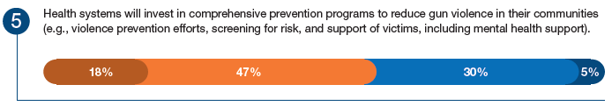
Forecast Response

Slide 21
Theme 1: Forecast Question 6
How likely is it that the following will occur, by the year 2028, in the geographic region where you work?
Disease and natural disasters will double the frequency of public health emergencies impacting health systems (e.g., preparedness, temporary facilities, workforce deployment).
Very Likely
Somewhat Likely
Somewhat Unlikely
Very Unlikely

Slide 22
Climate Change
Natural disasters are increasing in frequency and can cause:
  Disruptions in supply chain
  Displacement of people
  Compromise basic needs (food, shelter, clean water)
  Transmission of vector-born disease and infection
The majority (75%) of respondents indicated that natural disasters will double the frequency of public health emergencies
  Urgent need to develop approaches to mitigate impacts
Comprehensive preparation includes:
  Addressing supply chain and cold chain disruptions
  Contingency staffing
  Coordination with local public health
  Staff aware of disaster protocols

Slide 23
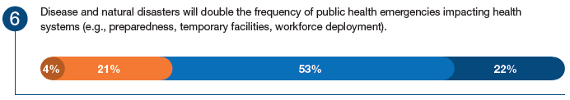
Forecast Response

Slide 24
Theme 1: Forecast Question 2
How likely is it that the following will occur, by the year 2028, in the geographic region where you work?
The gap between rural and urban morbidity and mortality will grow significantly wider.
Very Likely
Somewhat Likely
Somewhat Unlikely
Very Unlikely

Slide 25
Theme 1: Forecast Question 7
How likely is it that the following will occur, by the year 2028, in the geographic region where you work?
All states will implement plans to ensure that all persons have access to broadband internet.
Very Likely
Somewhat Likely
Somewhat Unlikely
Very Unlikely

Slide 26
Gap Between Rural and Urban Morbidity and Mortality
Rural residents experience significantly worse health outcomes and have a shorter life expectancy compared to urban residents
  Higher rates of:
    Tobacco use
    Hypertension
    Obesity
    Multiple comorbidities
Primary reason is reduced access
Telehealth models are associated with promising outcomes
  Broadband internet is needed for successful implementation
    Health systems have an opportunity to work with states to help overcome barriers to access

Slide 27
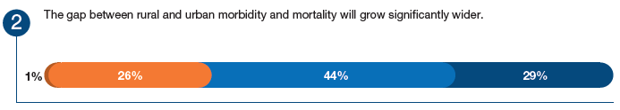
Forecast Response

Slide 28
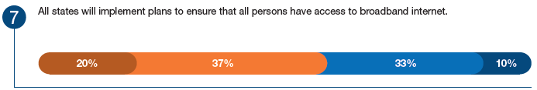
Forecast Response

Slide 29
Strategic Recommendations for Practice Leaders
Be a part of a community’s collective effort to incorporate research, community outreach, and new policies to spark change around gun violence
Violence prevention programs in hospitals should be designed to address needs and capabilities of the hospital and community
Incorporate climate change impacts into emergency preparedness and response plans
Work with pharmacy staff and clinics to identify and mitigate at risk populations, heat susceptible individuals, and those prone to illness during extreme weather events
Work to overcome barriers that limit access to telehealth in rural communities
Prioritize developing and maintaining a comprehensive emergency preparedness plan that is integrated with larger health-system and community plans

Slide 30
Theme 2:
Responding to the Mental Health Crisis

Slide 31
Responding to the Mental Health Crisis
Mental health crises are evident regardless of age, race, socioeconomic status, and geographic region (rural, urban, suburban)
The health systems and communities must coordinate and collaborate with aligned stakeholders to implement innovative strategies and mitigate costs
  The National Safety Council estimates an annual average of $15,000 spent on each employee due to healthcare costs, loss of life, and reduced productivity
Identified challenges have been associated with:
  Recognition and response
  Workforce education and training
  Pharmacist response

Slide 32
Theme 2:
Forecast Question 1
How likely is it that the following will occur, by the year 2028, in the geographic region where you work?
The U.S. federal government will declare the “mental health crisis” a public health emergency (e.g., as with the opioid crisis) and allow for allocation of resources to support a national response.
Very Likely
Somewhat Likely
Somewhat Unlikely
Very Unlikely

Slide 33
Theme 2: Forecast Question 2
How likely is it that the following will occur, by the year 2028, in the geographic region where you work?
Health systems will actively engage with community stakeholders (e.g. other health systems, local government, programs, organizations, employers) to coordinate a timely and appropriate first response when a person is experiencing a mental health crisis.
Very Likely
Somewhat Likely
Somewhat Unlikely
Very Unlikely

Slide 34
Recognition and Response
Recognizing signs and symptoms increases the potential for earlier intervention and improved outcomes
  Smartphone and wearable technology have augmented the potential to identify these signs and symptoms
Current systems provide inadequate or nonexistent care, prompting the emergence of new models designed to coordinate timely and appropriate first response in the event of a mental health crisis
Core services for an effective crisis care model include:
  Regional crisis call center
  Crisis mobile team response
  Crisis receiving and stabilization facilities

Slide 35
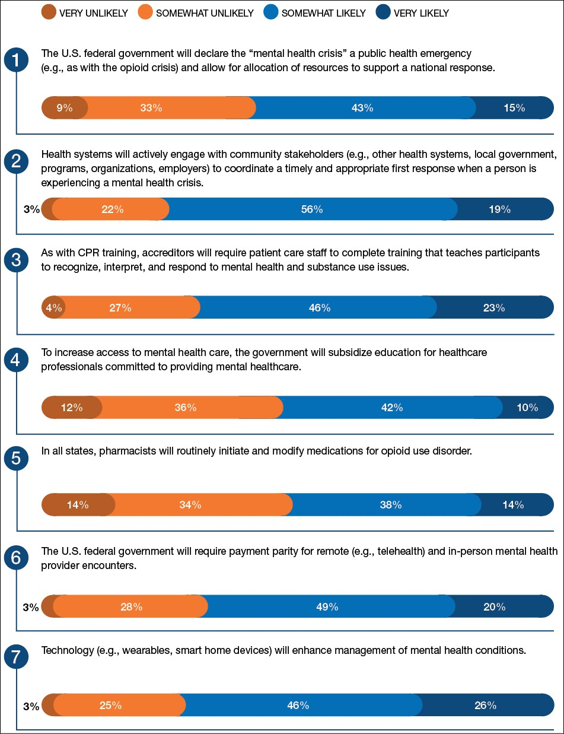
Forecast Response

Slide 36
Forecast Response

Slide 37
Theme 2: Forecast Question 3
How likely is it that the following will occur, by the year 2028, in the geographic region where you work?
As with CPR training, accreditors will require patient care staff to complete training that teaches participants to recognize, interpret, and respond to mental health and substance use issues.
Very Likely
Somewhat Likely
Somewhat Unlikely
Very Unlikely

Slide 38
Forecast Response

Slide 39
Theme 2: Forecast Question 4
How likely is it that the following will occur, by the year 2028, in the geographic region where you work?
To increase access to mental health care, the government will subsidize education for healthcare professionals committed to providing mental healthcare.
Very Likely
Somewhat Likely
Somewhat Unlikely
Very Unlikely

Slide 40
Workforce Education and Training
Education and training need to evolve to reduce stigma around mental health and substance use disorders, and to ensure equitable access to culturally competent patient care
  Further complicating this need is the growing shortage of behavioral health professionals despite increasing demand for these services
New strategies are needed to increase educational opportunities and training for healthcare professionals and to improve access to care, such as:
  Increase or streamline funding for educational programs
  Create career paths and training programs for emerging mental health roles
  Integrate behavioral health into primary care settings
  Optimize access to and utilization of telehealth services

Slide 41
Forecast Response

Slide 42
Theme 2: Forecast Question 5
How likely is it that the following will occur, by the year 2028, in the geographic region where you work?
In all states, pharmacists will routinely initiate and modify medications for opioid use disorder.
Very Likely
Somewhat Likely
Somewhat Unlikely
Very Unlikely

Slide 43
Theme 2: Forecast Question 6
How likely is it that the following will occur, by the year 2028, in the geographic region where you work?
Health systems will invest in expanded programs that support behavioral health of their employees.
Very Likely
Somewhat Likely
Somewhat Unlikely
Very Unlikely

Slide 44
Pharmacists’ Role in Responding to the Mental Health Crisis
Pharmacotherapy is a cornerstone of mental health and substance use treatment algorithms
Due to challenges and barriers associated with medication access and adherence, pharmacists have a unique opportunity to integrate into the interprofessional team in specialty and primary care settings
Significant obstacles for expansion of pharmacists’ role include:
  Prohibition or limitation of prescribing authority for pharmacists
  Lack of reimbursement for clinical pharmacy services
  Lack of preparation to meet demand for pharmacists with specialized mental health training and education

Slide 45
Forecast Response

Slide 46
Forecast Response

Slide 47
Theme 2: Forecast Question 7
How likely is it that the following will occur, by the year 2028, in the geographic region where you work?
Technology (e.g., wearables, smart home devices) will enhance management of mental health conditions.
Very Likely
Somewhat Likely
Somewhat Unlikely
Very Unlikely

Slide 48
Forecast Response

Slide 49
Strategic Recommendations for Practice Leaders
Promote and support novel community and hospital partnerships to create effective mental health crisis services to reduce ED wait times and overcrowding, reduce hospital readmissions, and decrease overuse of law enforcement resources.
Support and invest in the core elements needed for effective crisis care systems, such as staffing call centers, mobile response teams, and receiving and stabilization facilities.
Prioritize mental health education and skills training for all direct care staff to prepare the workforce to provide equitable, empathetic, and culturally competent care to individuals with mental health and substance use disorders.
Partner with academic institutions and community stakeholders to develop robust talent pipelines, including pharmacists, and career development programs to train and retain a competent behavioral health workforce.
Integrate behavioral health providers in primary care settings to provide a sustainable framework for collaborative care that includes pharmacists with advanced training and experience in mental health and substance use disorders.
Increase opportunities for pharmacy students and residents to gain exposure to psychiatric and substance use disorders and support expansion of PGY-2 psychiatric pharmacy training programs.

Slide 50
Theme 3:
Achieving Care Equity

Slide 51
Achieving Equity in Healthcare Delivery
Some segments of our population remain at greater risk for disparities in health or healthcare
  These include LGBTQ+ and rural health populations
Health systems must consider equity as an essential pillar of healthcare quality, and use multi-pronged approaches that:
  Define populations at-risk with available data
  Improve access to care for at-risk populations
  Address the individual, provider, and system contributors to disparities
  Increase workforce diversity to reduce biases as root causes of disparities

Slide 52
Theme 3: Forecast Question 1
How likely is it that the following will occur, by the year 2028, in the geographic region where you work?
Augmented reality technology will be used routinely to enhance patient encounters (e.g., assist with diagnostics, enhance patient virtual visits).
Very Likely
Somewhat Likely
Somewhat Unlikely
Very Unlikely

Slide 53
Digital Technology and Healthcare Equity
Digital technology presents an opportunity to promote high quality, equitable care and communication as healthcare systems embrace a “digital-first” approach to patient encounters
  A challenge in this approach is the digital divide that exists among at-risk and socially and economically disadvantaged populations
The availability and use of technology among at-risk populations must be considered so that healthcare disparities in disadvantaged groups are not exacerbated by reliance on digital tools

Slide 54
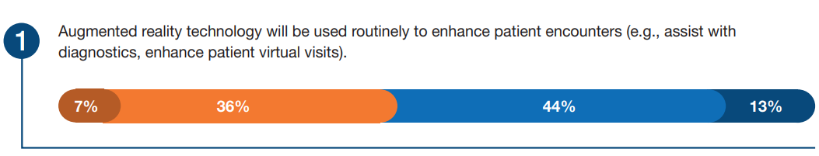
Forecast Response

Slide 55
Theme 3: Forecast Question 2
How likely is it that the following will occur, by the year 2028, in the geographic region where you work?
The 340B program will be reduced to the extent that hospitals no longer participate because the effort invested is not worth the savings provided.
Very Likely
Somewhat Likely
Somewhat Unlikely
Very Unlikely

Slide 56
Theme 3: Forecast Question 3
How likely is it that the following will occur, by the year 2028, in the geographic region where you work?
To maintain their non-profit status, health systems will have to demonstrate a specified level of investment in programs and services to reduce health disparities in their communities.
Very Likely
Somewhat Likely
Somewhat Unlikely
Very Unlikely

Slide 57
Theme 3: Forecast Question 4
How likely is it that the following will occur, by the year 2028, in the geographic region where you work?
Value-based payer contracts will include incentives when health systems demonstrate care equity (e.g., similar outcomes of care regardless of race, gender, location).
Very Likely
Somewhat Likely
Somewhat Unlikely
Very Unlikely

Slide 58
Theme 3: Forecast Question 5
How likely is it that the following will occur, by the year 2028, in the geographic region where you work?
Provider demographics (e.g., provider race, gender identity, sexual orientation) will be designated as a social determinant of health, recognizing the influence provider demographics have on the quality of health.
Very Likely
Somewhat Likely
Somewhat Unlikely
Very Unlikely

Slide 59
Health Equity Is an Essential Pillar of Healthcare Quality
To effectively promote health equity when designing incentive programs, healthcare systems should:
  Target quality measures relevant to their patient population
  Engage in creation of interprofessional health metrics
  Construct incentives that do not penalize hospitals that care for a high volume of disadvantaged populations
Ensuring health equity among LGBTQ+ individuals is a key dimension of delivering high-quality care
  Organizations’ advocacy for addressing disparities in this population at-risk can be discordant with state and local laws that challenge gender-affirming care
  Health systems need adequate health education (on social affirmation and allocation of medication and surgeries) for all medical providers to create a safe and affirming healthcare environment for LGBTQ+ patients

Slide 60
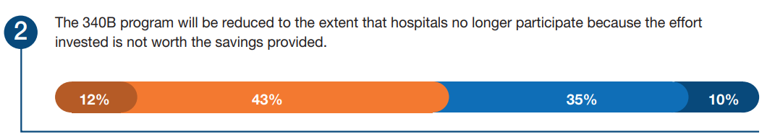
Forecast Response

Slide 61
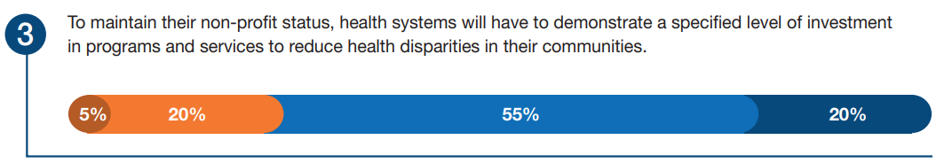
Forecast Response

Slide 62
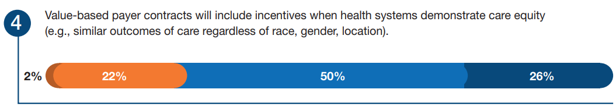
Forecast Response

Slide 63
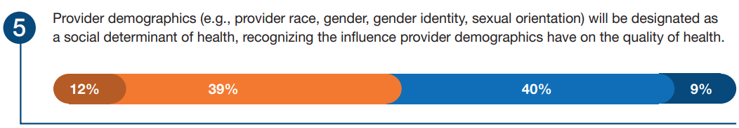
Forecast Response

Slide 64
Theme 3: Forecast Question 6
How likely is it that the following will occur, by the year 2028, in the geographic region where you work?
50% of critical access hospitals will convert their status to Rural Emergency status.
Very Likely
Somewhat Likely
Somewhat Unlikely
Very Unlikely

Slide 65
Theme 3: Forecast Question 7
How likely is it that the following will occur, by the year 2028, in the geographic region where you work?
Tertiary referral centers will partner with Rural Emergency Hospitals to increase market share and reach of referral center services.
Very Likely
Somewhat Likely
Somewhat Unlikely
Very Unlikely

Slide 66
Theme 3: Forecast Question 8
How likely is it that the following will occur, by the year 2028, in the geographic region where you work?
Health systems will embrace a “digital-first” approach to patient encounters (e.g., video primary care visits, telehealth, and remote patient monitoring), which will make patient access to virtual care universal.
Very Likely
Somewhat Likely
Somewhat Unlikely
Very Unlikely

Slide 67
Theme 3: Forecast Question 9
How likely is it that the following will occur, by the year 2028, in the geographic region where you work?
Federal action will mandate patient access to gender-affirming care, including relevant medications.
Very Likely
Somewhat Likely
Somewhat Unlikely
Very Unlikely

Slide 68
Optimizing Rural Health Access
Over 20% of US citizens currently live in rural areas, many at risk for disparities in healthcare
  Reduced access to a range of ambulatory and hospital-based services
  Closure of rural hospitals and the unintended spillover effects on remaining hospitals in their region
Several policies and programs have been introduced to promote optimal care and access for rural communities
  Medicare rural hospital payment designations
  Veterans Health Administration Office of Rural Health’s Rural Promising Practices model
  Centers for Medicare and Medicaid Services and the Pennsylvania Rural Health Model

Slide 69
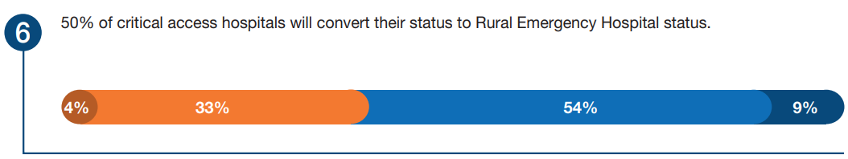
Forecast Response

Slide 70
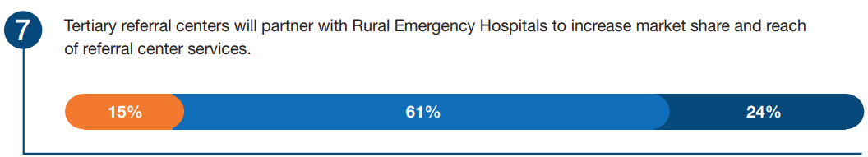
Forecast Response

Slide 71
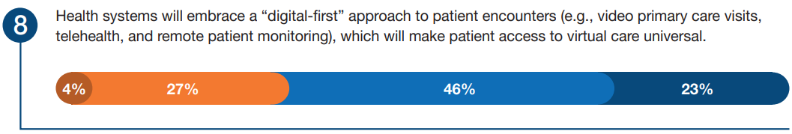
Forecast Response

Slide 72
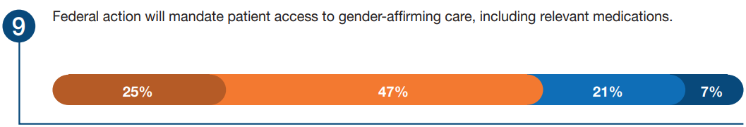
Forecast Response

Slide 73
Strategic Recommendations for Practice Leaders
Provide in-home technology and digital access in satellite clinics to ensure at-risk patients have access to infrastructure that promotes safe and appropriate medication use and pharmacoequity.
Advocate to payers and nonprofit organizations that the availability and infrastructure of digital technology are essential to ensure access and provide high-quality, equitable care.
Partner with healthcare professional organizations to enhance knowledge and access to gender-affirming care. Conduct comprehensive data analysis of positive and negative outcomes to identify gaps and develop strategies to enhance provision of gender-affirming care.
States with rural healthcare deserts should adopt best practice policies from other states, government agencies, and payers that have improved access to care in rural areas where hospitals and clinics have been closed.
Equity assessments of evidence-based metrics must become a standard method to assess quality of care by healthcare systems and payers. Encourage all forms of quality metrics to be stratified for at-risk populations, including those defined by race, ethnicity, age, sex, gender, LGBTQ+ status, and rurality of residence.

Slide 74
Theme 4:
New Disease Paradigms and Treatment Innovations

Slide 75
New Disease Paradigms and Treatment Innovations
The rising costs of new drug treatments generate unique challenges for health systems.
Driving Forces:
  The ultra-high expense incurred with a single treatment.
  Uncertainty around reimbursement.
  The deployment of new drug treatments is complicated by the highly specialized care.
  Complex contracting, product sourcing, logistics, and ongoing care after treatment.

Slide 76
Theme 4: Forecast Question 1
How likely is it that the following will occur, by the year 2028, in the geographic region where you work?
Formulary and policy decisions for ultra-high-cost drugs (e.g., rare and orphan drugs, gene therapy, CAR-T) will be decided by payer or service line stakeholders, and as a result, will weaken the scope of authority of the health-system Pharmacy and Therapeutics Committee.
Very Likely
Somewhat Likely
Somewhat Unlikely
Very Unlikely

Slide 77
Pharmacy and Therapeutics Committee – Scope of Authority
Formulary and policy decisions for ultra-high-cost drugs will be made by payers or service line stakeholders.
Ultra-high costs of new agents make it unsustainable for a healthcare organization to administer treatments that may not be reimbursed.
Ultimately weakening the role of the P&T committee in formulary decision-making.
Health-system leaders may be particularly involved in decision-making around the administration of these innovative agents.

Slide 78
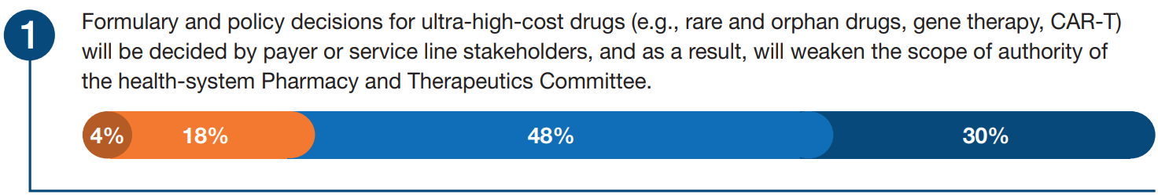
Forecast Response

Slide 79
Theme 4: Forecast Question 4
How likely is it that the following will occur, by the year 2028, in the geographic region where you work?
50% of community hospitals will partner with centers of excellence to expand patient access to precision medicine.
Very Likely
Somewhat Likely
Somewhat Unlikely
Very Unlikely

Slide 80
Center of Excellence Partnership
Cellular and gene therapies are a form of precision medicine, and their popularization will further accelerate the need for broader partnerships in healthcare delivery.
Health-system consolidation over the past 2 decades has laid the foundation for this evolution.
Independent community hospitals will develop affiliation agreements or referral networks to assure patient access.

Slide 81
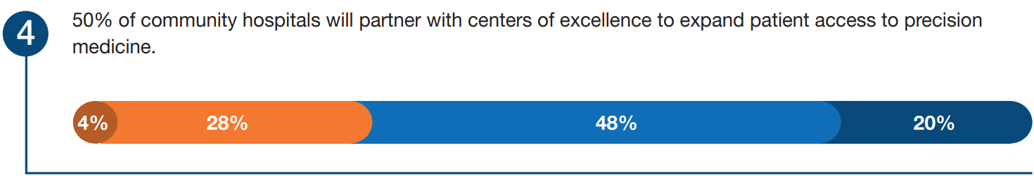
Forecast Response

Slide 82
Theme 4: Forecast Question 5
How likely is it that the following will occur, by the year 2028, in the geographic region where you work?
Generative artificial intelligence technology will access documentation in the health record to create personalized treatment plans.
Very Likely
Somewhat Likely
Somewhat Unlikely
Very Unlikely

Slide 83
Artificial Intelligence
Artificial intelligence to rapidly analyze information about genotype, phenotype, proteomics, and lifestyle will likely accelerate patient connection to the most appropriate therapeutic interventions.
Artificial intelligence may facilitate efficient navigation of the payer requirements, alleviating administrative burden from clinicians.
If not properly and thoughtfully configured, artificial intelligence has the potential to worsen inequities. Pharmacists will need to develop expertise in the application of artificial intelligence.

Slide 84
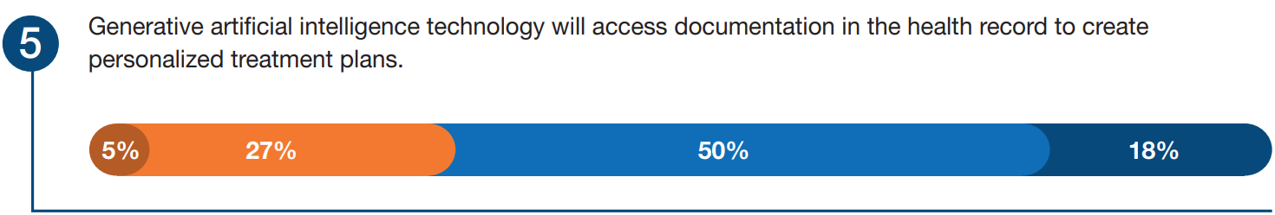
Forecast Response

Slide 85
Strategic Recommendations for Practice Leaders
Pharmacy leaders should collaborate with health-system finance experts to model the budget impact and measure financial risk associated with the provision of ultra-high-cost drugs through service lines to ensure long-term program feasibility and sustainability.
Health-system leaders should interpret the results from any financial analysis related to decision-making around the provision of ultra-high-cost therapies with input from service line stakeholders and the P&T committee.
Health-system leaders should expand affiliation agreements and referral networks beyond their immediate self owned delivery network to ensure all patients with need will have access to innovative therapies.
Health-system leaders should quantify revenue impact associated with the potential limitation of the 340B program to a unique contract pharmacy per entity and develop plans to capture prescriptions and facilitate patient access to medications through in-house or self-owned specialty pharmacies
Health-system leaders should develop, adopt, and implement artificial intelligence applications that accelerate the identification and referral of patients who are most likely to benefit from rare disease treatments while ensuring that these applications do not exacerbate inequities.
Health systems should establish artificial intelligence as a strategic priority to inform decisions about high-cost therapies and form a multidisciplinary team including pharmacists to ensure optimal implementation.

Slide 86
Theme 5:
Workforce: Focus on Culture for the Future

Slide 87
Focus on Future Workforce Culture
According to the American Hospital Association (AHA), 47% of healthcare workers may be planning to leave their jobs by 2025
Workforce challenges due to
  Aging population
  Decreased labor force participation
  Cultural change
The future pharmacy workforce will value diversity, equity, inclusion, and accessibility

Slide 88
Theme 5: Forecast Question 7
How likely is it that the following will occur, by the year 2028, in the geographic region where you work?
All health systems will mandate employee training concerning unconscious bias in patient care.
Very Likely
Somewhat Likely
Somewhat Unlikely
Very Unlikely

Slide 89
Demographics of the Future Workforce
Patient satisfaction is higher when the provider has a racial/ethnic concordance with the patient
For the next 20 years, Generation Z (born 1997 – 2012) will make up most of the workforce
  Prioritize mission-drive values
  Highly educated/progressive
  Most racially and ethnically diverse generation
Need for training in health equity and unconscious bias

Slide 90
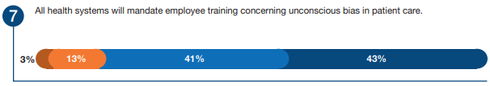
Forecast Response

Slide 91
Theme 5: Forecast Question 1
How likely is it that the following will occur, by the year 2028, in the geographic region where you work?
National efforts to address workforce shortages will consider pharmacists and pharmacy technicians with the same urgency as other health professions.
Very Likely
Somewhat Likely
Somewhat Unlikely
Very Unlikely

Slide 92
Pharmacy Workforce Shortage
2022 ASHP National Survey of Pharmacy Practice in Hospital Settings
  24% of hospitals reported an entry-level pharmacist shortage
  74% reported an entry-level technician shortage
The pharmacy workforce was not included in the 2023 AHA Health Care Workforce Scan
Pharmacy leaders need to advocate that pharmacists and pharmacy technicians are critical for the delivery of healthcare and the urgent need to address workforce shortages

Slide 93
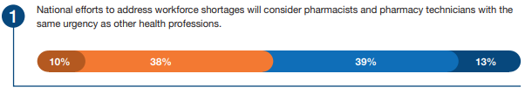
Forecast Response

Slide 94
Theme 5: Forecast Question 2
How likely is it that the following will occur, by the year 2028, in the geographic region where you work?
To address the pharmacist and pharmacy technician shortage, 25% of states will allow licensure compacts across state lines
Very Likely
Somewhat Likely
Somewhat Unlikely
Very Unlikely

Slide 95
Pharmacy Workforce Shortage
Pharmacy leaders should advocate for updated regulation that support multistate licensure consistent with ASHP’s policy position
  Expand the mobility of practice sites
  Enhance opportunity for multistate practice
Skill development that support the management of remote and hybrid teams should also be prioritized

Slide 96
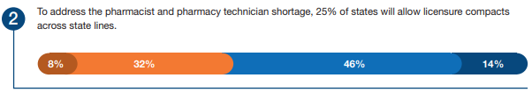
Forecast Response

Slide 97
Theme 5: Forecast Question 9
How likely is it that the following will occur, by the year 2028, in the geographic region where you work?
Concerns about workplace safety will become a major deterrent for recruitment to health professions
Very Likely
Somewhat Likely
Somewhat Unlikely
Very Unlikely

Slide 98
Culture of Workplace Safety
The healthcare industry has a high incidence of workplace violence
Any impact of workplace violence on recruitment will further exacerbate workforce shortages
Pharmacy leaders should advocate for pharmacy-specific considerations within comprehensive workplace violence prevention programs, including:
  Employee engagement
  Risk analysis
  Policy development
  Education

Slide 99
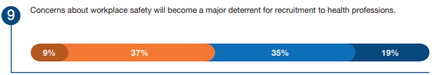
Forecast Response

Slide 100
Strategic Recommendations for Practice Leaders
Pharmacy leaders should partner with professional organizations and policy makers to advocate for solutions to the critical pharmacy technician shortage and place more attention on pharmacy workforce sustainability
Pharmacy organizations should advocate for and participate in the development of legislative actions that support multistate pharmacy licensure and/or registration.
Pharmacy leaders should develop operational and clinical practice models that support virtual and hybrid work environments.
Health systems should foster inclusive environments through meaningful health equity training, community partnerships, and recruitment of individuals from underrepresented populations.
Ensure health-system executive leaders have considered the impact of workplace violence on the pharmacy workforce, including pharmacy-specific risk factors, as best practices to deploy throughout the health system.

Slide 101
Theme 6: Artificial Intelligence: Can Ethics and Regulators Catch Up?

Slide 102
Artificial Intelligence: Can Ethics and Regulators Catch Up?
Artificial intelligence (AI) and data integration have helped drive healthcare change over the past several years
Use of AI includes radiological image analysis, electronic health record (EHR) data analysis, and other functions
Large language models are also expediting AI innovation in healthcare
It is crucial for healthcare leaders and regulators to consider the risks and benefits of AI usage in healthcare during this period of rapid advancement

Slide 103
Theme 6: Forecast Question 1
How likely is it that the following will occur, by the year 2028, in the geographic region where you work?
Accelerating adoption of advanced technologies (e.g., remote monitoring, artificial intelligence, data integration) will close the gap on healthcare disparities.
Very Likely
Somewhat Likely
Somewhat Unlikely
Very Unlikely

Slide 104
Ethics and the Rapid Pace of Innovation
AI models could remove unconscious bias from patient care
However, AI models could perpetuate bias and disparities caused by training the models on historically biased data
Additionally, some health-system have more resources to devote to AI implementation, which could magnify differences in patient outcomes across healthcare systems. This disparity is known as the “digital divide.”

Slide 105
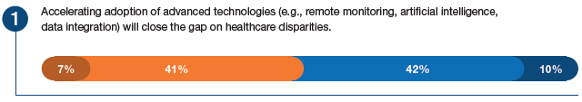
Forecast Response

Slide 106
Theme 6: Forecast Question 3
How likely is it that the following will occur, by the year 2028, in the geographic region where you work?
Health-system ethics committees will have expertise that ensures the equitable application of artificial intelligence technology when used in patient care.
Very Likely
Somewhat Likely
Somewhat Unlikely
Very Unlikely

Slide 107
Theme 6: Forecast Question 8
How likely is it that the following will occur, by the year 2028, in the geographic region where you work?
The FDA will take action to ensure that clinical decision support software driven by artificial intelligence technology does not exacerbate health disparities.
Very Likely
Somewhat Likely
Somewhat Unlikely
Very Unlikely

Slide 108
Monitoring the Impact of Innovation
Strategic emphasis must be placed on monitoring the impact of AI and ensuring that all patient populations benefit
AI must be trained on diverse and representative data, normalizing data and incorporating metrics to identify disparities in care
Local, regional, and federal groups/regulators will need to be involved to ensure equitable application of AI for all patients
Currently, forecast panelists do not believe the Food and Drug Administration (FDA) will regulate AI models, so more responsibility will fall on healthcare systems

Slide 109
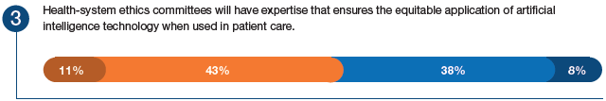
Forecast Response

Slide 110
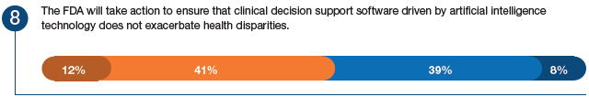
Forecast Response

Slide 111
Theme 6: Forecast Question 4
How likely is it that the following will occur, by the year 2028, in the geographic region where you work?
State boards of pharmacy will develop regulations allowing the use of artificial intelligence or other technology in place of pharmacist order review and verification.
Very Likely
Somewhat Likely
Somewhat Unlikely
Very Unlikely

Slide 112
Theme 6: Forecast Question 5
How likely is it that the following will occur, by the year 2028, in the geographic region where you work?
Integration of the electronic health record data with clinical decision support algorithms will automate drug dosing adjustments (e.g., renal, weight-based, age-based dosing).
Very Likely
Somewhat Likely
Somewhat Unlikely
Very Unlikely

Slide 113
Future Pharmacy Practice
While AI technology is capable of performing dosing adjustments based upon patient-specific factors (i.e., age, weight, renal function), regulatory bodies are not prepared to allow the use of AI for order review and verification
Allowing AI to perform some order review and verification could reduce verification variance and allow pharmacists to spend more time providing direct patient care
In the future, pharmacists may have to shift from focusing on verification to more clinical tasks

Slide 114
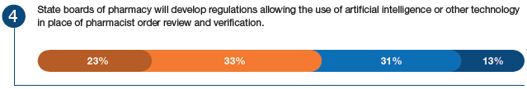
Forecast Response

Slide 115
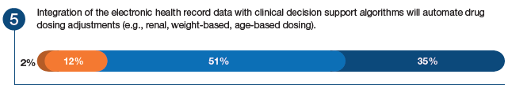
Forecast Response

Slide 116
Theme 6: Forecast Question 6
How likely is it that the following will occur, by the year 2028, in the geographic region where you work?
50% of quantitative health data (e.g., vital signs) will be captured and documented via remote monitoring (e.g., smartwatches, fitness trackers, and ambient monitoring technology).
Very Likely
Somewhat Likely
Somewhat Unlikely
Very Unlikely

Slide 117
Theme 6: Forecast Question 7
How likely is it that the following will occur, by the year 2028, in the geographic region where you work?
Health systems will routinely use patient-generated health data that has been integrated into the electronic health record.
Very Likely
Somewhat Likely
Somewhat Unlikely
Very Unlikely

Slide 118
Data Integration
Health trackers have become more prevalent throughout our society
These trackers can collect health information that could be useful for clinicians
In the future, some health data (i.e., vital signs) collected using such technology may be documented in the electronic health record for use by clinicians

Slide 119
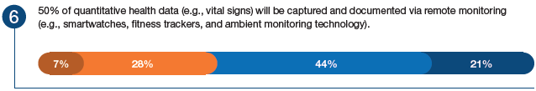
Forecast Response

Slide 120
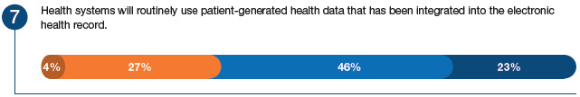
Forecast Response

Slide 121
Theme 6: Forecast Question 2
How likely is it that the following will occur, by the year 2028, in the geographic region where you work?
A high-profile case(s) involving patient harm related to artificial intelligence used for patient care decisions will accelerate government regulation of this technology.
Very Likely
Somewhat Likely
Somewhat Unlikely
Very Unlikely

Slide 122
Regulations and AI Safety
There are concerns for AI “hallucinations,” which occur when incorrect outputs are generated
There may also be errors in algorithms, implementation into workflows, or limited external validity of the models
These errors can heighten the risk of misinformation and patient harm
The model of legal liability with AI-facilitated workflows has not been well established, so organizations may be hesitant to implement AI until more regulatory, legal, and insurance frameworks are in place

Slide 123
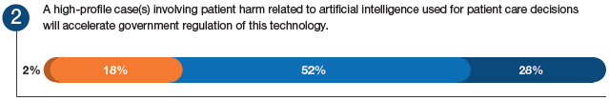
Forecast Response

Slide 124
Strategic Recommendations for Practice Leaders
Devise tailored strategies for AI and data integration implementation into the medication-use process, considering ethics, regulations, patient safety, and the rapidly evolving AI environment
Provide ethics committees with the resources needed to develop guidelines that ensure ethical and accurate AI application and surveillance, developing “AI stewardship”

Slide 125
Strategic Recommendations for Practice Leaders
3. Dedicate resources to evaluate the safety of AI algorithms for medication order review and verification to enable a data-driven approach to advocate for the use of AI algorithms in medication order review
4. Proactively engage with regulators, establishing comprehensive guidelines for the use of AI in clinical care, and define risk detection and mitigation methodologies to address the risk of misinformation or errors for AI used in patient care

Slide 126
Strategic Recommendations for Practice Leaders
5. Perform an AI readiness survey assessing technical infrastructure, staff training, emergency planning, and patient communication strategies
6. Include training on AI comprehension and collaboration as a key competency in the training of pharmacists and education of future pharmacists

Slide 127
Case Study Transition

Slide 128
30 minutes to work on assigned case and answer questions in a small group (4-8 people)
5 minutes per group to present the scenario and answer the questions from the case
Each group should select:
  A person to lead or facilitate discuss among the group
  A person to record discussions/decisions made
  A timekeeper to keep the group on task
  One or two presenters

Slide 129
Large Group Wrap-Up

Slide 130
Conclusion
The pharmacy forecast improves the effectiveness of leaders in hospital and health-system pharmacy practice
The forecast allows for students or other pharmacy professionals to better understand the emerging trends and predicted challenges
Pharmacists are positioned to improve access to care on multiple fronts associated with population health, technology and data, and virtual services

Slide 131
Group Q&A

