Slide 1
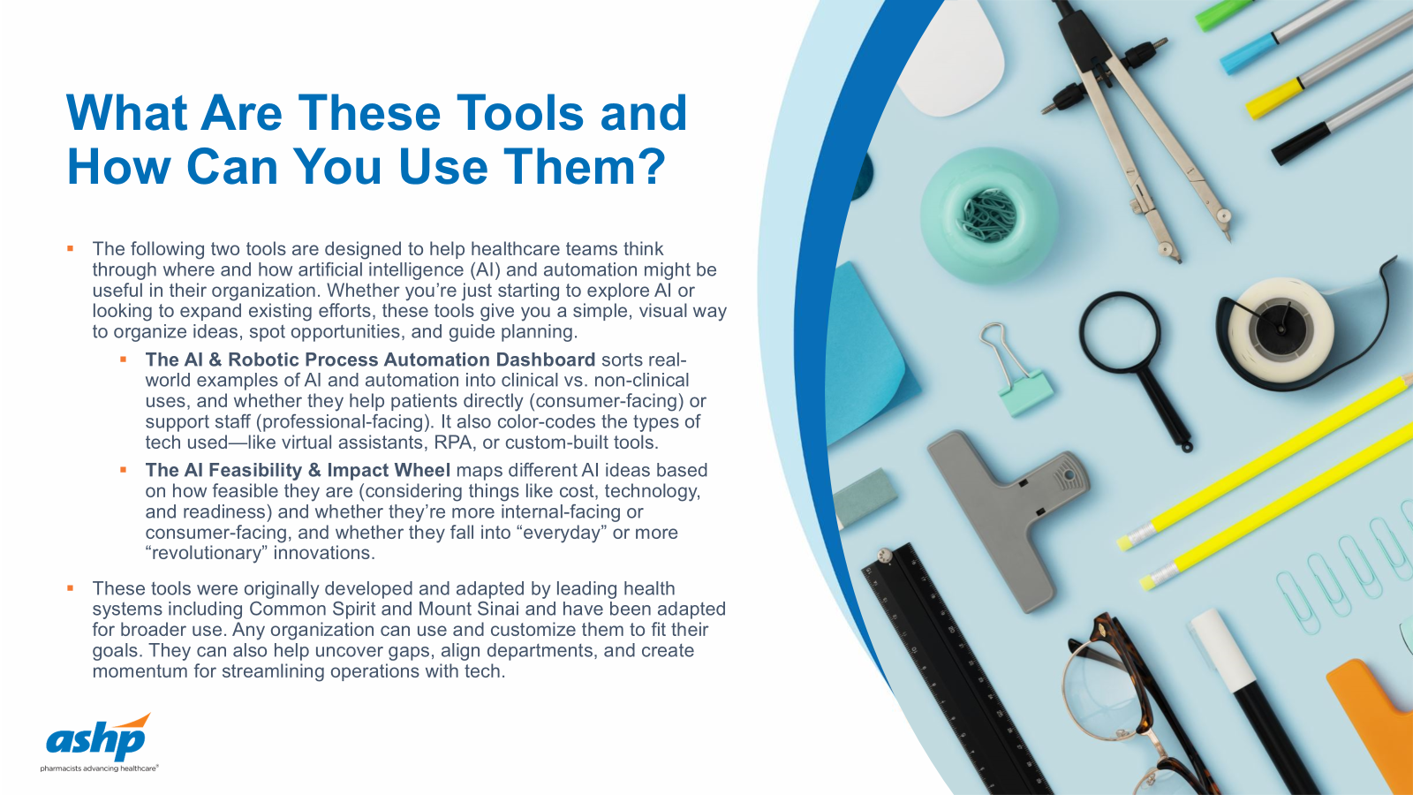

Slide 2
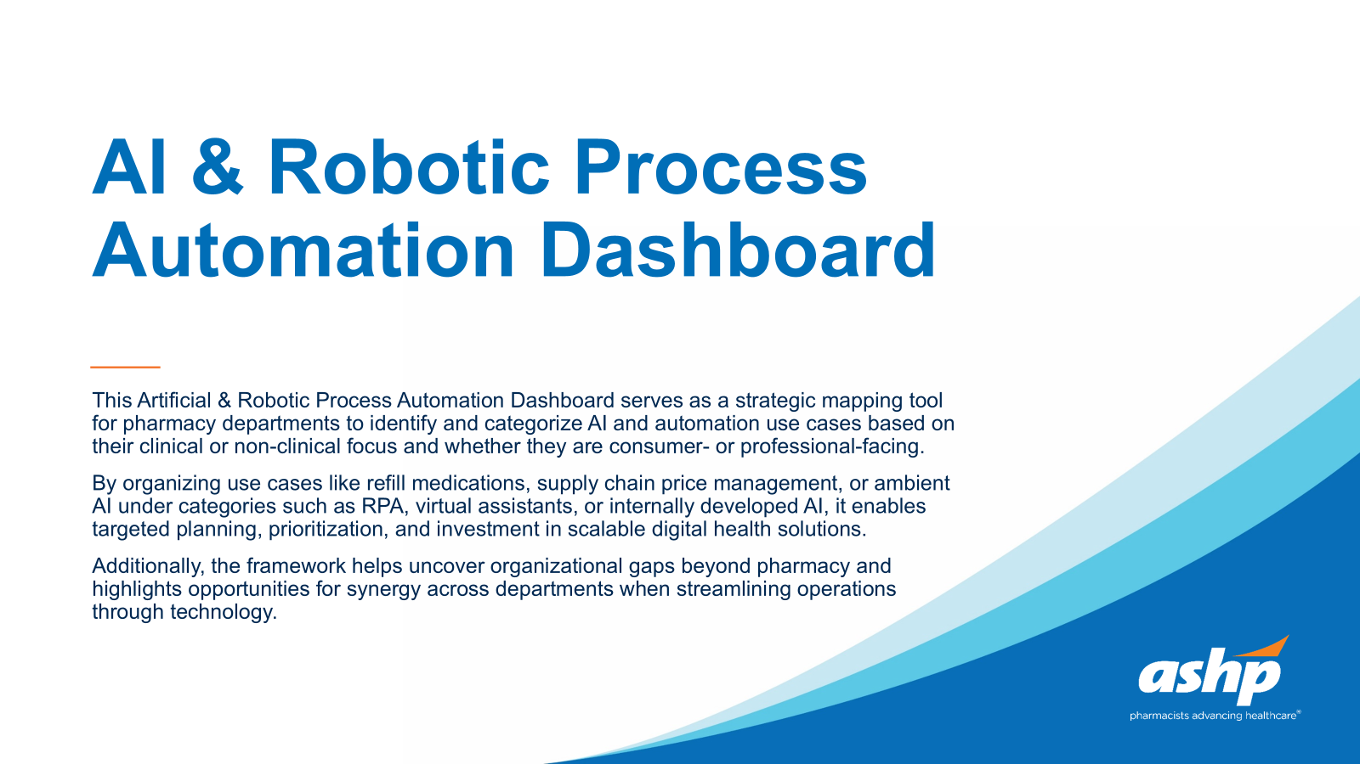

Slide 3
Artificial & Robotic Process Automation
Revision Date: x/x/xxxx
*Dashboard serves as an example and should be customized to the tools, vendors, and departments of the organization.
Clinical
Heart-Lung Incidental Lung Nodule
Risk of Unplanned Readmission
Pulmonary Embolism
Vessel Obstruction
Rib Fracture (CT)
Pneumoperitoneum (Free Air)
Ambient AI
Mammography
Care Pathway Navigation
Intracranial Hemorrhage
Pneumothorax
Vertebral Spine Fracture
Breast Ultrasound
Screen/Orders
Symptom Checker
Malnutrition Risk Prediction
Delirium Risk Prediction
Pressure Injury Risk Prediction
Aggression Risk Prediction
COPD Patient Identification
Oncology Prognosis
Diabetes Care Gaps
Refill Medications
Medical Imaging Pipeline
Vent Weaning Risk Prediction
High LDL Patient Identification
Clinical Deterioration Prediction
Noninvasive respiratory
Metastatic Risk Prediction
Cancel & Confirm Appts
Schedule Appt (existing patients)
Patient experience in Inpatient
48-hour Discharge Planning
Automated Stigmatizing Language
Surgical Complications
Discharge interventions
Pathology Coding
Chatbot
API for developers
Consumer Facing
Professional Facing
Find Care
Answer FAQs
InBasket Categorization
Risk of Patient No Show
Virtual Meeting AI Companion
Clinical Command Center
Access Termination
Consent Forms
Radiology Bill Updates
Supply Chain PO updates
Reset Portal Password
IVR Chatbot
Error Management
Staff Competency Verification
Supply Chain Price Management
Pending Orders Management
Appeals Management
Missing Charges Reporting
Surgery Quality Reporting
Estimate Consent
Pay bill
Provider Eligibility
Process Claim Data
Disability Forms
Workers Compensation Forms
Registration Missing Fields
Referral Management
Provisioning Automation
Radiology Peds Survey
Non-Clinical
Virtual Assistant
AI by Vendor
AI by Internal Development
RPA

Slide 4
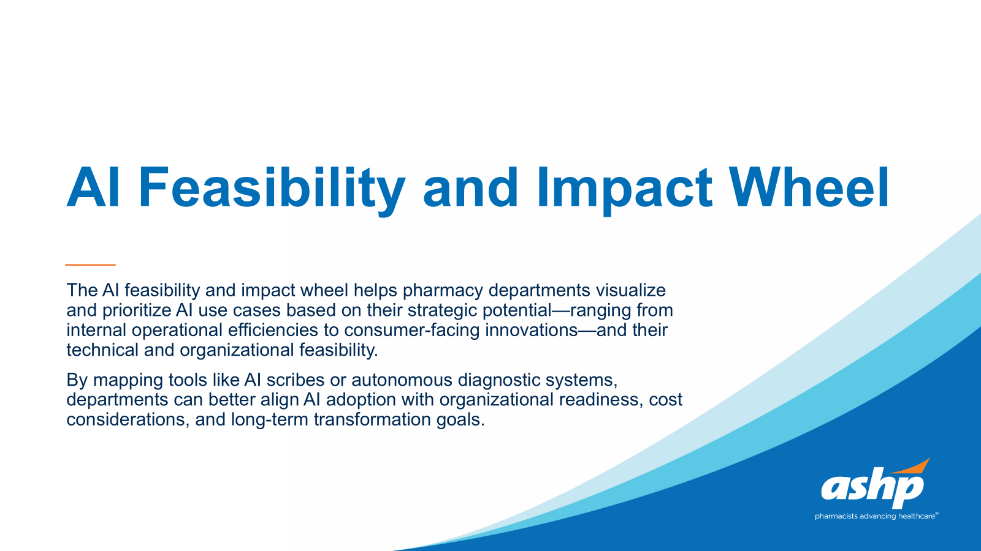

Slide 5
High feasibility / practical
External – Consumer Facing
Medium feasibility
Low feasibility / aspirational
E.g. Autonomous patient consult
Probability and feasibility level may depend on organizational readiness, technical infrastructure, and cost.
E.g. Automated patient scheduling
Everyday - Routine Task AI
Revolutionary AI
E.g. AI Scribes
E.g. Autonomous diagnostic tool
Internal - Operational

