Slide 1
Digging into Health System Specialty Pharmacy
{Insert Name, Credentials Practice Site Affiliations if applicable}

Slide 2
Learning Objectives
Describe the health system specialty pharmacy (HSSP) practice models and trends in healthcare.
Describe [insert institution]’s HSSP model of care.
Illustrate the importance of HSSPs by presenting a patient journey example.
Identify the different student rotations, post graduate education, and training available to explore and pursue specialty pharmacy practice opportunities.

Slide 3
Specialty Therapies Require a Different Care Model: Complex, Expensive
Treat rare, chronic conditions
High risk and high complexity
Limited distribution
>$6,000/yr patient cost
Require intensive patient management
Require special handling
Require Reimbursement/copay assistance and social support
Initiated by a specialist
Cold Chain or Refrigerated
American Journal of Health-System Pharmacy, Volume 78, Issue 19, 1 October 2021, Pages 1765–1791, https://doi.org/10.1093/ajhp/zxab277
Notes:
ASHP National Survey of Health-System Specialty Pharmacy Practice
https://doi.org/10.1093/ajhp/zxab277
Used to treat specific rare and/or complex chronic diseases
Meet 4 or more of the following criteria:
Initiated and maintained by a specialist
Annual cost of therapy of $6000 or more – why $6K vs $10K?
Unique distribution
Need for extensive or in-depth monitoring and/or patient counseling
Require reimbursement assistance

Slide 4
Specialty Therapies Require a Different Care Model: Complex, Expensive, Cont.
Distinct from traditional pharmacies in coordinating many aspects of patient care, insurance benefits, and disease management
Designed to:
Efficiently deliver medications with special handling, storage, and distribution requirements
Improve clinical and economic outcomes for patients with complex, often chronic and rare conditions, with close contact and management by clinicians
Specialty pharmacy practitioners provide patient education, help ensure appropriate medication use, promote adherence, and attempt to avoid unnecessary costs

Slide 5
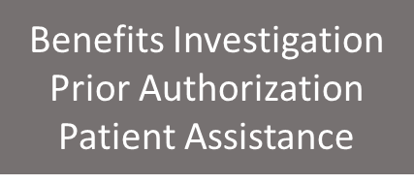
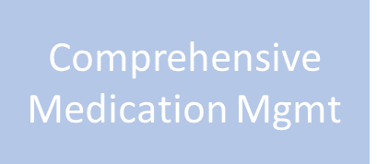
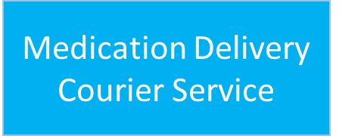
Specialty Pharmacy Services
Notes:
HSSPs provide extensive medication access, treatment selection and initial counseling support for all patients referred to the specialty pharmacy. Patients who fill with the HSSP benefit from additional services.
Advanced Integrated Patient Care Model:
Clinical Pharmacists and Patient Advocates
Embedded in Specialty clinics
Clinical Pharmacist Practitioner visits
Patient education
Benefits investigation
Medication assistance
Examples for each category:
Benefits Investigation: Insurance verification, grants / free drug
Comprehensive Medication Mgmt: some specialty pharmacies service non-specialty drugs AND specialty together; if not they will still potentially conduct CMRs, etc.
Medication Delivery: Cold Chain shipping/validation/care
Medication Adherence Program: Counseling / Refill reminders
Continuous Quality Improvement: Accreditation
Exceptional Patient Experience: Clinical Management Software / Psychosocial /wellness assessment (including vaccines) / Clinical interventions

Slide 6
Typical Patient & Provider Experience
Integrated specialty pharmacies provide support to patients and providers by:
Navigating access to medications and preventing gaps in therapy
Prior authorization requests, vouchers, and manufacturer programs
Organizing communication between providers, insurers, and patients
Providing education, adherence strategies, and therapy monitoring

Slide 7
Typical Patient & Provider Experience, Cont.

Slide 8
Specialty Pharmacy Landscape
1
National Pharmacy Benefit Managers
Specialty pharmacy supplier, no in-clinic or administrative services
Partner with health systems for retail space, discharge Rx (Walgreens)
Dictate network access, divert scripts to their mail order locations
2
Independent Specialty Pharmacies
Very sophisticated operations often in one specialty area
Regional services, not in-clinic with patients and providers
Strong networks especially for access to LDDs
3
Health System Specialty Pharmacies
Pharmacists and pharmacy liaisons integrated into care teams with EHR access
Local and regional services focused on serving health system’s patient population
Significant growth in past 5 years

Slide 9
Rapidly Evolving Marketplace
70% of multi-hospital health systems initiated specialty pharmacy services between 2012 and 2017
Prevalence of specialty pharmacy operations in hospitals growing from 7.8% in 2015 and 8.7% in 2016 to 19.9% in 2018 and 26.4% in 2019
Growth in the overall drug spend in the United States on specialty medications with projections to likely exceed 50% of overall drug expenditures in 2021
Vertical integration, mergers & acquisitions, and increasing limited drug distribution models

Slide 10
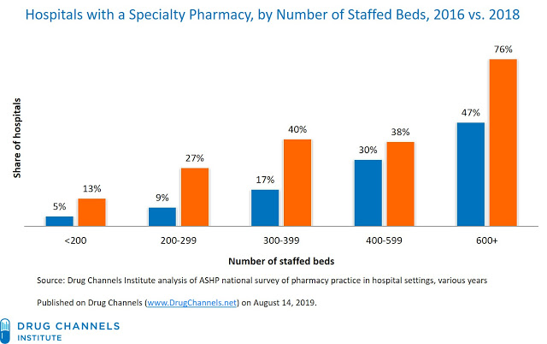
Rise of Health System Specialty Pharmacies
What’s Driving This?
Focus on population health & value-based care
Ability to support patient across entire continuum of care
Improved patient and provider experience
Better clinical outcomes, lower cost of care
Financial health
Source: Hospitals Continue Their Startling Expansion into Specialty Pharmacy. Drug Channels. https://www.drugchannels.net/2020/08/hospitals-continue-their-startling.html.

Slide 11
What Sets Health Systems Apart?
Integration
Pharmacists and pharmacy liaisons:
Work onsite as part of care team
Service patients in-clinic and/or via telehealth
Have direct access to electronic health record
Medications dispensed by health system, when possible
Notes:
Embedding clinical pharmacists and patient advocates in clinics

Slide 12
Integrated Advanced Practice Model: Keeping a Focus on the Patient
Adherence
Out of Pocket Costs
Value Based Care
Complex Disease
High Need and High Cost
Notes:
Recognizing the complex patient journey and experience and the value that HSSP provide. HSSP provides an integrated advanced practice model for specialty medication-use management across the continuum of care. This practice model has been shown to exceed industry standards, thanks to integration with clinics, providers, and EHR access (ASHP National HSSP Survey – 2020).
https://www.pharmacypracticenews.com/Operations-and-Management/Article/07-21/ASHP-Releases-Inaugural-Survey-of-Health-System-Specialty-Pharmacies-/64085

Slide 13
State of Health System Specialty Pharmacy
Health system specialty pharmacies (HSSPs) are common across academic medical centers and community health systems today
Specialty pharmacists and technicians are integrated into the clinics they serve
Perform patient-care services related to documentation, monitoring, interventions, and patient assessments
Top five therapeutic categories supported:
Inflammatory conditions
Hematology/oncology
Hepatology
Neurology
Infectious disease
Stubbings J. ASHP National Survey of Health System Specialty Pharmacy Practice. Presentation at ASHP Specialty Pharmacy State of Practice in Hospitals and Health Systems – Future Directions Summit. February 1-4, 2021

Slide 14
What Services Does a Health System Specialty Pharmacy Offer?
>50% provided to HSSP patients only
(% provided to all)
Injection training (48%)
Patient visits with clinic-embedded pharmacists (48%)
Transitions of care coordination (42%)
Disease state and/or lab monitoring (36%)
Immunization screening and/or admin (34%)
Individualized patient care plan (34%)
Treatment monitoring for medication safety/ effectiveness (34%)
Ongoing patient education (32%)
Adherence support (27%)
Non-specialty medication management (25% all; 36% do not provide)
REMS management (19%)
Refill reminders (18%)
>50% provided to ALL patients
(% provided to all)
PA completion assistance (84%)
PA denial assistance (80%)
Financial assistance enrollment (77%)
Free drug program management (71%)
Specialty medication selection and/or recommendation (69%)
Pre-treatment initiation disease state assessment (57%)
Initial patient education (52%)
Zuckerman A. ASHP National Survey Updates – Health System Specialty Pharmacy. Presentation at ASHP Summer Meetings and Exhibition. June 12, 2022
Notes:
Results from the 2022 ASHP and Vanderbilt University Medical Center National Clinical Services Provided by Health-System Specialty Pharmacies: A Survey of Current Practice

Slide 15
Telling the Story of Your Institution’s Specialty Program
{Insert Institutional Practice}
Notes:
Note: It is encouraged that you utilize your own patient journey to describe the nuances within your practice and the impact your HSSP provides
However, you can utilize a HSSP patient journey example from ASHP if you would prefer, which is included in the following slides (slides 31-44) or linked here: https://www.ashp.org/-/media/3E5DD6BB23AF4289838FCFB72AC40C78.ashx

Slide 16
Specialty Pharmacy Workflow
Intake:
Data Entry,
Benefits Investigation, Prior Authorization, Copay/Foundation Assistance, Onboarding
Pre-check: Clinical Drug Utilization Review for appropriateness, safety, interactions, and dosing
Clinical Assessment: Patient Education and Counseling on Therapy, Administration, Adherence, Barriers, Interactions, and Side Effects
Notes:
Intake: Data Entry, Benefits Investigation, Prior Authorization, Copay/Foundation Assistance, Onboarding
Precheck: Clinical Drug Utilization Review for appropriateness, safety, interactions, and dosing.
Clinical Assessment: Patient Education and Counseling on Therapy, Administration, Adherence, Barriers, Interactions, and Side Effects.

Slide 17
Specialty Pharmacy Workflow, Cont.
Scheduling: Patient Preference and Payment Collected
Fulfillment: Dispensation and final check by a pharmacist
Packaging and Shipment: Pickup, Home Delivery, or other specified location via courier or common carrier
Notes:
Scheduling: Patient Preference and Payment Collected
Fulfillment: Dispensation and final check by a pharmacist
Packaging and Shipment: Pickup, Home Delivery, or other specified location via courier or common carrier

Slide 18
New Script Workflow
E-script
Data Entry
Pre-check
Clinical Assessment
Shipment
Scheduling
Fulfillment
Provider or ambulatory pharmacist
Clinical tech
Clinical specialist
Clinical specialist
Tech or pharmacist
Operations tech and operations pharmacist
Operations tech

Slide 19
Maintained Patient
Clinical Assessment
Clinical specialist
Follow-up Assessment
Technician
Scheduling
Tech or pharmacist
Fulfillment
Operations tech and operations pharmacist
Shipment
Operations tech

Slide 20
Health System Specialty Pharmacy Services – Patient Population Served
Disease states served:
{Insert disease state}
Patient population and community demographics:
Rural/urban, etc

Slide 21
Health System Specialty Pharmacy Services
{Describe model (examples of things to mention included below)}
Embedded vs centralized
Separate call center/ fulfillment centers
Open door vs closed
Any associated services (infusion, home delivery, adherence packaging, etc.)

Slide 22
Health System Specialty Pharmacy Services, Cont.
{insert site specific information (For example: If Call center vs fulfillment vs integrated care describe in this slide)}

Slide 23
Health System Specialty Pharmacy Services, Cont.
{insert staffing breakdown/job roles}

Slide 24
Patient Journey: The Impact of Specialty Pharmacy
{Insert Institutional Practice}
Notes:
Note: It is encouraged that you utilize your own patient journey to describe the nuances within your practice and the impact your HSSP provides
However, you can utilize a HSSP patient journey example from ASHP if you would prefer, which is included in the following slides (slides 31-44) or linked here: https://www.ashp.org/-/media/3E5DD6BB23AF4289838FCFB72AC40C78.ashx

Slide 25
Patient Demographics
TH is an 54yo female with a history of HIV medication non-adherence and chronic kidney disease
PMH:
HIV
Depression
DM, Type II
HTN
Renal Failure
Notes:
Example patient demographics provided – feel free to personalize

Slide 26
Patient Journey
Specialty Pharmacy Services Begin
[insert date/year]
Patient enrollment into Specialty Pharmacy Services
[insert date/year]
[insert additional relevant dates for patient journey/outcomes]

Slide 27
Embedded Clinical Pharmacist Model
Notes:
Describe your embedding pharmacist model

Slide 28
Patient Enrollment

Slide 29
Medication Management
Notes:
Describe the medication management or other clinical services provided by your HSSP

Slide 30
Patient Assistance

Slide 31
Medication Management and Patient Outcomes

Slide 32
Patient Value
Medication adherence and compliance
{Insert disease specific benefits for patient journey story i.e. undetectable HIV RNA, etc.}
Interdisciplinary coordination of care between teams and health system

Slide 33
Clinic Value
Dedicated pharmacy resources
Specialty board-certified pharmacists
In-clinic prior authorization, medication assistance and copay
assistance support
Health system-owned specialty pharmacy provides clear insight into
patient adherence, side effects and prescription fills
Significantly improved coordination of care

Slide 34
Specialty Pharmacy Training and Career Opportunities

Slide 35
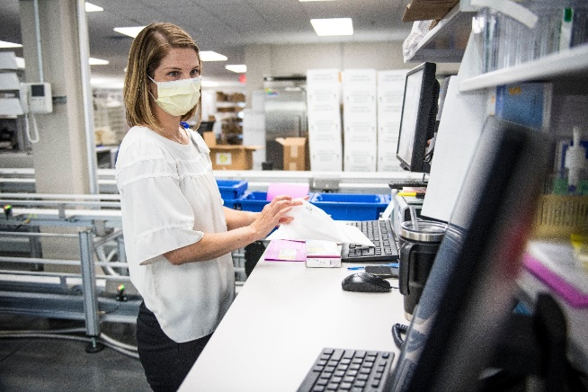
Didactic Specialty Pharmacy Training On The Rise
Shadowing in a Specialty Pharmacy
IPPE and APPE Rotations at local Specialty Pharmacies
Internships
Robust intern curriculum
Interns prepared for PGY1 residency training or job upon graduation
Example of internship opportunity: UK Specialty Pharmacy and Infusion Services Summer Internship
Introduction to Specialty Pharmacy Summer Course Elective (online course)
Open to all pharmacy students
{Insert any local opportunities}

Slide 36
Growth of Specialty Pharmacy Residencies to Meet Demand
Specialty pharmacy training is occurring within various types of residency programs – each type has a slightly different focus
PGY1 Specialty Pharmacy Residencies
Community and Hospital based PGY1 residencies with specialty pharmacy training
Focus on training for clinical or managed care roles
Training opportunities in: Rheumatology, Oncology, Neurology, Cystic Fibrosis, Hepatology, Operations, Management, etc.
PGY2 Specialty Pharmacy Administration and Leadership (SPAL)
Designed as standalone follow-up to PGY1 training
Administration focus: Management, accreditation, finance, infusion, revenue cycle, human resources, supply chain, operations, etc.
Notes:
Residency opportunities: PGY1, PGY2, and PGY1/PGY2 combined programs (cont. on next page)

Slide 37
Growth of Specialty Pharmacy Residencies to Meet Demand, Cont.
Specialty pharmacy training is occurring within various types of residency programs – each type has a slightly different focus:
PGY1 and PGY2 Combined Programs
Like a traditional Health-system Pharmacy Administration and Leadership residency
Focus on health-system specialty pharmacy administration
PGY1: Clinical focus: Inpatient and outpatient rotations
PGY2: Administration focus: Management, accreditation, finance, infusion, revenue cycle, human resources, supply chain, operations, etc.

Slide 38
Interested in Learning More About Specialty Pharmacy?
Section of Specialty Pharmacy Practitioners (SSPP): https://www.ashp.org/specialty-pharmacy-practitioners
SSPP hosts a free student networking roundtable with specialty practitioners and residents every November before Midyear about IPPE/APPE, residency, and career opportunities
Check the Specialty Pharmacy Connect or Pharmacy Student Forum Connect in October/November for registration information!
Health System Specialty Pharmacy Resource Center: https://www.ashp.org/pharmacy-practice/resource-centers/health-system-specialty-pharmacy-resource-center
Specialty Pharmacy Focused Residency Programs ASHP Resource: https://www.ashp.org/specialty-pharmacy-practitioners/specialty-pharmacy-focused-residency-programs
ASHP Residency Directory
Use the ASHP Residency Directory to search for specialty pharmacy residencies → Advanced Search Options → Model Type(s) → Community-based – Specialty Pharmacy to filter

Slide 39
Questions?

Slide 40
Patient Journey: The Impact of Specialty Pharmacy
Courtesy of ASHP Section of Specialty Pharmacy Practitioners
Link: https://www.ashp.org/-/media/3E5DD6BB23AF4289838FCFB72AC40C78.ashx
Notes:
Example Specialty Patient Journey provided by ASHP Section of Specialty Pharmacy Practitioners
**If you would like to use the ASHP provided Patient Journey, make sure you unhide the slides so the slides will appear when in presenter mode

Slide 41
Patient demographics
TH is an 54yo female with a history of HIV medication non- adherence and chronic kidney disease
PMH
HIV
DM, Type II
HTN
Renal Failure
Depression

Slide 42
Patient Journey
ID Pharmacists embedded in ID clinic
Patient enrollment in Specialty Pharmacy Services
Continued undetectable HIV; added to kidney transplant list
Continued compliance and positive outcomes
Medication management; medication assistance
Improved adherence – HIV undetectable
Successful kidney transplant
2017
2018
2019
2020
2021

Slide 43
Embedded Clinical Pharmacists
In 2017, a HSSP-affiliated clinical pharmacist was embedded at the Infectious Disease clinic with a primary focus on HIV patients
LH was one of the first patients referred to the new specialty pharmacy service

Slide 44
Patient Enrollment
Patient Enrolled: October 2017
TH had been off HIV medications for 10 months
TH had lost her job, was uninsured and applying for Medicaid
On HD for ESRD
HIV RNA = 97,802
CD4 = 220

Slide 45
Medication Management
October 2017
Pharmacist provided ongoing education regarding adherence and side effects of HIV and other maintenance medications
Pharmacist provided TH with pill box and assisted patient with filling the pill box
Monthly in-person clinic visits with pharmacist for medication therapy management and pill box assistance
Coordinated dispensing with Health System Specialty Pharmacy

Slide 46
Patient Assistance
October 2017
Patient was uninsured due to recent unemployment but was ineligible for ADAP
HSSP Patient advocates assisted with manufacturer assistance and Medicaid applications
Patient advocates ensured LH received medications through manufacturer assistance or other programs despite uninsured status
June 2018
Patient received commercial insurance
HSSP Patient advocates helped patient navigate:
Prior authorizations
Copay assistance
Pharmacy changes
Ensured uninterrupted medication supply

Slide 47
Medication Management and Patient Outcomes
October 2018
Continued monthly medication management and patient education
HIV RNA = undetectable
CD4 = 470

Slide 48
Kidney Transplant
June 2019 – April 2020
Due to significantly improved HIV status patient was able to qualify for a kidney transplant
Received kidney transplant April 2020
*This patient’s ability to qualify and receive a kidney transplant was directly impacted by specialty pharmacy support*

Slide 49
Patient Assistance
April 2020 - present
ID Pharmacist and Patient Advocates as liaisons with transplant center pharmacy
Provided prior authorizations, copay assistance and coordination of benefits with Medicare

Slide 50
Medication Management
April 2020 – present
From beginning of transplant process in June 2019 through today, the clinical pharmacist coordinated with ID and Transplant providers at the transplant center
Liaison between transplant center and clinic
Coordinated HIV, transplant and maintenance medication changes with transplant center to ensure no drug interactions
Continued to manage patient pill box and counsel on adherence

Slide 51
Patient Value
TH continues to compliant with medications
Patient now fills own pill box
Frequent check-ins with clinical pharmacist
HIV RNA - undetectable
Successful kidney transplant
Interdisciplinary coordination of care between teams and health systems

Slide 52
Clinic Value
Dedicated pharmacy resources
Specialty board-certified pharmacists
In-clinic prior authorization, medication assistance and copay assistance support
Health system-owned specialty pharmacy provides clear insight into patient adherence, side effects and prescription fills
Significantly improved coordination of care

