Slide 1
Careers in Pharmacy and the Pharmaceutical Sciences

Slide 2
Pharmacy is a noble profession
Consistently in the top 5 of most trusted professions*
Excellent earning potential
Rigorously tested and licensed
*Gallup annual rating of the honesty and ethics of professions: https://news.gallup.com/poll/388649/military-brass-judges-among-professions-new-image-lows.aspx

Slide 3
Degrees in Pharmacy
Practice Degrees:
  Bachelors Degree in Pharmacy (BSPharm)
    No longer available as terminal degree
  Doctor of Pharmacy (PharmD)
Research Degrees
  MSc- multiple areas of focus
  PhD- multiple areas of focus
Some schools offer dual degrees
  PharmD/MPH, PharmD/MBA

Slide 4
Resident and Fellowship Training
Residencies
  Post-graduate year 1: Hospital-based, Community-based, or Managed-care based
  Post-graduate year 2: Various specialty areas
Fellowships
  Academic / Research
  Clinical/Administrative (Health-system)
  Non-profit / Government
  Public Health / Global Health
  Industry
  …

Slide 5
Research Areas
Clinical
Medicinal Chemistry
Biopharmaceutics
Outcomes
Pharmacoeconomics
Data Science

Slide 6
Practice Settings

Slide 7
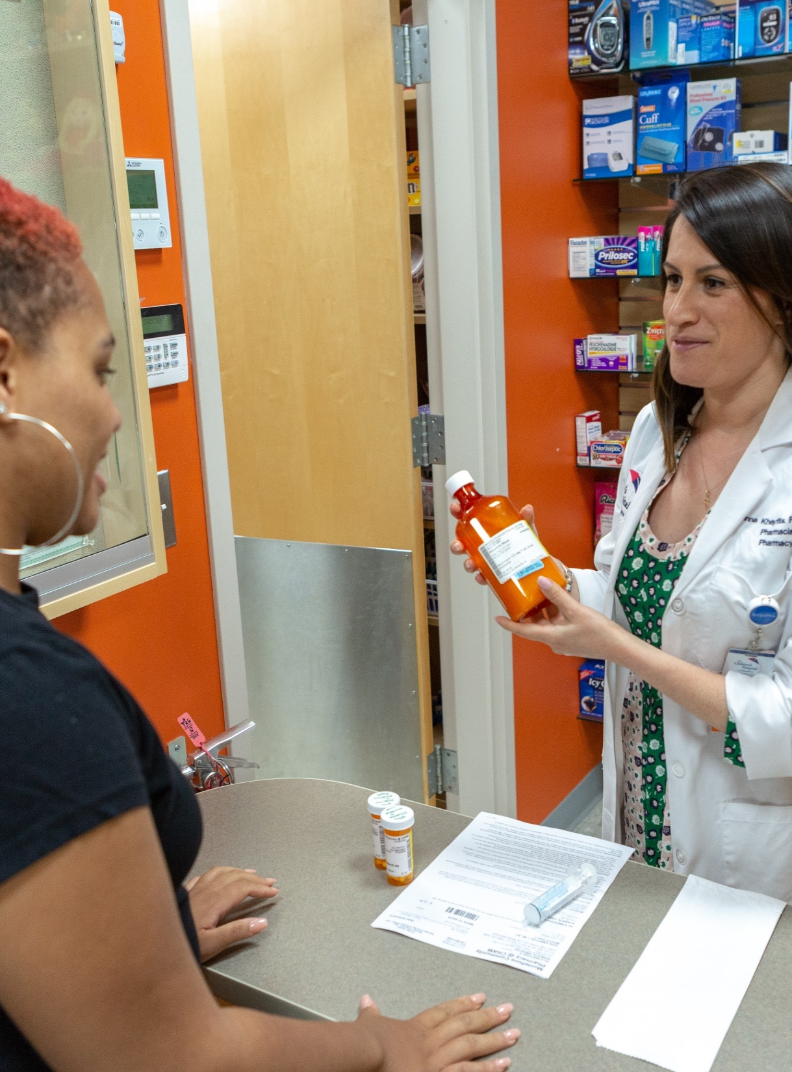
Community Pharmacy Practice
About 30% of pharmacists work in this setting
Key community health resource
Independent vs. Chain vs. Clinic-, Hospital-, or Health-System-based
Practice is seeing a lot of change
Advanced training expanding for pharmacists providing advance clinical services in the community

Slide 8
Hospital or Health-Systems Pharmacy Practice
Many different types of pharmacist positions
  Clinical
  Operational
  Administrative
  Leadership
Many settings:
  Large academic medical centers
  Non-academic health centers
  Community hospitals
  Small and rural hospitals
Pharmacist receive advanced training tailored to their roles

Slide 9
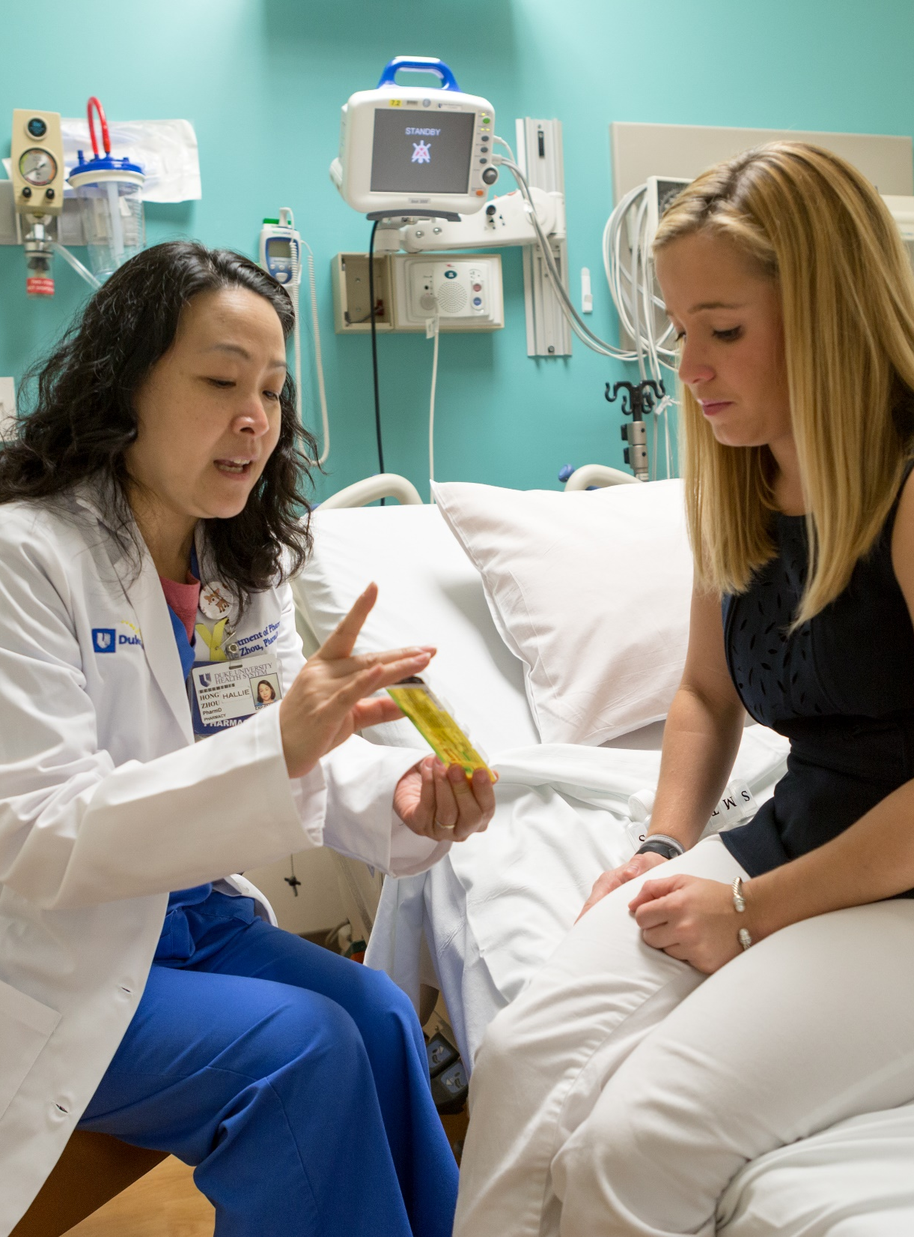
Inpatient Clinical Specialist
Participate in medical team rounding
Actively involved in medication decisions for patients
Several different models of practice
Specialty expertise in many practice areas:
  Cardiology
  Critical Care
  Emergency Medicine
  Infectious Diseases
  Pediatrics
  Oncology
  …

Slide 10
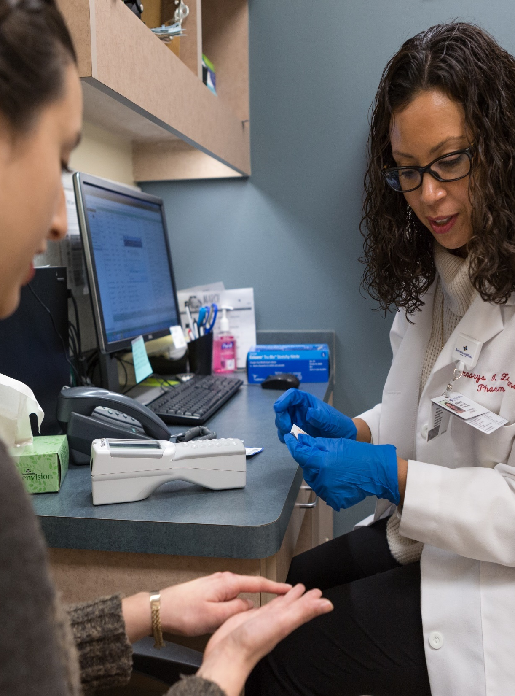
Ambulatory Clinical Specialists
Rapidly growing practice area
Found in health system clinics or private practices
Drug experts in area of specialty
Advanced clinical authority
  Example: Collaborative Practice Agreements (CPA) - Pharmacist referral from a licensed provider to order medications, labs, and other clinical tasks

Slide 11
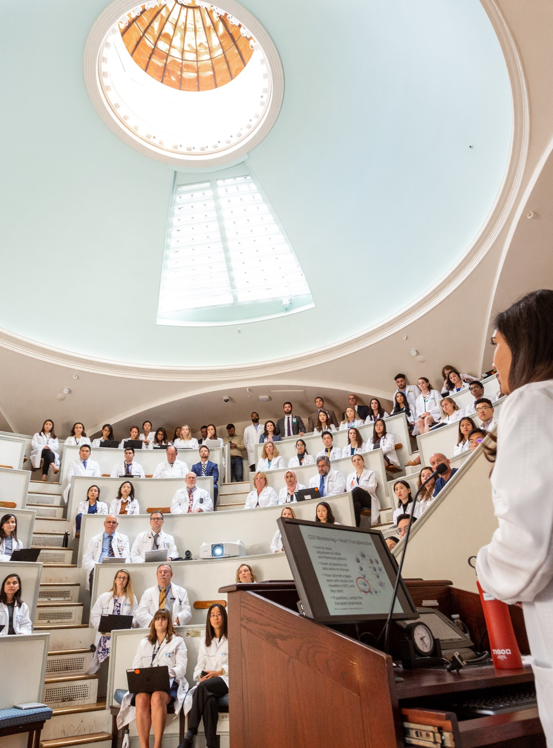
Academic Pharmacy
Teaching responsibilities
Research opportunities
Possible careers:
  Professor
  Associate dean / administrator
  Dean
Pharmacy educator, working with student pharmacists and student technicians

Slide 12

Pharmaceutical Industry
Medical Science Liaison
Medical Affairs
Research
Manufacturing
Regulatory

Slide 13
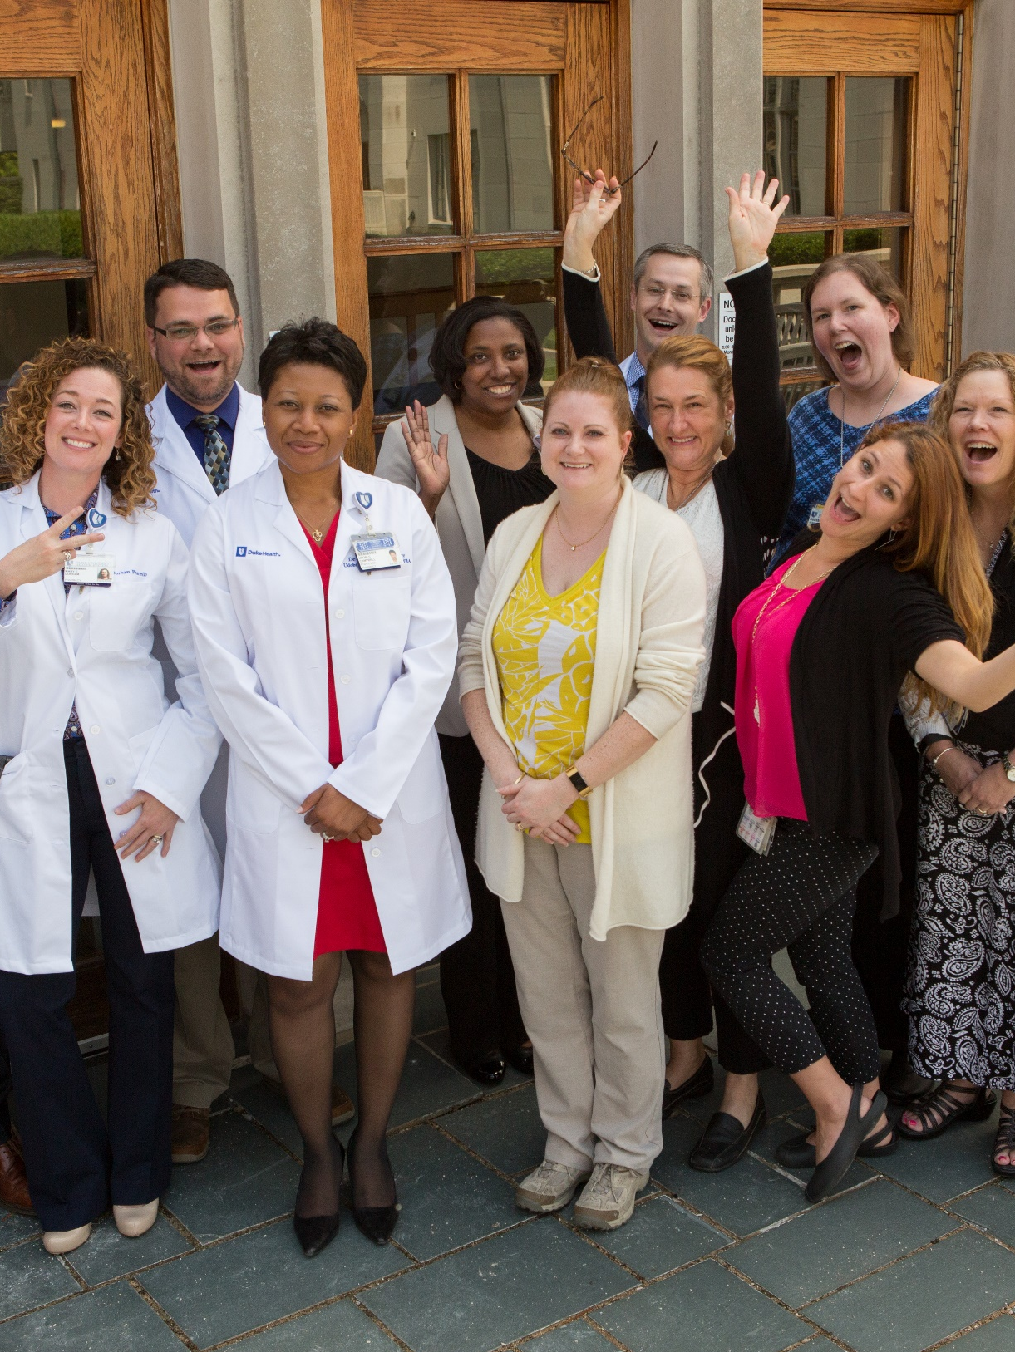
Other Potential Career Options
Managed Care
Population Health Pharmacy
Specialty Pharmacy
Nuclear Pharmacy
Veterinary Pharmacy
Governmental
Regulatory
Military
Non-Profits

Slide 14
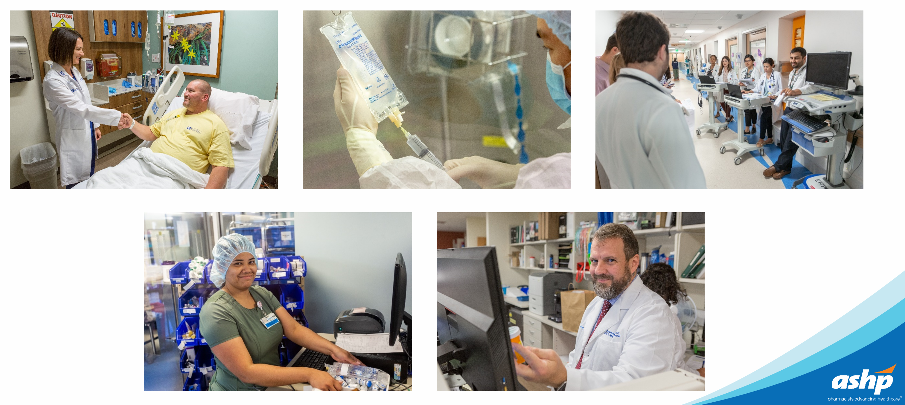
Where there is a patient, there is a pharmacist…

