Slide 1
You’ve Got Game!
Discover the Fast-Paced
World of Pharmacy
Presented by:

Slide 2

What We’re Exploring
How medications safely travel from a healthcare decision to a real patient
The role that pharmacists and pharmacy technicians play in that journey
The systems and teamwork that keep patients safe

Slide 3

Pharmacy Careers exist everywhere healthcare exists
💊 Community
  CVS, Walgreens, Independents, etc.
🏥 Health-System/Hospital
  Intensive Care Unit (ICU), Emergency Room, etc.
🥼 Ambulatory
  Cardiology (heart) clinics, Pulmonary (lung) clinics, etc.
🌏 Public Health
  Government, Indian Health Service, etc.
🏫 Education
  Colleges of Pharmacy
🏢 Industry
  Pfizer, Johnson & Johnson, Moderna, etc.
🎖️ National Defense
  Army, Navy, Air Force, National Guard, etc.

Slide 4

Who Is Responsible for Medication Safety?
Pharmacist
Medication expert & healthcare leader
Pharmacy Technician
Keeps the pharmacy running safely and efficiently
WHAT THEY FOCUS ON:
Makes clinical decisions about medications
Checks for safety, allergies, and drug interactions
Communicates with doctors, nurses, patients, and families
WHAT THEY FOCUS ON:
Prepares prescriptions and medications
Helps with insurance and access
Manages workflow and inventory
Pharmacists and technicians WORK TOGETHER
to keep patients safe

Slide 5

Why Pharmacy Matters
Pharmacy exists because medication decisions:
Can save lives
Can prevent serious harm
Must be monitored and adjusted over time

Slide 6
Community Pharmacy:
High-Volume Decisions
💊
WHAT HAPPENS HERE:
📋Prescriptions are filled
💬Patients are educated by a pharmacist
✅Safety checks occur before medications leave the pharmacy
WHY IT’S IMPORTANT:
Often the first healthcare professional a patient sees
Recommends Over-the-Counter (OTC) medications
TEAM SNAPSHOT
Pharmacist
Technician
Patients

Slide 7
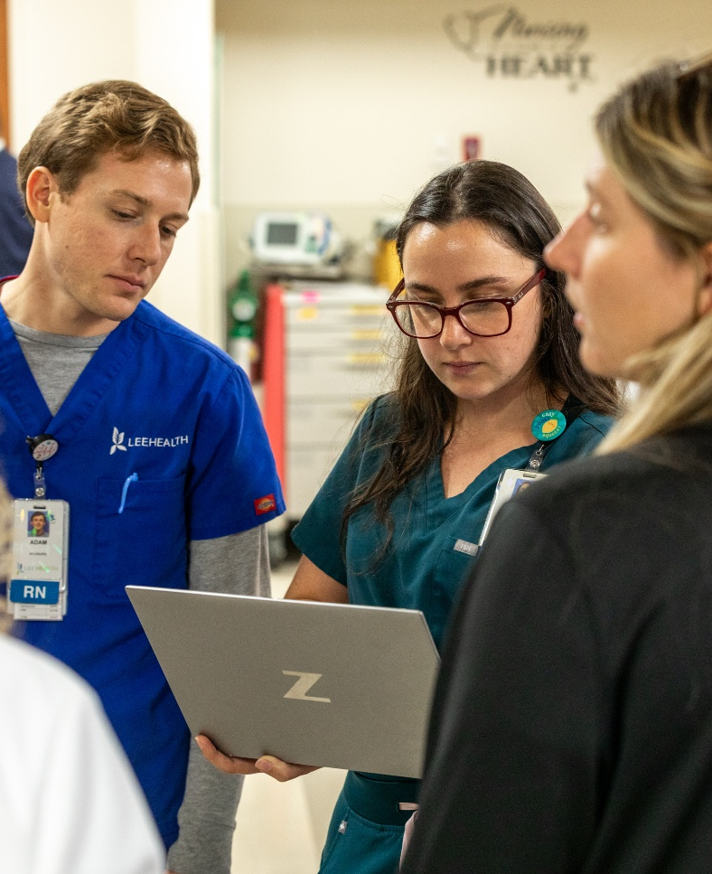
Hospital Pharmacy:
Complex Care Decisions
🏥
WHAT HAPPENS HERE:
🤒Medications are used for critically ill patients
⏰Doses and timing are closely monitored
🤝Pharmacists work together with the care team
WHY IT MATTERS:
Decisions must be fast and precise
Recommend appropriate treatment to transition patients out of the hospital
TEAM SNAPSHOT
Physician
Pharmacist
Technician
Nurse

Slide 8
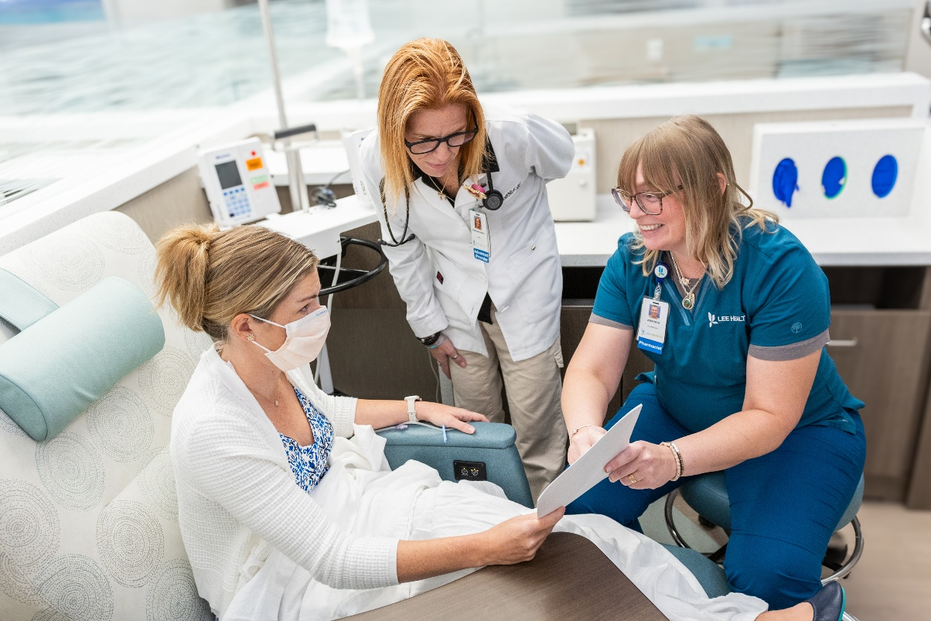
Ambulatory Care:
Long-Term Decisions
🥼
WHAT HAPPENS HERE:
💬One-on-one patient education
🧪Reviewing labs and health data
💊Adjusting medications over time
WHY IT MATTERS:
Manges chronic conditions
Prevents complications long-term
TEAM SNAPSHOT
Physician
Pharmacist
Pharmacy Technician
Nurse
Patient

Slide 9

Pharmacists Specialize Too – Just like Physicians!
DID YOU KNOW?
  FUN FACT #1
  Qualified pharmacists are also able to get Board Certified!
Cardiology ❤️
Critical Care 🏥
Emergency Medicine 🚑
Oncology 🎗️
Infectious Diseases 🦠
Informatics 💻
Pediatrics 👩‍👦
Psychiatry 🧠
Transplant 🚨
  FUN FACT #2
  Pharmacists runs to hospital codes too! They mix the medications in the room for immediate use to save lives.

Slide 10
Team-Based Care Across Settings
No one in healthcare works alone – leadership is shared.
Across all settings:
Pharmacists lead medication decisions
Technicians support safety and efficiency
Providers and nurses coordinate care
Patients are active partners

Slide 11
How People Enter the Pharmacy Team
Pharmacy Technician
Pharmacist
Advanced Training
Pharmacy technician training program (vocational school, community college, or employer training program)
Optional: take National Certification Exam
High school degree (or later in career)
High school degree
Bachelor’s degree (independent 4-year degree or in combination program)
PharmD (3-4 years)
Optional: Residency or Fellowship
Pharmacy Residency
Pharmacy Fellowship
Advanced patient care training
Specialized leadership & research training
  FUN FACT:
  You can work as a pharmacy clerk during high school.

Slide 12
Game: Path to the Patient
Can you help our patient?

Slide 13
Path to the Patient – Before We Begin
Let’s get into teams of 4-6 students per team
Be prepared for math questions!
Pick a Team Name
Nominate someone to raise their hand when you have the answer

Slide 14
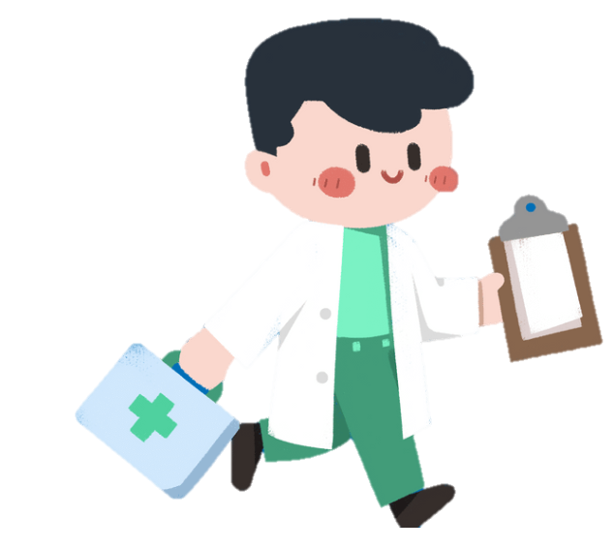

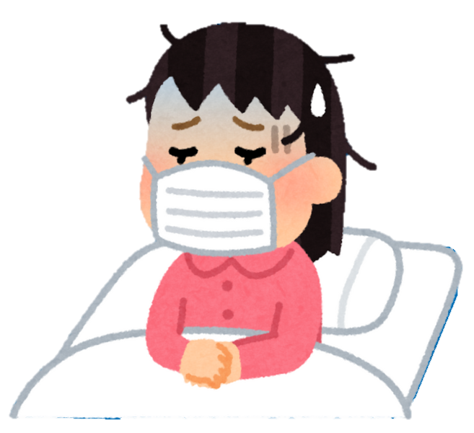
Path to the Patient
START
1
2
3
4
5
6
7
8
KEY
 | Math
 | Medication Identification
 | Think Like a Pharmacist
 | Medication Safety & Errors
 | Patient Counseling & Communication
 | Bonus Rush
15
14
13
12
11
10
9
16
17
18
19
20
21
22
23
FINISH

Slide 15
Path to the Patient
START
1
2
3
4
5
6
7
8
KEY
 | Math
 | Medication Identification
 | Think Like a Pharmacist
 | Medication Safety & Errors
 | Patient Counseling & Communication
 | Bonus Rush
15
14
13
12
11
10
9
16
17
18
19
20
21
22
23
FINISH

Slide 16
Path to the Patient
START
1
2
3
4
5
6
7
8
KEY
 | Math
 | Medication Identification
 | Think Like a Pharmacist
 | Medication Safety & Errors
 | Patient Counseling & Communication
 | Bonus Rush
15
14
13
12
11
10
9
16
17
18
19
20
21
22
23
FINISH

Slide 17
Path to the Patient
START
1
2
3
4
5
6
7
8
KEY
 | Math
 | Medication Identification
 | Think Like a Pharmacist
 | Medication Safety & Errors
 | Patient Counseling & Communication
 | Bonus Rush
15
14
13
12
11
10
9
16
17
18
19
20
21
22
23
FINISH

Slide 18
Path to the Patient
START
1
2
3
4
5
6
7
8
KEY
 | Math
 | Medication Identification
 | Think Like a Pharmacist
 | Medication Safety & Errors
 | Patient Counseling & Communication
 | Bonus Rush
15
14
13
12
11
10
9
16
17
18
19
20
21
22
23
FINISH

Slide 19
Path to the Patient
START
1
2
3
4
5
6
7
8
KEY
 | Math
 | Medication Identification
 | Think Like a Pharmacist
 | Medication Safety & Errors
 | Patient Counseling & Communication
 | Bonus Rush
15
14
13
12
11
10
9
16
17
18
19
20
21
22
23
FINISH

Slide 20
Path to the Patient
START
1
2
3
4
5
6
7
8
KEY
 | Math
 | Medication Identification
 | Think Like a Pharmacist
 | Medication Safety & Errors
 | Patient Counseling & Communication
 | Bonus Rush
15
14
13
12
11
10
9
16
17
18
19
20
21
22
23
FINISH

Slide 21
Path to the Patient
START
1
2
3
4
5
6
7
8
KEY
 | Math
 | Medication Identification
 | Think Like a Pharmacist
 | Medication Safety & Errors
 | Patient Counseling & Communication
 | Bonus Rush
15
14
13
12
11
10
9
16
17
18
19
20
21
22
23
FINISH

Slide 22
Path to the Patient
START
1
2
3
4
5
6
7
8
KEY
 | Math
 | Medication Identification
 | Think Like a Pharmacist
 | Medication Safety & Errors
 | Patient Counseling & Communication
 | Bonus Rush
15
14
13
12
11
10
9
16
17
18
19
20
21
22
23
FINISH

Slide 23
Path to the Patient
START
1
2
3
4
5
6
7
8
KEY
 | Math
 | Medication Identification
 | Think Like a Pharmacist
 | Medication Safety & Errors
 | Patient Counseling & Communication
 | Bonus Rush
15
14
13
12
11
10
9
16
17
18
19
20
21
22
23
FINISH

Slide 24
Path to the Patient
START
1
2
3
4
5
6
7
8
KEY
 | Math
 | Medication Identification
 | Think Like a Pharmacist
 | Medication Safety & Errors
 | Patient Counseling & Communication
 | Bonus Rush
15
14
13
12
11
10
9
16
17
18
19
20
21
22
23
FINISH

Slide 25
Path to the Patient
START
1
2
3
4
5
6
7
8
KEY
 | Math
 | Medication Identification
 | Think Like a Pharmacist
 | Medication Safety & Errors
 | Patient Counseling & Communication
 | Bonus Rush
15
14
13
12
11
10
9
16
17
18
19
20
21
22
23
FINISH

Slide 26
Path to the Patient
START
1
2
3
4
5
6
7
8
KEY
 | Math
 | Medication Identification
 | Think Like a Pharmacist
 | Medication Safety & Errors
 | Patient Counseling & Communication
 | Bonus Rush
15
14
13
12
11
10
9
16
17
18
19
20
21
22
23
FINISH

Slide 27
Path to the Patient
START
1
2
3
4
5
6
7
8
KEY
 | Math
 | Medication Identification
 | Think Like a Pharmacist
 | Medication Safety & Errors
 | Patient Counseling & Communication
 | Bonus Rush
15
14
13
12
11
10
9
16
17
18
19
20
21
22
23
FINISH

Slide 28
Path to the Patient
START
1
2
3
4
5
6
7
8
KEY
 | Math
 | Medication Identification
 | Think Like a Pharmacist
 | Medication Safety & Errors
 | Patient Counseling & Communication
 | Bonus Rush
15
14
13
12
11
10
9
16
17
18
19
20
21
22
23
FINISH

Slide 29
Path to the Patient
START
1
2
3
4
5
6
7
8
KEY
 | Math
 | Medication Identification
 | Think Like a Pharmacist
 | Medication Safety & Errors
 | Patient Counseling & Communication
 | Bonus Rush
15
14
13
12
11
10
9
16
17
18
19
20
21
22
23
FINISH

Slide 30
Path to the Patient
START
1
2
3
4
5
6
7
8
KEY
 | Math
 | Medication Identification
 | Think Like a Pharmacist
 | Medication Safety & Errors
 | Patient Counseling & Communication
 | Bonus Rush
15
14
13
12
11
10
9
16
17
18
19
20
21
22
23
FINISH

Slide 31
Path to the Patient
START
1
2
3
4
5
6
7
8
KEY
 | Math
 | Medication Identification
 | Think Like a Pharmacist
 | Medication Safety & Errors
 | Patient Counseling & Communication
 | Bonus Rush
15
14
13
12
11
10
9
16
17
18
19
20
21
22
23
FINISH

Slide 32
Path to the Patient
START
1
2
3
4
5
6
7
8
KEY
 | Math
 | Medication Identification
 | Think Like a Pharmacist
 | Medication Safety & Errors
 | Patient Counseling & Communication
 | Bonus Rush
15
14
13
12
11
10
9
16
17
18
19
20
21
22
23
FINISH

Slide 33
Path to the Patient
START
1
2
3
4
5
6
7
8
KEY
 | Math
 | Medication Identification
 | Think Like a Pharmacist
 | Medication Safety & Errors
 | Patient Counseling & Communication
 | Bonus Rush
15
14
13
12
11
10
9
16
17
18
19
20
21
22
23
FINISH

Slide 34
Path to the Patient
START
1
2
3
4
5
6
7
8
KEY
 | Math
 | Medication Identification
 | Think Like a Pharmacist
 | Medication Safety & Errors
 | Patient Counseling & Communication
 | Bonus Rush
15
14
13
12
11
10
9
16
17
18
19
20
21
22
23
FINISH

Slide 35
Path to the Patient
START
1
2
3
4
5
6
7
8
KEY
 | Math
 | Medication Identification
 | Think Like a Pharmacist
 | Medication Safety & Errors
 | Patient Counseling & Communication
 | Bonus Rush
15
14
13
12
11
10
9
16
17
18
19
20
21
22
23
FINISH

Slide 36
Path to the Patient
START
1
2
3
4
5
6
7
8
KEY
 | Math
 | Medication Identification
 | Think Like a Pharmacist
 | Medication Safety & Errors
 | Patient Counseling & Communication
 | Bonus Rush
15
14
13
12
11
10
9
16
17
18
19
20
21
22
23
FINISH

Slide 37
Path to the Patient
START
1
2
3
4
5
6
7
8
KEY
 | Math
 | Medication Identification
 | Think Like a Pharmacist
 | Medication Safety & Errors
 | Patient Counseling & Communication
 | Bonus Rush
15
14
13
12
11
10
9
16
17
18
19
20
21
22
23
FINISH

Slide 38
Path to the Patient
START
1
2
3
4
5
6
7
8
KEY
 | Math
 | Medication Identification
 | Think Like a Pharmacist
 | Medication Safety & Errors
 | Patient Counseling & Communication
 | Bonus Rush
15
14
13
12
11
10
9
16
17
18
19
20
21
22
23
FINISH

Slide 39
Math – Calculating Days Supply
2-part question

Slide 40
Do not edit
How to change the design
Scenario:
A patient is picking up a bottle of Latanoprost Ophthalmic Solution 0.005% (125 mcg/2.5 mL). The patient wants to know how many days the bottle of eye drops should last them. The prescription label says: “Instill 1 drop into both eyes every day in the evening”.
Part 1. If there are 20 drops/mL of solution, how many drops would be in a 2.5 mL bottle?
The Slido app must be installed on every computer you’re presenting from

Slide 41
Do not edit
How to change the design
Scenario:
A patient is picking up a bottle of Latanoprost Ophthalmic Solution 0.005% (125 mcg/2.5 mL). The patient wants to know how many days the bottle of eye drops should last them. The prescription label says: “Instill 1 drop into both eyes every day in the evening”.
Part 2. How many days will the patient’s prescription last?
The Slido app must be installed on every computer you’re presenting from

Slide 42
Math – Calculating Days Supply
Scenario:
  A patient is picking up a bottle of Latanoprost Ophthalmic Solution 0.005% (125 mcg/2.5 mL). The patient wants to know how many days the bottle of eye drops should last them. The prescription label says: “Instill 1 drop into both eyes every day in the evening”.
Correct Answer
View Explanation
Try Again

Slide 43
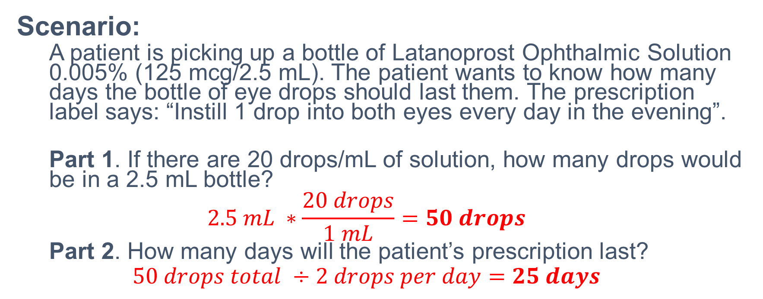
Math – Calculating Days Supply
Scenario:
  A patient is picking up a bottle of Latanoprost Ophthalmic Solution 0.005% (125 mcg/2.5 mL). The patient wants to know how many days the bottle of eye drops should last them. The prescription label says: “Instill 1 drop into both eyes every day in the evening”.
  Part 1. If there are 20 drops/mL of solution, how many drops would be in a 2.5 mL bottle?
  $$2.5 mL ∗\frac{20 drops}{1 mL}=50 drops$$
  Part 2. How many days will the patient’s prescription last?
  $$50 drops total ÷2 drops per day=25 days$$
Correct Answer
Try Again

Slide 44
Do not edit
How to change the design
Scenario:
A patient is picking up a bottle of Latanoprost Ophthalmic Solution 0.005% (125 mcg/2.5 mL). The patient wants to know how many days the bottle of eye drops should last them. The prescription label says: “Instill 1 drop into both eyes every day in the evening”.
Part 1. If there are 20 drops/mL of solution, how many drops would be in a 2.5 mL bottle?
The Slido app must be installed on every computer you’re presenting from

Slide 45
Do not edit
How to change the design
Scenario:
A patient is picking up a bottle of Latanoprost Ophthalmic Solution 0.005% (125 mcg/2.5 mL). The patient wants to know how many days the bottle of eye drops should last them. The prescription label says: “Instill 1 drop into both eyes every day in the evening”.
Part 2. How many days will the patient’s prescription last?
The Slido app must be installed on every computer you’re presenting from

Slide 46
Math – Calculating Days Supply
Scenario:
  A patient is picking up a bottle of Latanoprost Ophthalmic Solution 0.005% (125 mcg/2.5 mL). The patient wants to know how many days the bottle of eye drops should last them. The prescription label says: “Instill 1 drop into both eyes every day in the evening”.
Correct Answer
View Explanation

Slide 47
Do not edit
How to change the design
Identification - How to Identify Unknown Pill:
A patient brings in a loose pill with no bottle to the pharmacy. What information would help you identify it?
The Slido app must be installed on every computer you’re presenting from

Slide 48
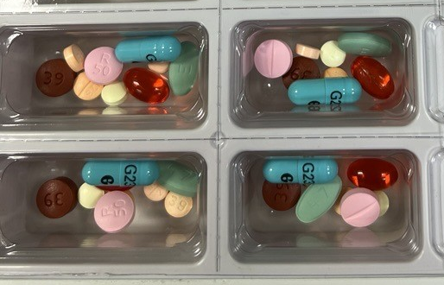
Identification – How to Identify Unknown Pill
A patient brings in a loose pill with no bottle to the pharmacy.
What information would help you identify it?
Example of different pills
Correct Answer
Try Again

Slide 49
Do not edit
How to change the design
Identification - How to Identify Unknown Pill:
A patient brings in a loose pill with no bottle to the pharmacy. What information would help you identify it?
The Slido app must be installed on every computer you’re presenting from

Slide 50
Identification – How to Identify Unknown Pill
A patient brings in a loose pill with no bottle to the pharmacy. What information would help you identify it?
Pill color
Shape and imprint
Size
All of the above
Correct Answer

Slide 51
Do not edit
How to change the design
Think Like a Pharmacist - Medication:
A patient takes a medication that causes drowsiness. The patient asks if they can take the medication now before driving to work. What is your biggest concern here?
The Slido app must be installed on every computer you’re presenting from

Slide 52
Think Like a Pharmacist – Medication
A patient takes a medication that causes drowsiness. The patient asks if they can take the medication now before driving to work. What is your biggest concern here?
Correct Answer
Try Again

Slide 53
Do not edit
How to change the design
Think Like a Pharmacist - Medication:
A patient takes a medication that causes drowsiness. The patient asks if they can take the medication now before driving to work. What is your biggest concern here?
The Slido app must be installed on every computer you’re presenting from

Slide 54
Think Like a Pharmacist – Medication
A patient takes a medication that causes drowsiness. The patient asks if they can take the medication now before driving to work. What is your biggest concern here?
Cost
Side effects
Drug interaction
Insurance coverage
Correct Answer

Slide 55
Do not edit
How to change the design
Medication Safety & Errors - Importance:
Why is medication safety important?
The Slido app must be installed on every computer you’re presenting from

Slide 56
Medication Safety & Errors – Importance
Why is medication safety important?
Correct Answer
Try Again

Slide 57
Do not edit
How to change the design
Medication Safety & Errors - Importance:
Why is medication safety important?
The Slido app must be installed on every computer you’re presenting from

Slide 58
Medication Safety & Errors – Importance
Why is medication safety important?
Pharmacies are busy
Medications are expensive
Medication decisions can save lives and prevent serious harm
Doctors are not always available
Correct Answer

Slide 59
Do not edit
How to change the design
Patient Counseling & Communication - Medication Understanding:
A patient says, “I don’t really understand how to take this medication.” What is the pharmacist’s best first response?
The Slido app must be installed on every computer you’re presenting from

Slide 60
Patient Counseling & Communication – Medication Understanding
A patient says, “I don’t really understand how to take this medication.” What is the pharmacist’s best first response?
Correct Answer
Try Again

Slide 61
Do not edit
How to change the design
Patient Counseling & Communication - Medication Understanding:
A patient says, “I don’t really understand how to take this medication.” What is the pharmacist’s best first response?
The Slido app must be installed on every computer you’re presenting from

Slide 62
Patient Counseling & Communication – Medication Understanding
A patient says, “I don’t really understand how to take this medication.” What is the pharmacist’s best first response?
“Just take it once a day.”
“It’s written on the bottle.”
“Let’s go over it together.”
“You should have listened earlier.”
Correct Answer

Slide 63
⭐ Bonus Rush
This is your team’s chance to take the lead!
You will get 4 questions to answer.
GET READY!

Slide 64
Do not edit
How to change the design
Bonus Rush T/F Statements:
Pill color helps identify medications.
The Slido app must be installed on every computer you’re presenting from

Slide 65
Do not edit
How to change the design
Bonus Rush T/F Statements:
It's safe to take pills without knowing what they are.
The Slido app must be installed on every computer you’re presenting from

Slide 66
Do not edit
How to change the design
Bonus Rush T/F Statements:
Most medication errors are caused by lack of teamwork.
The Slido app must be installed on every computer you’re presenting from

Slide 67
Do not edit
How to change the design
Bonus Rush T/F Statements:
If an error doesn't reach the patient, it doesn't matter.
The Slido app must be installed on every computer you’re presenting from

Slide 68
⭐ Bonus Rush T/F Statements
Pill color helps identify medications.
It’s safe to take pills without knowing what they are.
Most medication errors are caused by lack of teamwork.
If an error doesn’t reach the patient, it doesn’t matter.
Correct Answer
Try Again

Slide 69
Do not edit
How to change the design
Bonus Rush T/F Statements:
Pill color helps identify medications.
The Slido app must be installed on every computer you’re presenting from

Slide 70
Do not edit
How to change the design
Bonus Rush T/F Statements:
It's safe to take pills without knowing what they are.
The Slido app must be installed on every computer you’re presenting from

Slide 71
Do not edit
How to change the design
Bonus Rush T/F Statements:
Most medication errors are caused by lack of teamwork.
The Slido app must be installed on every computer you’re presenting from

Slide 72
Do not edit
How to change the design
Bonus Rush T/F Statements:
If an error doesn't reach the patient, it doesn't matter.
The Slido app must be installed on every computer you’re presenting from

Slide 73
⭐ Bonus Rush T/F Statements
Pill color helps identify medications. T
It’s safe to take pills without knowing what they are. F
Most medication errors are caused by lack of teamwork. T
If an error doesn’t reach the patient, it doesn’t matter. F
Correct Answer

Slide 74
Math – Calculating Dose
2-part question

Slide 75
Do not edit
How to change the design
Scenario:
A patient is to receive 100 mg/kg/day of ampicillin. The patient weighs 40 pounds.
Part 1. What is the patient’s weight in kilograms (kg) rounded to the nearest hundredth? (1 kg = 2.2 lbs)
The Slido app must be installed on every computer you’re presenting from

Slide 76
Do not edit
How to change the design
Scenario:
A patient is to receive 100 mg/kg/day of ampicillin. The patient weighs 40 pounds.
Part 2. How much ampicillin (in mg) should the patient get each day?
The Slido app must be installed on every computer you’re presenting from

Slide 77
Math – Calculating Dose
Scenario:
  A patient is to receive 100 mg/kg/day of ampicillin. The patient weighs 40 pounds.
Correct Answer
View Explanation
Try Again

Slide 78
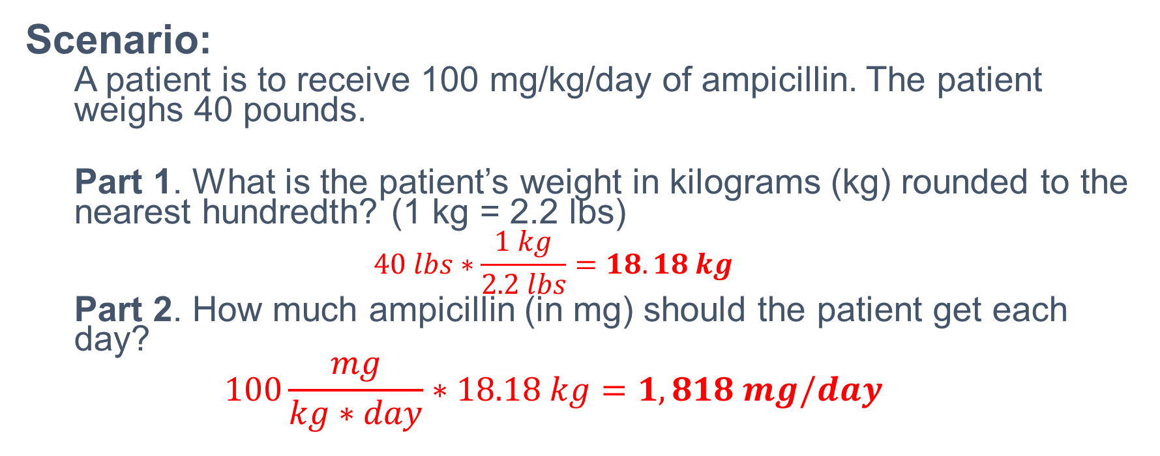
Math – Calculating Dose
Scenario:
  A patient is to receive 100 mg/kg/day of ampicillin. The patient weighs 40 pounds.
  Part 1. What is the patient’s weight in kilograms (kg) rounded to the nearest hundredth? (1 kg = 2.2 lbs)
  $$40 lbs∗\frac{1 kg}{2.2 lbs}=18.18 kg$$
  Part 2. How much ampicillin (in mg) should the patient get each day?
  $$100\frac{mg}{kg∗day}∗18.18 kg=1,818 mg/day$$
Correct Answer
Try Again

Slide 79
Do not edit
How to change the design
Scenario:
A patient is to receive 100 mg/kg/day of ampicillin. The patient weighs 40 pounds.
Part 1. What is the patient’s weight in kilograms (kg) rounded to the nearest hundredth? (1 kg = 2.2 lbs)
The Slido app must be installed on every computer you’re presenting from

Slide 80
Do not edit
How to change the design
Scenario:
A patient is to receive 100 mg/kg/day of ampicillin. The patient weighs 40 pounds.
Part 2. How much ampicillin (in mg) should the patient get each day?
The Slido app must be installed on every computer you’re presenting from

Slide 81
Math – Calculating Dose
Scenario:
  A patient is to receive 100 mg/kg/day of ampicillin. The patient weighs 40 pounds.
Correct Answer
View Explanation

Slide 82
Do not edit
How to change the design
Identification - Identify the Pill:
A patient called the pharmacy to ask for assistance identifying the pill they found at the bottom of their bag. They stated the pill has an X on one side and a 36 on the other.
What medication did the patient find?
The Slido app must be installed on every computer you’re presenting from

Slide 83
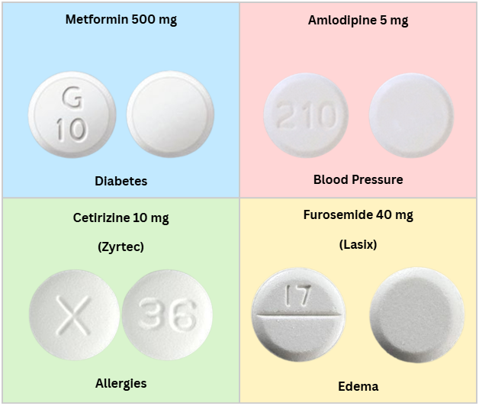
Identification – Identify the Pill
A patient called the pharmacy to ask for assistance identifying the pill they found at the bottom of their bag. They stated the pill has an X on one side and a 36 on the other.
What medication did the patient find?
Correct Answer
Try Again

Slide 84
Do not edit
How to change the design
Identification - Identify the Pill:
A patient called the pharmacy to ask for assistance identifying the pill they found at the bottom of their bag. They stated the pill has an X on one side and a 36 on the other.
What medication did the patient find?
The Slido app must be installed on every computer you’re presenting from

Slide 85
Identification – Identify the Pill
A patient called the pharmacy to ask for assistance identifying the pill they found at the bottom of their bag. They stated the pill has an X on one side and a 36 on the other.
What medication did the patient find?
Cetirizine 10 mg
Amlodipine 5 mg
Metformin 500 mg
Furosemide 40 mg
Correct Answer

Slide 86
Do not edit
How to change the design
Think Like a Pharmacist - Medication Process:
A patient receives a medication but is not told how or when to take it. What step was missed in the medication process?
The Slido app must be installed on every computer you’re presenting from

Slide 87
Think Like a Pharmacist – Medication Process
A patient receives a medication but is not told how or when to take it. What step was missed in the medication process?
Correct Answer
Try Again

Slide 88
Do not edit
How to change the design
Think Like a Pharmacist - Medication Process:
A patient receives a medication but is not told how or when to take it. What step was missed in the medication process?
The Slido app must be installed on every computer you’re presenting from

Slide 89
Think Like a Pharmacist – Medication Process
A patient receives a medication but is not told how or when to take it. What step was missed in the medication process?
Writing the prescription
Filling the medication
Explaining how to take it
Documenting the interaction
Correct Answer

Slide 90
Do not edit
How to change the design
Medication Safety & Errors - Safety Check:
What is the most important thing to check before handing someone a medication vial?
The Slido app must be installed on every computer you’re presenting from

Slide 91
Medication Safety & Errors – Safety Check
What is the most important thing to check before handing someone a medication vial?
Correct Answer
Try Again

Slide 92
Do not edit
How to change the design
Medication Safety & Errors - Safety Check:
What is the most important thing to check before handing someone a medication vial?
The Slido app must be installed on every computer you’re presenting from

Slide 93
Medication Safety & Errors – Safety Check
What is the most important thing to check before handing someone a medication vial?
The color of the pill
The patient’s name
The price
The pharmacy label design
Correct Answer

Slide 94
Do not edit
How to change the design
Patient Counseling & Communication - Medication Understanding:
A patient says, “I’m nervous about taking this medication.” What is the best response?
The Slido app must be installed on every computer you’re presenting from

Slide 95
Patient Counseling & Communication – Medication Understanding
A patient says, “I’m nervous about taking this medication.” What is the best response?
Correct Answer
Try Again

Slide 96
Do not edit
How to change the design
Patient Counseling & Communication - Medication Understanding:
A patient says, “I’m nervous about taking this medication.” What is the best response?
The Slido app must be installed on every computer you’re presenting from

Slide 97
Patient Counseling & Communication – Medication Understanding
A patient says, “I’m nervous about taking this medication.” What is the best response?
“You’ll be fine.”
“There’s nothing to worry about.”
“What are you concerned about?”
“Just take it as directed.”
Correct Answer

Slide 98
⭐ Bonus Rush
This is your team’s chance to take the lead!
You will get 4 questions to answer.
Get ready!

Slide 99
Do not edit
How to change the design
Bonus Rush T/F Statements:
It's okay to ask questions about medications.
The Slido app must be installed on every computer you’re presenting from

Slide 100
Do not edit
How to change the design
Bonus Rush T/F Statements:
Pills that look the same are always the same medications.
The Slido app must be installed on every computer you’re presenting from

Slide 101
Do not edit
How to change the design
Bonus Rush T/F Statements:
Pharmacists help prevent medication errors.
The Slido app must be installed on every computer you’re presenting from

Slide 102
Do not edit
How to change the design
Bonus Rush T/F Statements:
Taking medication incorrectly can be harmful.
The Slido app must be installed on every computer you’re presenting from

Slide 103
⭐ Bonus Rush T/F Statements
It’s okay to ask questions about medications.
Pills that look the same are always the same medication.
Pharmacists help prevent medication errors.
Taking medication incorrectly can be harmful.
Correct Answer
Try Again

Slide 104
Do not edit
How to change the design
Bonus Rush T/F Statements:
It's okay to ask questions about medications.
The Slido app must be installed on every computer you’re presenting from

Slide 105
Do not edit
How to change the design
Bonus Rush T/F Statements:
Pills that look the same are always the same medications.
The Slido app must be installed on every computer you’re presenting from

Slide 106
Do not edit
How to change the design
Bonus Rush T/F Statements:
Pharmacists help prevent medication errors.
The Slido app must be installed on every computer you’re presenting from

Slide 107
Do not edit
How to change the design
Bonus Rush T/F Statements:
Taking medication incorrectly can be harmful.
The Slido app must be installed on every computer you’re presenting from

Slide 108
⭐ Bonus Rush T/F Statements
It’s okay to ask questions about medications. T
Pills that look the same are always the same medication. F
Pharmacists help prevent medication errors. T
Taking medication incorrectly can be harmful. T
Correct Answer

Slide 109
Math – Calculating Next Dose
3-part question

Slide 110
Do not edit
How to change the design
Scenario:
A patient is in the hospital and requires IV fluids around the clock. The nurse hangs a 1-liter bag of 0.9% normal saline fluid. The nurse set the infusion rate to be 0.5 milliliters (mL) per minute.
Part 1. How many mL are in 1-liter?
The Slido app must be installed on every computer you’re presenting from

Slide 111
Do not edit
How to change the design
Scenario:
A patient is in the hospital and requires IV fluids around the clock. The nurse hangs a 1-liter bag of 0.9% normal saline fluid. The nurse set the infusion rate to be 0.5 milliliters (mL) per minute.
Part 2. How many minutes will it take for
the 1-liter bag for normal saline to run out?
The Slido app must be installed on every computer you’re presenting from

Slide 112
Do not edit
How to change the design
Scenario:
A patient is in the hospital and requires IV fluids around the clock. The nurse hangs a 1-liter bag of 0.9% normal saline fluid. The nurse set the infusion rate to be 0.5 milliliters (mL) per minute.
Part 3. How many days will it take for the 1-liter
bag of normal saline to run out? (Round to the nearest tenth)
The Slido app must be installed on every computer you’re presenting from

Slide 113
Math – Calculating Next Dose
Scenario:
  A patient is in the hospital and requires IV fluids around the clock. The nurse hangs a 1-liter bag of 0.9% normal saline fluid. The nurse set the infusion rate to be 0.5 milliliters (mL) per minute.
Conversion Chart
1 milliliter (mL) | 0.001 liter (L)
1 centiliter (cL) | 0.01 liter (L)
1 deciliter (dL) | 0.1 liter (L)
1 kiloliter (kL) | 1000 liters (L)
Correct Answer
View Explanation
Try Again

Slide 114
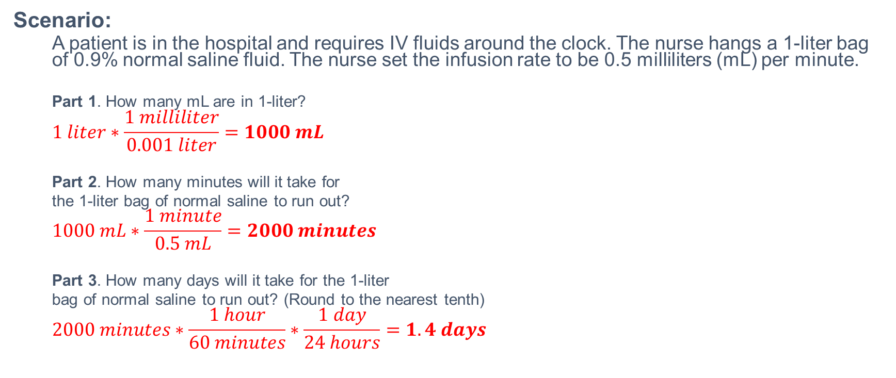
Math – Calculating Next Dose
Scenario:
  A patient is in the hospital and requires IV fluids around the clock. The nurse hangs a 1-liter bag of 0.9% normal saline fluid. The nurse set the infusion rate to be 0.5 milliliters (mL) per minute.
  Part 1. How many mL are in 1-liter?
  $$1 liter∗\frac{1 milliliter}{0.001 liter}=1000 mL$$
  Part 2. How many minutes will it take for
  the 1-liter bag of normal saline to run out?
  $$1000 mL∗\frac{1 minute}{0.5 mL}=2000 minutes$$
  Part 3. How many days will it take for the 1-liter
  bag of normal saline to run out? (Round to the nearest tenth)
  $$2000 minutes∗\frac{1 hour}{60 minutes}∗\frac{1 day}{24 hours}=1.4 days$$
Conversion Chart
1 milliliter (mL) | 0.001 liter (L)
1 centiliter (cL) | 0.01 liter (L)
1 deciliter (dL) | 0.1 liter (L)
1 kiloliter (kL) | 1000 liters (L)
Correct Answer
Try Again

Slide 115
Do not edit
How to change the design
Scenario:
A patient is in the hospital and requires IV fluids around the clock. The nurse hangs a 1-liter bag of 0.9% normal saline fluid. The nurse set the infusion rate to be 0.5 milliliters (mL) per minute.
Part 1. How many mL are in 1-liter?
The Slido app must be installed on every computer you’re presenting from

Slide 116
Do not edit
How to change the design
Scenario:
A patient is in the hospital and requires IV fluids around the clock. The nurse hangs a 1-liter bag of 0.9% normal saline fluid. The nurse set the infusion rate to be 0.5 milliliters (mL) per minute.
Part 2. How many minutes will it take for
the 1-liter bag for normal saline to run out?
The Slido app must be installed on every computer you’re presenting from

Slide 117
Do not edit
How to change the design
Scenario:
A patient is in the hospital and requires IV fluids around the clock. The nurse hangs a 1-liter bag of 0.9% normal saline fluid. The nurse set the infusion rate to be 0.5 milliliters (mL) per minute.
Part 3. How many days will it take for the 1-liter
bag of normal saline to run out? (Round to the nearest tenth)
The Slido app must be installed on every computer you’re presenting from

Slide 118
Math – Calculating Next Dose
Scenario:
  A patient is in the hospital and requires IV fluids around the clock. The nurse hangs a 1-liter bag of 0.9% normal saline fluid. The nurse set the infusion rate to be 0.5 milliliters (mL) per minute.
Conversion Chart
1 milliliter (mL) | 0.001 liter (L)
1 centiliter (cL) | 0.01 liter (L)
1 deciliter (dL) | 0.1 liter (L)
1 kiloliter (kL) | 1000 liters (L)
Correct Answer
View Explanation

Slide 119
Do not edit
How to change the design
Identification - Identify the Pill:
A technician accidentally spilled two different doses of Losartan.
What are the differences?
The Slido app must be installed on every computer you’re presenting from

Slide 120
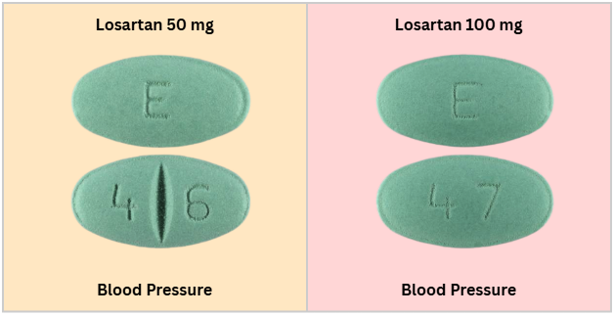
Identification – Identify the Pill
A technician accidentally spilled two different doses of Losartan.
What are the differences?
  FUN FACT #1
  The pills are also different sizes!
Correct Answer
Try Again

Slide 121
Do not edit
How to change the design
Identification - Identify the Pill:
A technician accidentally spilled two different doses of Losartan.
What are the differences?
The Slido app must be installed on every computer you’re presenting from

Slide 122
Identification – Identify the Pill
A technician accidentally spilled two different doses of Losartan.
What are the differences?
  FUN FACT #1
  The pills are also different sizes!
Correct Answer

Slide 123
Do not edit
How to change the design
Think Like a Pharmacist - Child vs Adult:
Two patients receive the same medication. One is a child, one is an older adult. What might the pharmacist need to adjust or check?
The Slido app must be installed on every computer you’re presenting from

Slide 124
Think Like a Pharmacist – Child vs Adult
Two patients receive the same medication. One is a child, one is an older adult. What might the pharmacist need to adjust or check?
Correct Answer
Try Again

Slide 125
Do not edit
How to change the design
Think Like a Pharmacist - Child vs Adult:
Two patients receive the same medication. One is a child, one is an older adult. What might the pharmacist need to adjust or check?
The Slido app must be installed on every computer you’re presenting from

Slide 126
Think Like a Pharmacist – Child vs Adult
Two patients receive the same medication. One is a child, one is an older adult. What might the pharmacist need to adjust or check?
Dose
Instructions
Side effects
All of the above
Correct Answer

Slide 127
Do not edit
How to change the design
Medication Safety & Errors - Different Looking Pill:
A patient says their pill looks different than usual. What should happen next?
The Slido app must be installed on every computer you’re presenting from

Slide 128
Medication Safety & Errors – Different Looking Pill
A patient says their pill looks different than usual. What should happen next?
Correct Answer
Try Again

Slide 129
Do not edit
How to change the design
Medication Safety & Errors - Different Looking Pill:
A patient says their pill looks different than usual. What should happen next?
The Slido app must be installed on every computer you’re presenting from

Slide 130
Medication Safety & Errors – Different Looking Pill
A patient says their pill looks different than usual. What should happen next?
Ignore it
Throw it away
Tell them it’s normal
Check to make sure it’s correct
Correct Answer

Slide 131
Do not edit
How to change the design
Patient Counseling & Communication - Visual Cues:
A patient looks worried after the pharmacist counsels them on their medication but doesn’t say anything. What should the pharmacist do?
The Slido app must be installed on every computer you’re presenting from

Slide 132
Patient Counseling & Communication – Visual Cues
A patient looks worried after the pharmacist counsels them on their medication but doesn’t say anything. What should the pharmacist do?
Correct Answer
Try Again

Slide 133
Do not edit
How to change the design
Patient Counseling & Communication - Visual Cues:
A patient looks worried after the pharmacist counsels them on their medication but doesn’t say anything. What should the pharmacist do?
The Slido app must be installed on every computer you’re presenting from

Slide 134
Patient Counseling & Communication – Visual Cues
A patient looks worried after the pharmacist counsels them on their medication but doesn’t say anything. What should the pharmacist do?
Ignore it
End the conversation
Ask if they have concerns
Tell them to call later
Correct Answer

Slide 135
⭐ Bonus Rush
This is your team’s chance to take the lead!
You will get 4 questions to answer.
Get ready!

Slide 136
Do not edit
How to change the design
Bonus Rush T/F Statements:
Asking questions helps keep patients safe.
The Slido app must be installed on every computer you’re presenting from

Slide 137
Do not edit
How to change the design
Bonus Rush T/F Statements:
If a patient is quiet, they understand everything.
The Slido app must be installed on every computer you’re presenting from

Slide 138
Do not edit
How to change the design
Bonus Rush T/F Statements:
Clear communication can prevent medication errors.
The Slido app must be installed on every computer you’re presenting from

Slide 139
Do not edit
How to change the design
Bonus Rush T/F Statements:
Patients should feel comfortable speaking up.
The Slido app must be installed on every computer you’re presenting from

Slide 140
⭐ Bonus Rush T/F Statements
Asking questions helps keep patients safe.
If a patient is quiet, they understand everything.
Clear communication can prevent medication errors.
Patients should feel comfortable speaking up.
Correct Answer
Try Again

Slide 141
Do not edit
How to change the design
Bonus Rush T/F Statements:
Asking questions helps keep patients safe.
The Slido app must be installed on every computer you’re presenting from

Slide 142
Do not edit
How to change the design
Bonus Rush T/F Statements:
If a patient is quiet, they understand everything.
The Slido app must be installed on every computer you’re presenting from

Slide 143
Do not edit
How to change the design
Bonus Rush T/F Statements:
Clear communication can prevent medication errors.
The Slido app must be installed on every computer you’re presenting from

Slide 144
Do not edit
How to change the design
Bonus Rush T/F Statements:
Patients should feel comfortable speaking up.
The Slido app must be installed on every computer you’re presenting from

Slide 145
⭐ Bonus Rush T/F Statements
Asking questions helps keep patients safe. T
If a patient is quiet, they understand everything. F
Clear communication can prevent medication errors. T
Patients should feel comfortable speaking up. T
Correct Answer

Slide 146
Math – Calculating Day Supply
3-part question

Slide 147
Do not edit
How to change the design
Scenario:
You receive this prescription
Part 1. What is the maximum number of times Jane Doe can take her Albuterol medication in one day?
The Slido app must be installed on every computer you’re presenting from

Slide 148
Do not edit
How to change the design
Scenario:
You receive this prescription
Part 2. What is the maximum number of puffs could Jane Doe take in 1 day?
The Slido app must be installed on every computer you’re presenting from

Slide 149
Do not edit
How to change the design
Scenario:
You receive this prescription
Part 3. 1 box of albuterol inhaler contains 200 puffs of medication. How many full days will 1 box of albuterol last?
The Slido app must be installed on every computer you’re presenting from

Slide 150
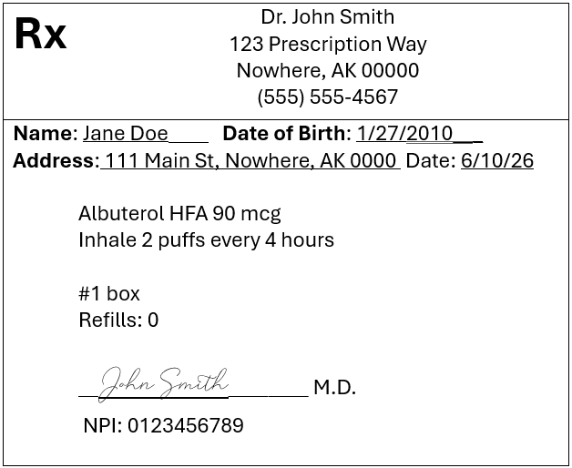
Math – Calculating Next Dose
Scenario:
  You receive this prescription
Correct Answer
View Explanation
Try Again

Slide 151
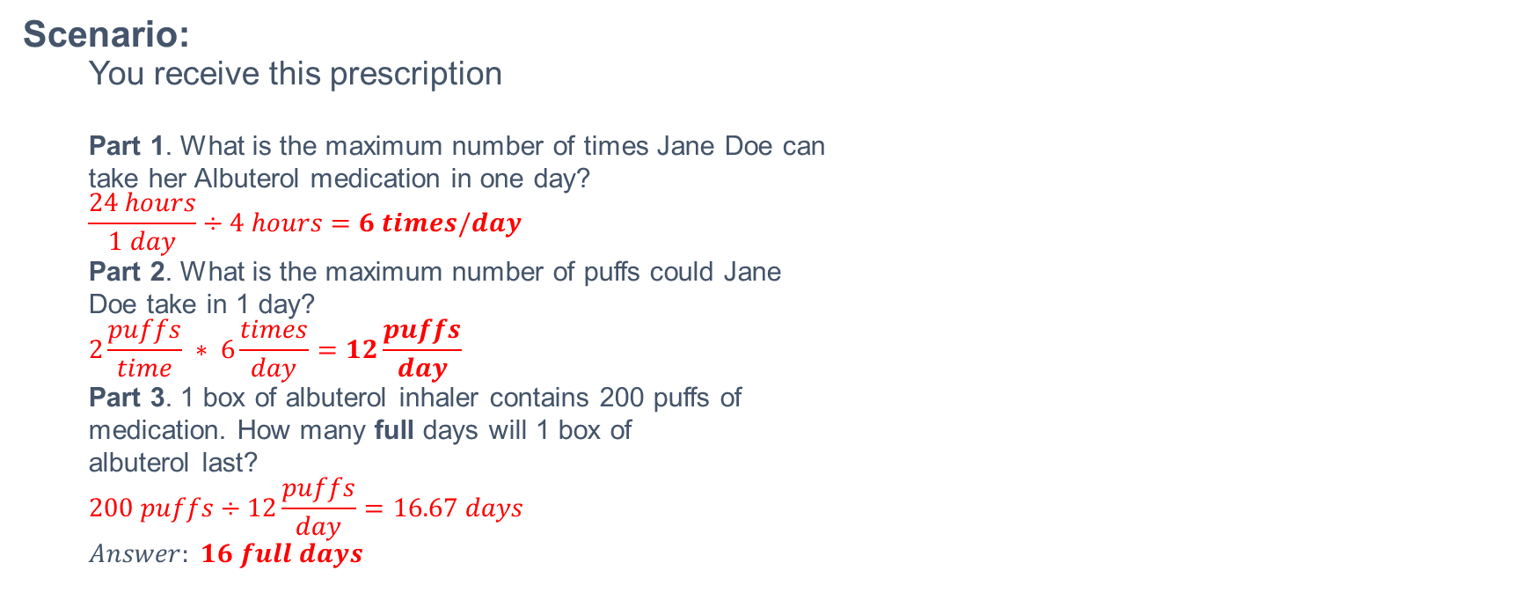
Math – Calculating Next Dose
Scenario:
  You receive this prescription
  Part 1. What is the maximum number of times Jane Doe can
  take her Albuterol medication in one day?
  $$\frac{24 hours}{1 day}÷4 hours=6 times/day$$
  Part 2. What is the maximum number of puffs could Jane
  Doe take in 1 day?
  $$2\frac{puffs}{time} ∗ 6\frac{times}{day}=12\frac{puffs}{day}$$
  Part 3. 1 box of albuterol inhaler contains 200 puffs of
  medication. How many full days will 1 box of
  albuterol last?
  $$200 puffs÷12\frac{puffs}{day}=16.67 days$$
  $$Answer: 16 full days$$
Correct Answer
Try Again

Slide 152
Do not edit
How to change the design
Scenario:
You receive this prescription
Part 1. What is the maximum number of times Jane Doe can take her Albuterol medication in one day?
The Slido app must be installed on every computer you’re presenting from

Slide 153
Do not edit
How to change the design
Scenario:
You receive this prescription
Part 2. What is the maximum number of puffs could Jane Doe take in 1 day?
The Slido app must be installed on every computer you’re presenting from

Slide 154
Do not edit
How to change the design
Scenario:
You receive this prescription
Part 3. 1 box of albuterol inhaler contains 200 puffs of medication. How many full days will 1 box of albuterol last?
The Slido app must be installed on every computer you’re presenting from

Slide 155
Math – Calculating Next Dose
Scenario:
  You receive this prescription
Correct Answer
View Explanation

Slide 156
Do not edit
How to change the design
Identification - Unknown Pill:
An unconscious patient arrives in the emergency room with unknown pills in their pocket. Why is medication identification critical in this situation?
The Slido app must be installed on every computer you’re presenting from

Slide 157
Identification – Unknown Pill
An unconscious patient arrives in the emergency room with unknown pills in their pocket. Why is medication identification critical in this situation?
Correct Answer
Try Again

Slide 158
Do not edit
How to change the design
Identification - Unknown Pill:
An unconscious patient arrives in the emergency room with unknown pills in their pocket. Why is medication identification critical in this situation?
The Slido app must be installed on every computer you’re presenting from

Slide 159
Identification – Unknown Pill
An unconscious patient arrives in the emergency room with unknown pills in their pocket. Why is medication identification critical in this situation?
For paperwork
To keep the patient safe
To organize supplies
To save time
Correct Answer

Slide 160
Do not edit
How to change the design
Think Like a Pharmacist - Teamwork:
A prescription passes through multiple hands before reaching the patient. Why are multiple checkpoints important?
The Slido app must be installed on every computer you’re presenting from

Slide 161
Think Like a Pharmacist – Teamwork
A prescription passes through multiple hands before reaching the patient. Why are multiple checkpoints important?
Correct Answer
Try Again

Slide 162
Do not edit
How to change the design
Think Like a Pharmacist - Teamwork:
A prescription passes through multiple hands before reaching the patient. Why are multiple checkpoints important?
The Slido app must be installed on every computer you’re presenting from

Slide 163
Think Like a Pharmacist – Teamwork
A prescription passes through multiple hands before reaching the patient. Why are multiple checkpoints important?
To slow things down
To reduce human error
To make the process look official
To increase paperwork
Correct Answer

Slide 164
Do not edit
How to change the design
Medication Safety & Errors - Questions:
When should someone ask a pharmacist a question about their medication?
The Slido app must be installed on every computer you’re presenting from

Slide 165
Medication Safety & Errors – Questions
When should someone ask a pharmacist a question about their medication?
Correct Answer
Try Again

Slide 166
Do not edit
How to change the design
Medication Safety & Errors - Questions:
When should someone ask a pharmacist a question about their medication?
The Slido app must be installed on every computer you’re presenting from

Slide 167
Medication Safety & Errors – Questions
When should someone ask a pharmacist a question about their medication?
Only if something goes wrong
Only if it’s a new medication
If they are unsure or confused
Never
Correct Answer

Slide 168
Do not edit
How to change the design
Patient Counseling & Communication - Encouragement:
A patient admits they forgot to take their medication. What response encourages honesty?
The Slido app must be installed on every computer you’re presenting from

Slide 169
Patient Counseling & Communication – Encouragement
A patient admits they forgot to take their medication. What response encourages honesty?
Correct Answer
Try Again

Slide 170
Do not edit
How to change the design
Patient Counseling & Communication - Encouragement:
A patient admits they forgot to take their medication. What response encourages honesty?
The Slido app must be installed on every computer you’re presenting from

Slide 171
Patient Counseling & Communication – Encouragement
A patient admits they forgot to take their medication. What response encourages honesty?
“Why didn’t you take it?”
“You should be more careful.”
“We talked about this last time.”
“Let’s talk about how to remember to take it next time.”
Correct Answer

Slide 172
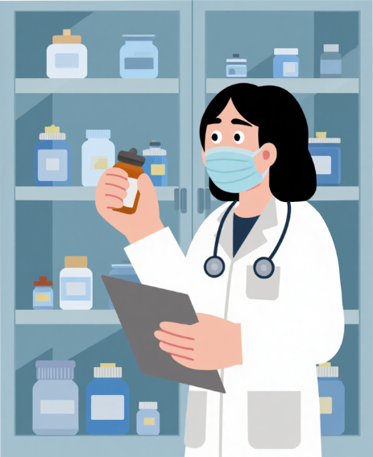
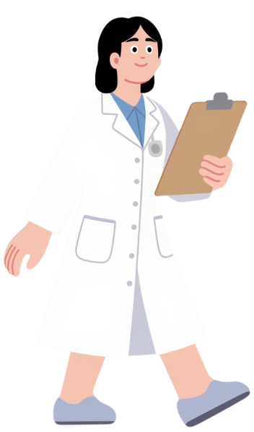
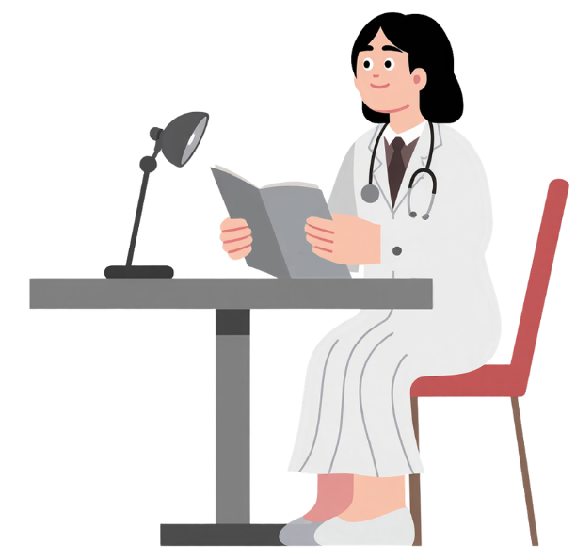
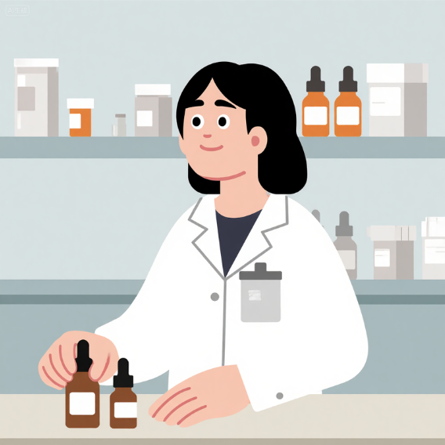
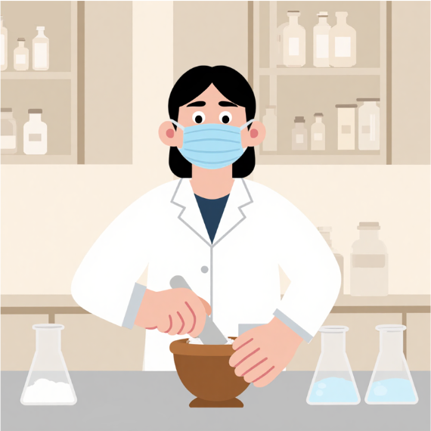
🎉CONGRATULATIONS!🎊
The patient feels much better! She experienced firsthand how different healthcare teams worked together to care for her and formed a meaningful connection with her pharmacist.
Inspired by her experience, she decided
to pursue a career in pharmacy!
Replay

Slide 173
You’ve Got Game!
Discover the Fast-Paced
World of Pharmacy
Presented by: Deanna Tran, PharmD

