Slide 1

The Pharmacy Files
Explore the unexpected places a pharmacy career can take you!

Slide 2
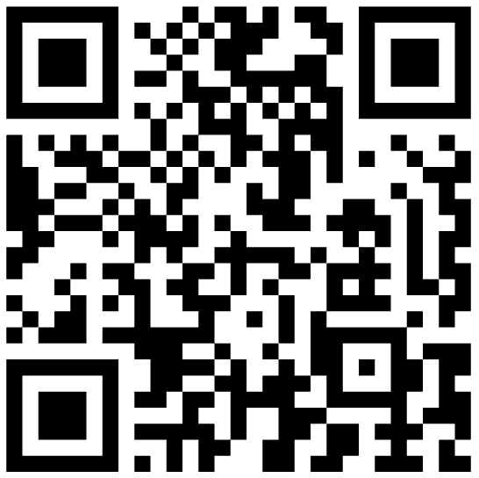
What Pharmacy Career is right for you?
SCAN THE
QR CODE
Take the Pharmacy Career Quiz.
yourpharmacist.org/quiz

Slide 3
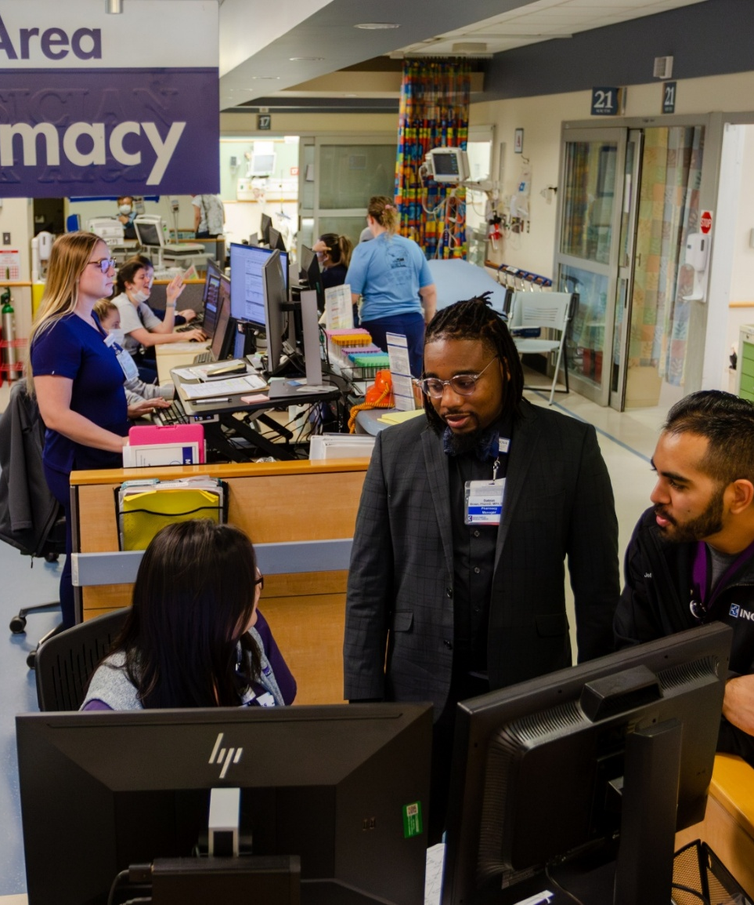
Pharmacy Careers exist everywhere healthcare exists
💊 Community
  CVS, Walgreens, Independents, etc.
🏥 Health-System/Hospital
  Intensive Care Unit (ICU), Emergency Room, etc.
🥼 Ambulatory
  Cardiology (heart) clinics, Pulmonary (lung) clinics, etc.
🌏 Public Health
  Government, Indian Health Service, etc.
🏫 Education
  Colleges of Pharmacy
🏢 Industry
  Pfizer, Johnson & Johnson, Moderna, etc.
🎖️ National Defense
  Army, Navy, Air Force, National Guard, etc.
Notes:
FYI – the Marine Corps does not have their own pharmacists, their pharmacy services are provided by the U.S. Navy

Slide 4

Meet the Pharmacy Team
Pharmacist
Medication expert & healthcare leader
Pharmacy Technician
Keeps the pharmacy running safely and efficiently
What they focus on:
Makes clinical decisions about medications
Checks for safety, allergies, and drug interactions
Communicates with doctors, nurses, patients, and families
What they focus on:
Prepares prescriptions and medications
Helps with insurance and access
Manages workflow and inventory
Pharmacists and technicians WORK TOGETHER
to keep patients safe

Slide 5
Community Pharmacist
💊
WHERE THEY WORK:
CVS, Walgreens, grocery store pharmacies, independent hometown pharmacies, etc.
WHAT THEY DO:
✅ Check for medication safety issues and interactions
🔍 Solve insurance/medication access issues
💬 Educate patients on prescriptions
📋 Help manage diabetes, blood pressure, and other chronic diseases
WHY IT’S IMPORTANT:
Community pharmacists are often the first healthcare professional someone sees – making them key in early detection, prevention, and education!
TEAM SNAPSHOT
Pharmacist: Clinical decisions, counseling
Technician: Prescription preparation, insurance support, patient flow
Notes:
Speaker: Explain what an independent pharmacy is

Slide 6
Community Pharmacy Technician
💊
WHAT THEY DO:
🖥️ Enter and prepare prescriptions
💊 Handle insurance payments and prior authorizations
📦 Manage inventory, audits, returns, and over-the-counter medications
💉 Administer vaccines (with proper training and depending on state law)
WHY IT’S IMPORTANT:
Technicians provide support to pharmacists so that pharmacists can focus on clinical decision making.
🤝
Team
📆
Schedule
🌟
Personality Traits
Notes:
Community technicians also compound at certain locations

Slide 7
Health-System/Hospital Pharmacist
🏥
WHERE THEY WORK:
Local hospitals, large medical centers, children’s hospitals, trauma centers, etc.
WHAT THEY DO:
🤝 Round with doctors and nurses in the ICU, ER, and surgery
🧠 Manage complex patient cases and dosing medications based on lab values
🛡️ Design protocols, educate staff, and ensure medication safety
📣 Communicate medication plans across the care team
WHY IT’S IMPORTANT:
Hospital pharmacists are medication experts who work with a clinical team, ensuring every drug decision in the hospital is safe, accurate, and personalized.
TEAM SNAPSHOT
Physician: Diagnoses illness, orders medication
Pharmacist: Helps select most appropriate medications, ensures medication safety
Technician: Prepares IV medications, manages medication distribution
Nurse: Administers medication & monitors patients

Slide 8
Health- System/Hospital Pharmacy Technician
🏥
WHAT THEY DO:
🧪 Compound IV medications
📦 Stock and deliver medications
📋 Manage medication inventory, medication shortages, removal of expired/recalled medications
🌎 Perform medication history assessments
WHY IT’S IMPORTANT:
Hospital pharmacy technicians are essential to safe medication delivery and teamwork, helping pharmacists spend more time on direct patient care.
🤝
Team
📆
Schedule
🌟
Personality Traits

Slide 9

Pharmacists Specialize Too – Just like Physicians!
DID YOU KNOW?
Cardiology ❤️
Critical Care 🏥
Emergency Medicine 🚑
Oncology 🎗️
Infectious Diseases 🦠
Informatics 💻
Pediatrics 👩‍👦
Psychiatry 🧠
Transplant 🚨
  FUN FACT
  Qualified pharmacists are also able to get Board Certified!
Notes:
Highlight career diversity—can match interests with specialties.

Slide 10
Ambulatory Clinic Pharmacists
🥼
WHERE THEY WORK:
Pediatric clinics, primary care clinics, cardiology clinics, diabetes centers, oncology infusion centers, geriatric ambulatory care clinics
WHAT THEY DO:
🤝 Partner with providers to fine-tune medication treatment plans
📊 Review labs and health data
📋 Adjusts medications
🧑‍🤝‍🧑 Counsels patients one-on-one
COMPARE TO HOSPITAL:
Ambulatory = long-term management
Hospital = short-term critical care
🤝
Team
📆
Schedule
🌟
Personality Traits
Notes:
Clinic pharmacists don’t fill prescriptions.
They focus on patient counseling, reviewing labs, adjusting medications, and working closely with providers over time to help patients reach their health goals.

Slide 11
Public Health/Government
🌏
WHERE THEY WORK:
Health departments, CDC, FDA, VA health system, community health programs
WHAT THEY DO:
Improve vaccination access
Manage disease outbreaks
Ensure medication quality and safety nationwide
Compare to Community/Hospital:
Population-level impact instead of individual patient care

Slide 12



National Defense
🎖️
WHERE THEY WORK:
Army, Navy, and Air Force
WHAT THEY DO:
    Field Operations: pharmacy operations in field hospitals during deployments
    Research: aimed at improving healthcare and medical outcomes of soldiers
    Sea Duty: serving aboard aircraft carriers or hospital ships
    Humanitarian Missions: participating in global public health initiatives and humanitarian relief operations
    Aeromedical Evacuation: prepare medications for patients undergoing air transport
    Technical Innovation: Managing high-tech pharmacies that use advanced automation
Notes:
Most of the time, National Defense pharmacists have clinical duties identical to civilian pharmacists – managing pharmaceutical care, advise medical leadership, dispensing medications, educating patients, etc.
Talking point if mentioned:
* Pharmacists can get deployed, but it depends on the rank and station

Slide 13
Colleges/Universities
🏫
WHERE THEY WORK:
Schools of pharmacy, healthcare training programs
WHAT THEY DO:
Teach future pharmacists and technicians
Conduct research
Mentor the next generation of healthcare providers
Some teach and work in a health-system
COMPARE TO ALL OTHERS:
Focus on training and knowledge growth rather than daily patient encounters

Slide 14
Poison Control & Toxicology Pharmacist
☎️
WHERE THEY WORK:
poison control centers, hospitals, emergency response systems, public health agencies
WHAT THEY DO:
Answer emergency calls about poisonings/overdoses
Guide doctors and nurses on treatment during emergencies
Experts in toxicology (the study of poisons and their effects on the body)
WHY IT’S IMPORTANT
Poison control pharmacists stay calm under pressure and help save lives with expert advice – often over the phone
TEAM SNAPSHOT
Caller/Family
Poison Control Pharmacist
Physician/ER Team
EMS
Notes:
Some pharmacists work in poison control centers. When someone swallows something dangerous, takes the wrong medication, or gets bitten by a venomous animal, these pharmacists help families and healthcare teams know exactly what to do. They make quick decisions, often during stressful emergencies.
Toxicology is the study of poisons – and poison control pharmacists are experts in this area.

Slide 15
Research/Pharmaceutical Industry
🏢
WHERE THEY WORK:
Pharmaceutical companies, clinical trials, drug development labs
WHAT THEY DO:
Help discover and test new medications
Work on medical affairs, drug safety, regulatory science
Analyze clinical data
COMPARE TO CLINICAL ROLES:
More science/technology focused
Less direct patient care

Slide 16
Healthcare Careers:
Schooling, Teamwork & Pay
Different paths. Same healthcare team.
Career | Typical School Length* | General Salary Range**
Pharmacy Technician | 6 months – 1 year (training + certification) | $32,000 – 57,000
Registered Nurse (RN) | 2-4 years (ADN or BSN) | $65,000 – 132,000
Pharmacist (PharmD) | 6-8 years total (pre-pharmacy + PharmD) | $90,000 – $168,000
Family Medicine Physician | 10-11 years total (college + med school + residency) | $69,000 – $250,000
Notes:
Different paths. Same healthcare team.
All of these roles work together every day
More schooling often means higher pay, but also more time and debt
Pharmacy offers a strong balance of science, leadership, and patient impact
Pharmacy technicians can enter healthcare quickly and grow from there

Slide 17
Path to Becoming a Pharmacy Technician
Starting Right After High School
Starting After You’ve Begun Another Career
High School or GED
Begin working in a Community or Hospital Pharmacy
Optional: Pass a National Certification Exam
Pharmacy Technician Training Program
Begin working in a Community or Hospital Pharmacy
Optional: Pass a National Certification Exam
Pharmacy Technician Training Program
  FUN FACT:
  If you want to get exposure ASAP, you can work as a pharmacy clerk during high school!
Notes:
Speaker Notes:
If you want to become a pharmacy technician right after high school, some schools have programs to become a pharmacy technician
If not, you can complete a pharmacy technician training program through vocational school, community college, or employer training
Some states require you to take the National Certification Exam while others do not
If you change your mind in the future and want to become a pharmacy technician later in your career, there are often evening, online, or employer-supported pharmacy technician training or certification programs you can enroll in – You do not need to decide now

Slide 18
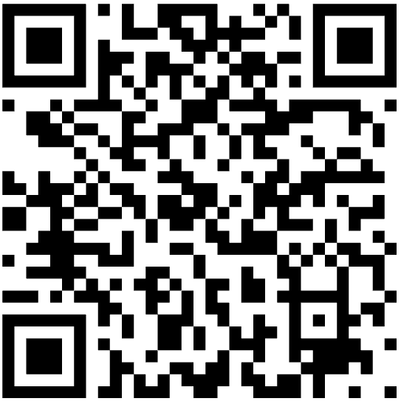
Pharmacy Technician Information
Study Materials for Pharmacy Technicians
Example Requirements for California
Each state has a different requirement
Check your state’s Board of Pharmacy website for more information
Scan to find your state’s Board of Pharmacy website here:
Must be at least 18 years old and have a high school diploma or GED
Must complete one of the following training or certification:
  Complete a pharmacy technician training program accredited by ASHP or approved by the Board
  Obtain a national certification from the Pharmacy Technician Certification Board (PTCB) or National Healthcareer Association (ExCPT)
  Complete training provided by a federal armed services branch
Notes:
Some states, such as California, also require you to have a background check.

Slide 19
Additional Pharmacy Technician Information
Study Materials for Pharmacy Technicians
Example Requirements for Indiana
Each state has a different requirement
Check your state’s Board of Pharmacy website for more information
Scan to find your state’s Board of Pharmacy website here:
Must be a high school graduate/have a GED
Must complete one of the following board-approved programs:
  A comprehensive curricular-based education and training program conducted by a pharmacy or educational organization
  A technician training program from the employer
  Board-approved certification exam

Slide 20
Paths to Becoming a Pharmacist
Path 1
Path 2
Path 3
High School
Accelerated PharmD Program (6-7 years)
Optional: Residency or Fellowship
High School
Pre-requisite Courses (2-4 years)
PharmD (3-4 years)
Optional: Residency or Fellowship
High School
Bachelor’s Degree (4 years)
PharmD (3-4 years)
Optional: Residency or Fellowship
  FUN FACT:
  Many schools offer dual degree options
  (PharmD plus a graduate/professional degree)
Notes:
Note for Presenter: Share your pathway
Dual degree pharmacy programs allow you to gain specialized skills, often saving time and money by overlapping the curriculums. Some common dual degree options includes a PharmD with a Masters of Business Administration to better understand the business, a Masters of Public Health to pursue a career in population health, or even a PhD to go into research or industry.

Slide 21
Advanced Training after PharmD
Pharmacy Residency
Advanced patient care training
Pharmacy Fellowship
Specialized leadership & research training
1-2 years
Hands-on clinical experience
  Spend 1-2 months in different areas (internal medicine, emergency medicine, ICU, pediatrics, med-surg, etc.) of the hospital to develop experience
Works directly with patients and healthcare teams
1-2 years
Focus on research, industry, policy, or academia
  Different functional areas: medical affairs, regulatory affairs, clinical development, pharmacovigilance, etc.
Less direct patient care, more systems-level impact
Both paths build leadership, expertise, and career opportunities – just in different ways!

Slide 22
Getting Ready for a Career in Pharmacy
BUILD A STRONG
ACADEMIC FOUNDATION
Take science classes (biology, chemistry, AP if available)
Develop strong stud y habits and time management
Maintain a solid GPA
DEVELOP KEY SKILLS – MATTER JUST AS MUCH AS GRADES!
Communication & teamwork
Relationship-building
Problem-solving
PLAN YOUR PATH
Consider pre-pharmacy or pre-health organizations in college
Research pharmacy schools and program options
Look into scholarships and financial planning
There is no “perfect” path, many routes can lead to pharmacy.
Notes:
These are some things you can start doing now.
The PCAT is no longer required to apply to pharmacy school.
Focus on being a well-rounded student – strong academically, involved, and curious about healthcare.

Slide 23
How You Can Explore Pharmacy Now
Pharmacy Programs and Camps
ASHP Student Website
  yourpharmacist.org/students
HOSA Pharmacy Science Competition
Pharmacy Technician certification
Talk to your local pharmacist or pharmacy technician
  Ask to shadow

Slide 24
The Pharmacy Files:
Thank You!

