Slide 1
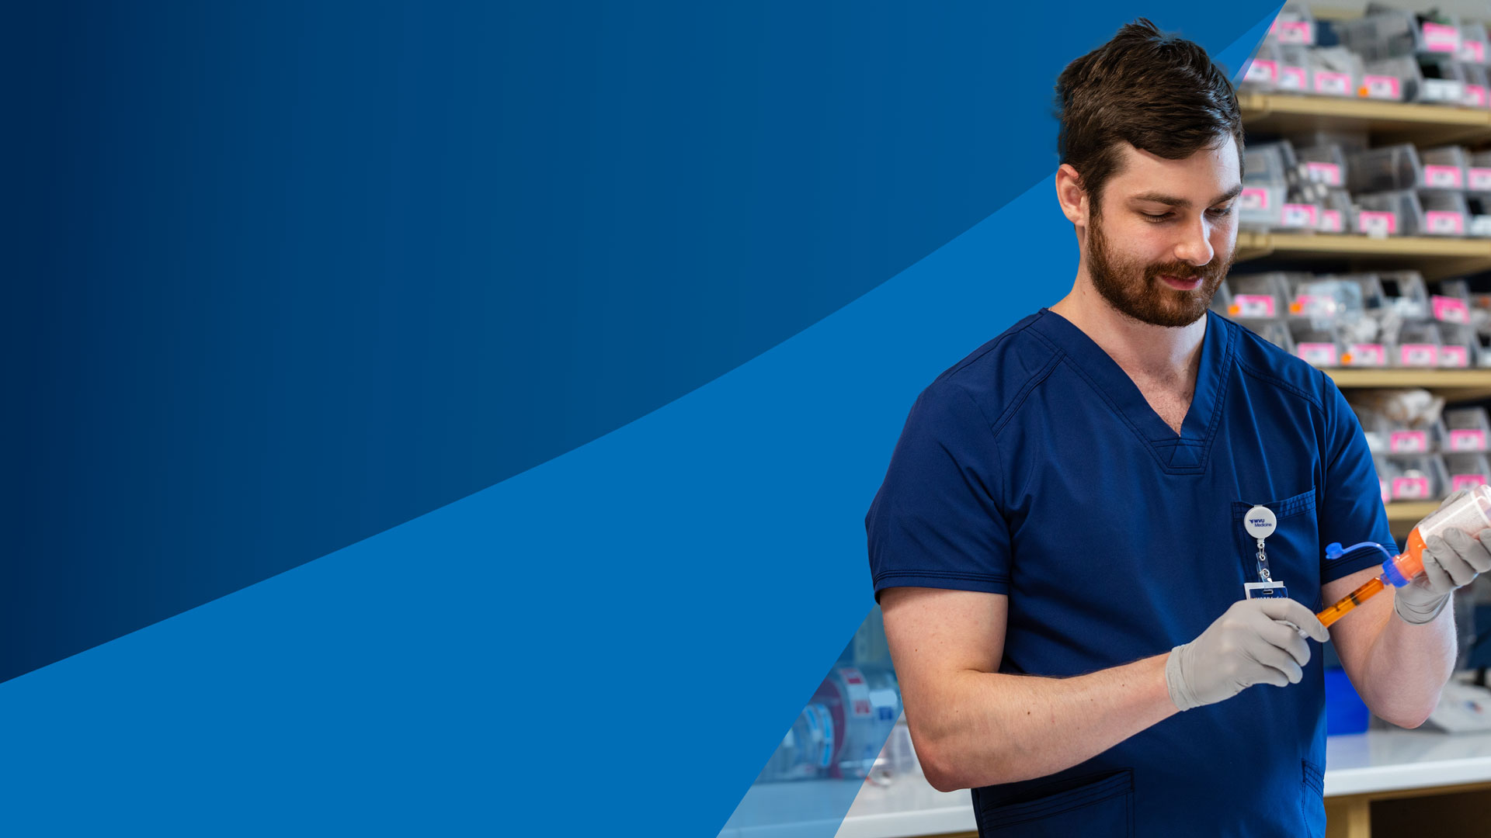
Pharmacy Careers Beyond Expectations
DID YOU KNOW?
Presented by:

Slide 2
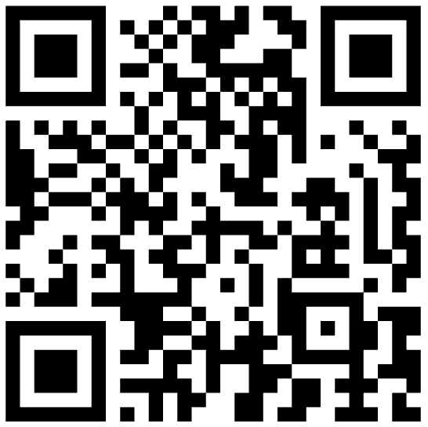
What Pharmacy Career is right for you?
SCAN THE
QR CODE
Take the Pharmacy Career Quiz.
yourpharmacist.org/quiz

Slide 3
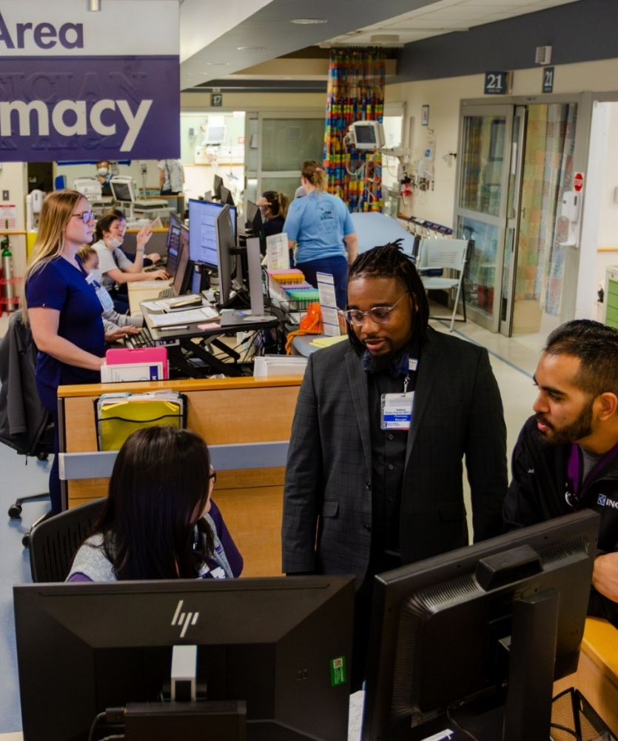
Pharmacy Careers exist everywhere healthcare exists
💊 Community
  CVS, Walgreens, Independents, etc.
🏥 Health-System/Hospital
  Intensive Care Unit (ICU), Emergency Room, etc.
🥼 Ambulatory
  Cardiology (heart) clinics, Pulmonary (lung) clinics, etc.
🌏 Public Health
  Government, Indian Health Service, etc.
🏫 Education
  Colleges of Pharmacy
🏢 Industry
  Pfizer, Johnson & Johnson, Moderna, etc.
🎖️ National Defense
  Army, Navy, Air Force, National Guard, etc.

Slide 4

Meet the Pharmacy Team
Pharmacist
Medication expert & healthcare leader
Pharmacy Technician
Keeps the pharmacy running safely and efficiently
WHAT THEY FOCUS ON:
Makes clinical decisions about medications
Checks for safety, allergies, and drug interactions
Communicates with doctors, nurses, patients, and families
WHAT THEY FOCUS ON:
Prepares prescriptions and medications
Helps with insurance and access
Manages workflow and inventory
Pharmacists and technicians WORK TOGETHER
to keep patients safe

Slide 5
Community Pharmacist
💊
WHERE THEY WORK:
CVS, Walgreens, grocery store pharmacies, independent hometown pharmacies, etc.
WHAT THEY DO:
✅ Check for medication safety issues and interactions
🔍 Solve insurance/medication access issues
💬 Educate patients on prescriptions
📋 Help manage diabetes, blood pressure, and other chronic diseases
WHY IT’S IMPORTANT:
Community pharmacists are often the first healthcare professional someone sees – making them key in early detection, prevention, and education!
TEAM SNAPSHOT
Pharmacist: Clinical decisions, counseling
Technician: Prescription preparation, insurance support, patient flow

Slide 6
Community Pharmacy Technician
💊
WHAT THEY DO:
🖥️ Enter and prepare prescriptions
💊 Handle insurance payments and prior authorizations
📦 Manage inventory, audits, returns, and over-the-counter medications
💉 Administer vaccines (with proper training and depending on state law)
WHY IT’S IMPORTANT:
Technicians provide support to pharmacists so that pharmacists can focus on clinical decision making.
🤝
Team
📆
Schedule
🌟
Personality Traits

Slide 7
Health-System/Hospital Pharmacist
🏥
WHERE THEY WORK:
Local hospitals, large medical centers, children’s hospitals, trauma centers, etc.
WHAT THEY DO:
🤝 Round with doctors and nurses in the ICU, ER, and surgery
🧠 Manage complex patient cases and dosing medications based on lab values
🛡️ Design protocols, educate staff, and ensure medication safety
📣 Communicate medication plans across the care team
WHY IT’S IMPORTANT:
Hospital pharmacists are medication experts who work with a clinical team, ensuring every drug decision in the hospital is safe, accurate, and personalized.
TEAM SNAPSHOT
Physician: Diagnoses illness, orders medication
Pharmacist: Helps select most appropriate medications, ensures medication safety
Technician: Prepares IV medications, manages medication distribution
Nurse: Administers medication & monitors patients

Slide 8
Health- System/Hospital Pharmacy Technician
🏥
WHAT THEY DO:
🧪 Compound IV medications
📦 Stock and deliver medications
📋 Manage medication inventory, medication shortages, removal of expired/recalled medications
🌎 Perform medication history assessments
WHY IT’S IMPORTANT:
Hospital pharmacy technicians are essential to safe medication delivery and teamwork, helping pharmacists spend more time on direct patient care.
🤝
Team
📆
Schedule
🌟
Personality Traits

Slide 9

Pharmacists Specialize Too – Just like Physicians!
DID YOU KNOW?
Cardiology ❤️
Critical Care 🏥
Emergency Medicine 🚑
Oncology 🎗️
Infectious Diseases 🦠
Informatics 💻
Pediatrics 👩‍👦
Psychiatry 🧠
Transplant 🚨
  FUN FACT
  Qualified pharmacists are also able to get Board Certified!

Slide 10
Ambulatory Clinic Pharmacists
🥼
WHERE THEY WORK:
Pediatric clinics, primary care clinics, cardiology clinics, diabetes centers, oncology infusion centers, geriatric ambulatory care clinics
WHAT THEY DO:
🤝 Partner with providers to fine-tune medication treatment plans
📊 Review labs and health data
📋 Adjusts medications
🧑‍🤝‍🧑 Counsels patients one-on-one
COMPARE TO HOSPITAL:
Ambulatory = long-term management
Hospital = short-term critical care
🤝
Team
📆
Schedule
🌟
Personality Traits

Slide 11
Public Health/Government
🌏
WHERE THEY WORK:
Health departments, CDC, FDA, VA health system, community health programs
WHAT THEY DO:
Improve vaccination access
Manage disease outbreaks
Ensure medication quality and safety nationwide
Compare to Community/Hospital:
Population-level impact instead of individual patient care

Slide 12



National Defense
🎖️
WHERE THEY WORK:
Army, Navy, and Air Force
WHAT THEY DO:
    Field Operations: pharmacy operations in field hospitals during deployments
    Research: aimed at improving healthcare and medical outcomes of soldiers
    Sea Duty: serving aboard aircraft carriers or hospital ships
    Humanitarian Missions: participating in global public health initiatives and humanitarian relief operations
    Aeromedical Evacuation: prepare medications for patients undergoing air transport
    Technical Innovation: Managing high-tech pharmacies that use advanced automation

Slide 13
Colleges/Universities
🏫
WHERE THEY WORK:
Schools of pharmacy, healthcare training programs
WHAT THEY DO:
Teach future pharmacists and technicians
Conduct research
Mentor the next generation of healthcare providers
Some teach and work in a health-system
COMPARE TO ALL OTHERS:
Focus on training and knowledge growth rather than daily patient encounters

Slide 14
Poison Control & Toxicology Pharmacist
☎️
WHERE THEY WORK:
poison control centers, hospitals, emergency response systems, public health agencies
WHAT THEY DO:
Answer emergency calls about poisonings/overdoses
Guide doctors and nurses on treatment during emergencies
Experts in toxicology (the study of poisons and their effects on the body)
WHY IT’S IMPORTANT
Poison control pharmacists stay calm under pressure and help save lives with expert advice – often over the phone
TEAM SNAPSHOT
Caller/Family
Poison Control Pharmacist
Physician/ER Team
EMS

Slide 15
Research/Pharmaceutical Industry
🏢
WHERE THEY WORK:
Pharmaceutical companies, clinical trials, drug development labs
WHAT THEY DO:
Help discover and test new medications
Work on medical affairs, drug safety, regulatory science
Analyze clinical data
COMPARE TO CLINICAL ROLES:
More science/technology focused
Less direct patient care

Slide 16
Healthcare Careers:
Schooling, Teamwork & Pay
Different paths. Same healthcare team.
Career | Typical School Length* | General Salary Range**
Pharmacy Technician | 6 months – 1 year (training + certification) | $32,000 – 57,000
Registered Nurse (RN) | 2-4 years (ADN or BSN) | $65,000 – 132,000
Pharmacist (PharmD) | 6-8 years total (pre-pharmacy + PharmD) | $90,000 – $168,000
Family Medicine Physician | 10-11 years total (college + med school + residency) | $69,000 – $250,000

Slide 17
Path to Becoming a Pharmacy Technician
Starting Right After High School
Starting After You’ve Begun Another Career
High School or GED
Begin working in a Community or Hospital Pharmacy
Optional: Pass a National Certification Exam
Pharmacy Technician Training Program
Begin working in a Community or Hospital Pharmacy
Optional: Pass a National Certification Exam
Pharmacy Technician Training Program
  FUN FACT:
  If you want to get exposure ASAP, you can work as a pharmacy clerk during high school!

Slide 18
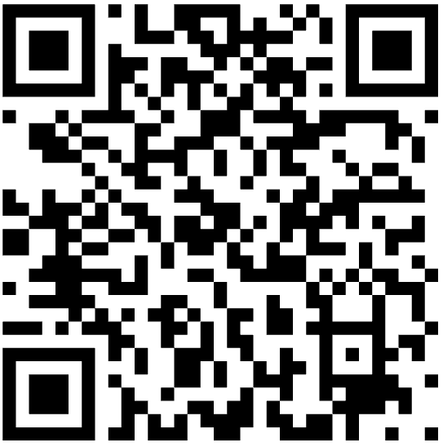
Additional Pharmacy Technician Information
Study Materials for Pharmacy Technicians
Example Requirements for Indiana
Each state has a different requirement
Check your state’s Board of Pharmacy website for more information
Scan to find your state’s Board of Pharmacy website here:
Must be a high school graduate/have a GED
Must complete one of the following board-approved programs:
  A comprehensive curricular-based education and training program conducted by a pharmacy or educational organization
  A technician training program from the employer
  Board-approved certification exam

Slide 19
Paths to Becoming a Pharmacist
Path 1
Path 2
Path 3
High School
Accelerated PharmD Program (6-7 years)
Optional: Residency or Fellowship
High School
Pre-requisite Courses (2-4 years)
PharmD (3-4 years)
Optional: Residency or Fellowship
High School
Bachelor’s Degree (4 years)
PharmD (3-4 years)
Optional: Residency or Fellowship
  FUN FACT:
  Many schools offer dual degree options
  (PharmD plus a graduate/professional degree)

Slide 20
Advanced Training after PharmD
Pharmacy Residency
Advanced patient care training
Pharmacy Fellowship
Specialized leadership & research training
1-2 years
Hands-on clinical experience
  Spend 1-2 months in different areas (internal medicine, emergency medicine, ICU, pediatrics, med-surg, etc.) of the hospital to develop experience
Works directly with patients and healthcare teams
1-2 years
Focus on research, industry, policy, or academia
  Different functional areas: medical affairs, regulatory affairs, clinical development, pharmacovigilance, etc.
Less direct patient care, more systems-level impact
Both paths build leadership, expertise, and career opportunities – just in different ways!

Slide 21
Getting Ready for a Career in Pharmacy
BUILD A STRONG
ACADEMIC FOUNDATION
Take science classes (biology, chemistry, AP if available)
Develop strong stud y habits and time management
Maintain a solid GPA
DEVELOP KEY SKILLS – MATTER JUST AS MUCH AS GRADES!
Communication & teamwork
Relationship-building
Problem-solving
PLAN YOUR PATH
Consider pre-pharmacy or pre-health organizations in college
Research pharmacy schools and program options
Look into scholarships and financial planning
There is no “perfect” path, many routes can lead to pharmacy.

Slide 22
How You Can Explore Pharmacy Now
Pharmacy Programs and Camps
ASHP Student Website
  yourpharmacist.org/students
HOSA Pharmacy Science Competition
Pharmacy Technician certification
Talk to your local pharmacist or pharmacy technician
  Ask to shadow

Slide 23
Game: Jeopardy
Let’s test your knowledge!

Slide 24
Jeopardy – Before We Begin
Let’s get into teams of 4-6 students per team
Pick a Team Name
Determine which team will start
Good Luck!

Slide 25

Jeopardy
Where do Pharmacists Work? | The Healthcare Team | A Day in the Life | Paths & Careers
100 | 100 | 100 | 100
200 | 200 | 200 | 200
300 | 300 | 300 | 300
400 | 400 | 400 | 400
End Game

Slide 26
Do not edit
How to change the design
CVS and Walgreens are examples of which pharmacy setting?
The Slido app must be installed on every computer you’re presenting from

Slide 27
Great Job!
Click the Home Button to go back to the game board.

Slide 28
Do not edit
How to change the design
Pharmacists who work in the ICU, ER, or inpatient are practicing in which setting?
The Slido app must be installed on every computer you’re presenting from

Slide 29
Great Job!
Click the Home Button to go back to the game board.

Slide 30
Do not edit
How to change the design
Which pharmacy setting focuses on long-term management of chronic diseases?
The Slido app must be installed on every computer you’re presenting from

Slide 31
Great Job!
Click the Home Button to go back to the game board.

Slide 32
Do not edit
How to change the design
Which pharmacy career focuses mainly on educating future pharmacy students
The Slido app must be installed on every computer you’re presenting from

Slide 33
Great Job!
Click the Home Button to go back to the game board.

Slide 34
Do not edit
How to change the design
Which pharmacy team member prepares prescriptions and helps with insurance issues?
The Slido app must be installed on every computer you’re presenting from

Slide 35
Great Job!
Click the Home Button to go back to the game board.

Slide 36
Do not edit
How to change the design
In a hospital, who diagnoses illness and orders medications?
The Slido app must be installed on every computer you’re presenting from

Slide 37
Great Job!
Click the Home Button to go back to the game board.

Slide 38
Do not edit
How to change the design
Who administers medications and monitors patients in the hospital?
The Slido app must be installed on every computer you’re presenting from

Slide 39
Great Job!
Click the Home Button to go back to the game board.

Slide 40
Do not edit
How to change the design
Which pharmacy team member counsels patients on their prescriptions?
The Slido app must be installed on every computer you’re presenting from

Slide 41
Great Job!
Click the Home Button to go back to the game board.

Slide 42
Do not edit
How to change the design
Pharmacists can NOT specialize in a specific area of healthcare.
The Slido app must be installed on every computer you’re presenting from

Slide 43
Great Job!
Click the Home Button to go back to the game board.

Slide 44
Do not edit
How to change the design
Hospital pharmacists focus mainly on which part of patient care?
The Slido app must be installed on every computer you’re presenting from

Slide 45
Great Job!
Click the Home Button to go back to the game board.

Slide 46
Do not edit
How to change the design
Community pharmacists are often the ____ healthcare professional a patient sees.
The Slido app must be installed on every computer you’re presenting from

Slide 47
Great Job!
Click the Home Button to go back to the game board.

Slide 48
Do not edit
How to change the design
Emergency Medicine Pharmacists may do what during hospital codes?
The Slido app must be installed on every computer you’re presenting from

Slide 49
Great Job!
Click the Home Button to go back to the game board.

Slide 50
Do not edit
How to change the design
Pharmacy technicians can often enter the profession in:
The Slido app must be installed on every computer you’re presenting from

Slide 51
Great Job!
Click the Home Button to go back to the game board.

Slide 52
Do not edit
How to change the design
Which advanced post-graduate training focuses on hands-on patient care after pharmacy school?
The Slido app must be installed on every computer you’re presenting from

Slide 53
Great Job!
Click the Home Button to go back to the game board.

Slide 54
Do not edit
How to change the design
Which advanced post-graduate training focuses on research, leadership, and industry roles?
The Slido app must be installed on every computer you’re presenting from

Slide 55
Great Job!
Click the Home Button to go back to the game board.

Slide 56
Do not edit
How to change the design
Which educational pathway is the fastest to take if you know pharmacy is your calling?
The Slido app must be installed on every computer you’re presenting from

Slide 57
Great Job!
Click the Home Button to go back to the game board.

Slide 58
Thank You!

