Slide 1
A Guide to Effective Utilization for Pharmacy Students
Notes:
This is a PowerPoint template that your SSHP may use. This is YOUR SSHP and we want you to highlight past achievements and upcoming events for your current members and for the students you are recruiting. Add pictures of officers and the faculty advisor. Insert slides amongst the slides already present. Make the necessary modifications to fit your SSHP’s individual needs.

Slide 2
AGENDA
Overview of ASHP Connect
Features
Top Initiatives
Networking and Engagement
FAQs

Slide 3
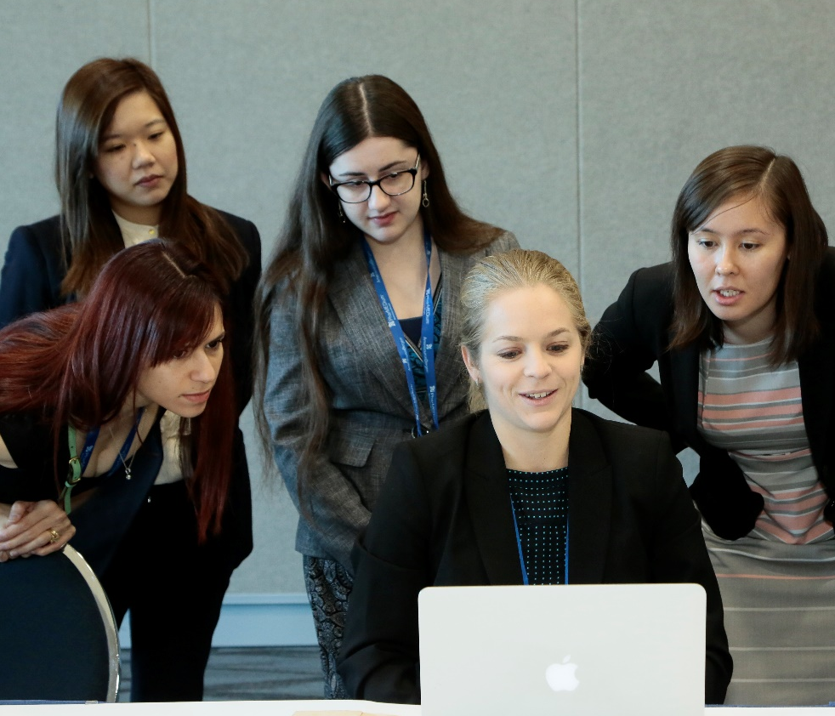
What is ASHP Connect?
An online community free of charge to ASHP members
Designed for students, new practitioners, clinical specialists, and affiliates at all levels to connect, communicate, and learn together
Opportunities for national committee involvement
Notes:
1. ASHP Connect is an online community available free of charge to ASHP members. This service allows ASHP members, including students and practitioners, to network and communicate on a professional level.

Slide 4
Overview of ASHP Connect
Communicate with other Student Pharmacists
Sense of community
Idea sharing
Mentorship opportunities
Network with Professionals
Provides learning opportunities and broaden student knowledge

Slide 5
Vision Medication use will be optimal, safe, and effective for all people all of the time
Mission
To help people achieve optimal health outcomes
Notes:
ASHP helps its members achieve this mission by advocating and supporting the professional practice of pharmacists in hospitals, health systems, ambulatory clinics, and other settings spanning the full spectrum of medication use. ASHP serves its members as their collective voice on issues related to medication use and public health.

Slide 6
Features of ASHP Connect
Discussion Boards
Webinars
Membership Directory
Mentor Match
Notes:
There is a wealth of activity at ASHP Connect.

Slide 7
Top ASHP Initiatives
Practice Advancement Initiative
Clinician Well-Being and Resilience
Facilitate preparation of the pharmacy workforce
Notes:
ASHP Connect is the place to get the latest news on developments in various areas of pharmacy from the latest treatment protocols to changes in pharmacy student education.
Learn about PAI, one of ASHP’s largest initiatives, and how you can get involved in this movement.
PAI 2030: https://www.ashp.org/Pharmacy-Practice/PAI
Well-Being & You: https://wellbeing.ashp.org/

Slide 8
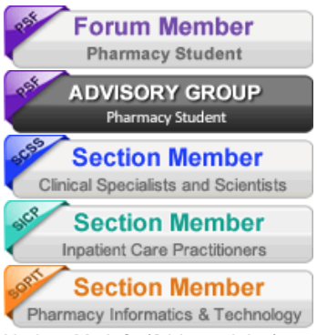
Networking and Engagement
Get involved with customizable subscriptions
Stay up-to-date with the latest news and discussions
Post your questions or ideas and get feedback
Engage in discussion boards
Notes:
ASHP Connect is a highly customizable and evolving tool for members. Member activity is what drives the community and as such there are opportunities to make suggestions for site expansion and changes to make the overall experience more worthwhile and enjoyable.
ASHP Connect is so expansive and diverse that there is a little something for everyone.

Slide 9
Frequently Asked Questions
FAQ Section located on the ASHP Connect home page
Notes:
https://connect.ashp.org/help/faqs?ssopc=1

Slide 10
National Leadership Opportunities
5 Advisory Groups
Advancement of Pharmacy Practice
Career & Leadership Development
Community and eCommunications
Policy & Legislative Advocacy
Student Society Development
Application deadline: May 1
Commitment
Live meeting at MCM (optional)
Frequent conference calls and emails

Slide 11
Thank you!
Visit: www.ashp.org/students
Email: students@ashp.org

