Slide 1


Tips for PhORCAS
Ed Evangelista
PharmD Candidate 2024
University of Arizona College of Pharmacy
ASHP Experiential Education Extern
Notes:
Welcome to ASHP’s webinar on PhORCAS
My name is Ed Evangelista, and I am a student extern at ASHP, and I am in my final year at the University of Arizona College of Pharmacy.
This webinar will provide an overview of the application timeline and tips for PhORCAS for students

Slide 2
Objectives
Establish expectations concerning the process of residency recruitment
Understand functionalities of PhORCAS to assist you with submitting residency applications
Explain the Two-Phase Match process
Understand how PhORCAS and The Match will interact
Identify pointers to help you effectively navigate the application portal in PhORCAS
Notes:
At the end of this presentation we hope you’ll be able to…. <<READ BULLETS>>
We hope that you will be able to gain a better understanding of both PhORCAS and The Match and be able to navigate the applicant portal of PhORCAS by the end of this presentation.

Slide 3
ASHP Role in Residency Training
Accreditation
Midyear Clinical Meeting
Residency Showcase
Personnel Placement Service (PPS)
Education sessions concerning the residency recruitment process, use of PhORCAS, and what to expect
PhORCAS
The Match
Notes:
ASHP is heavily involved with the residency training process through our Department of Accreditation Services that works on accrediting residencies and PhORCAS
Additionally, the organization as a whole supports the residency process through events like the residency showcase, the personal placement service or PPS, and various residency recruitment education programming including sessions concerning the recruitment process, use of PhORCAS, and what to expect. You will see many of these initiatives at the Midyear Clinical Meeting.

Slide 4

Goal
Streamline the residency recruitment process wherever possible to benefit:
Residency applicants
Residency programs
Reference writers
Image courtesy of adamr / FreeDigitalPhotos.net".
Notes:
The ultimate goal of PhORCAS is to streamline the residency recruitment process wherever possible to benefit residency applicants, residency programs, and reference writers.

Slide 5
Basics
PhORCAS is the result of a partnership between ASHP and Liaison International
Intent is to streamline residency application process
Similar to ‘PharmCAS’ used for pharmacy applications
Notes:
PhORCAS or The Pharmacy Online Residency Centralized Application Service is the platform that helps automate the entire residency application process, following ASHP’s guidelines & requirements.
PhORCAS is a product of Liaison International, a Boston company that specializes in centralized application services including PharmCAS, used by many of you in the admission process for pharmacy schools.

Slide 6

Applicant Portal
Application
  Applicant/personal information
  Academic Records
  Program Evaluations
Upload personal statement
Upload CV
Select references
Site-specific supplemental requirements
This Photo by Unknown Author is licensed under CC BY-SA
Notes:
There is an applicant video tutorial that goes through how to access and use the portal and it is a good idea to review before you apply.
This presentation will focus more on the components of each section of the application process, and any site-specific questions should be directed to PhORCAS
There are various components that interface within PhORCAS, but for the purposes of this presentation, we will be focusing on the Applicant Portal.
The applicant portal includes <<READ BULLETS>>
We will review each of the listed components in the following slide.

Slide 7
Applicant Process
You
(Applicant)
Create Account
Update Application Information
Upload Documents
Select 3 References
Submit Application
Notes:
As mentioned, the application process for residencies occurs through the PhORCAS portal. To complete it you have to follow several steps:
Step 1 -Create a PhORCAS account and sign up for the National Matching Service
Step 2 -Fill in application information requested in your profile, even it is included in your CV. Here you will Request official transcripts from your school to be sent via PhorCAS and is a change from previous years.
Step 3 –Upload your CVs, cover letters, and any site-specific documents (such as essay questions, questionnaires or other requirements as outlined on the website of the residency of your interest).
Double check that all your documents are final, labelled appropriately and free of errors prior to uploading
Step 4 -Select references that apply to your programs of interest – typically it is three letters, but programs may request additional ones based on their application requirements
Step 5 -Submit the final application to your selected sites
One online profile submission will be disseminated to multiple programs. Make sure that all uploaded documents that are personalized to your program are labeled correctly, to avoid confusion during the dissemination process.
The platform allows electronic tracking, to notify you of the application progress. You will know exactly what application components are pending and which reference writers have not submitted letters of reference.

Slide 8
Cost
Program | Cost
National Matching Service | $ 160 Flat Fee
PhORCAS (up to 4 applications) | $ 110
Each additional application | $ 43
Ex: Wilber wants to apply to 10 residency programs
  Wilber will pay $160 to NMS
  Wilber will pay $368 to PhORCAS {$110 + ($43 x 6)}
Notes:
Remember, the National Matching Service and PhORCAS are two different entities by two different companies. Both fees need to be paid to allow access to the portal and submission to the residency match.
To access the portal and initiate the application process, there are several fees that need to be provided.
The base fee is $160 for the National Matching Service. This is flat fee regardless of the number of applications or number of rankings that you submit, and allows you to access the Match.
There is an additional PhORCAS fee of $110 that covers up to 4 program applications. This fee is also standard regardless if you are applying to just one or all four programs.
- If you are interested in applying to more than 4 programs, each additional application is $43.

Slide 9
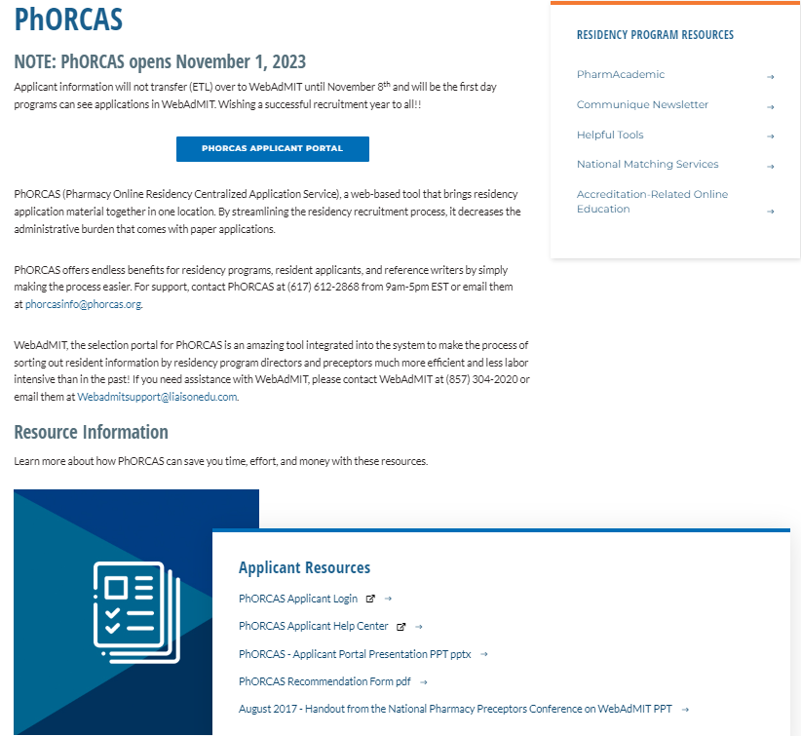
Access this page at: https://www.ashp.org/phorcas
Login here
Notes:
To initiate the process and access PhORCAS, start by visiting the website.
This webpage provides all the information you need about the application process, assistance with selecting and submitting for residency programs.
Once in the page, scroll down, under resource information, → applicant resources and click on ‘PhORCAS Applicant login’ or ‘PhORCAS Application Portal’ – this will direct you to the online application portal.
Please note PhORCAS opens Nov 1st, 2023

Slide 10
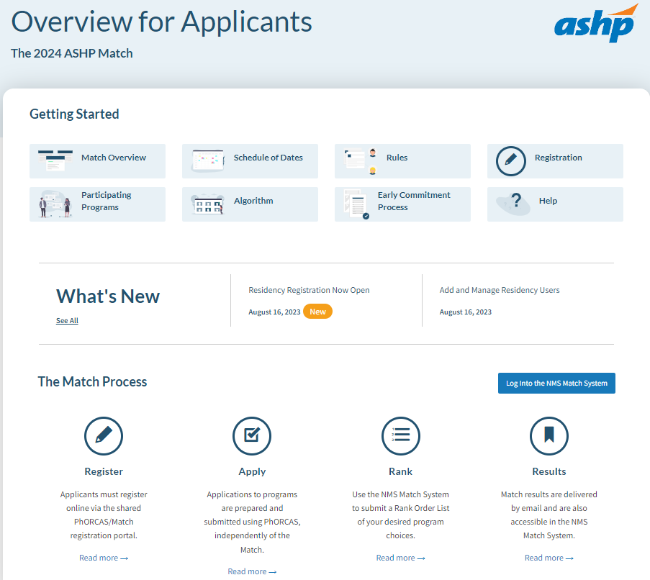
Start by Creating a New Account
Notes:
Here is a screenshot of the main page you will see as a student
As you may notice across the bottom, there are four main links.
1. Register: which will allow you to register online for PhORCAS.
2nd Apply: Apply to your programs of interest
3rd: Rank: This allows you to rank your programs
4th: Results: Here you can review the results of the match

Slide 11
Sign-On Tips
Do not create more than one account:
  If you have problems, do not start over, as we must work through the issues on that account. Contact PhORCAS staff if you need additional assistance.
Trouble signing-on? Check that you are using the correct portal link!
  If you Google “PhORCAS”, the applicant portal comes up first. Some of your reference writers will try to sign into the applicant portal instead of the generated link provided to them.
Reference Portal (Letters by Liaison): https://recommendations.liaisoncas.com/recommendation/ui/login
Applicant Portal: https://phorcas.liaisoncas.com/
Notes:
Now I will go over tips to help you with your application …..
I have links here for References and Applicants
Contact phorcas and not ASHP because they have staff to help you

Slide 12
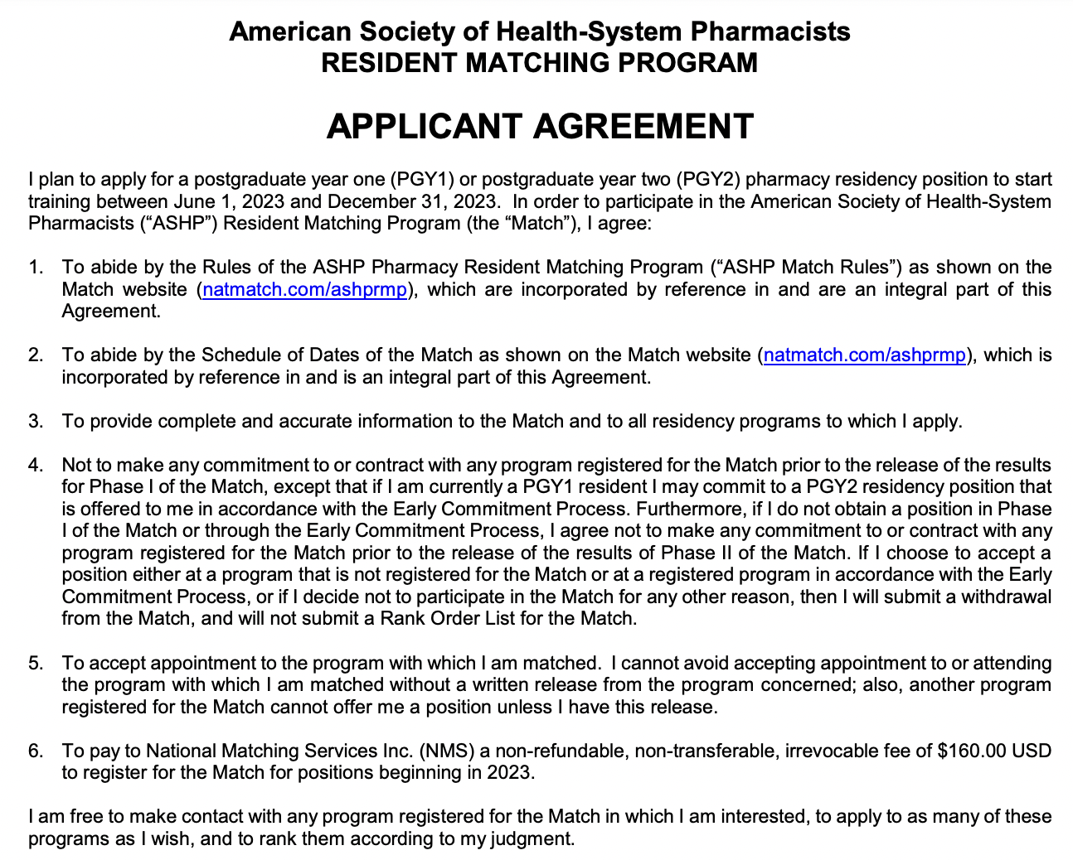
ASHP Match Rules & Eligibility
Each applicant must accept the Match Agreement when they register to participate in the Match. Make sure to read it thoroughly.
Notes:
Before entering the match, you must complete the applicant agreement listed on this page. Make sure you read it thoroughly to understand the conditions of participation in the match. As a reminder, each applicant must register to participate in the match.
Once you have reviewed the NMS materials carefully, the sign-up process occurs within PhORCAS. You will pay your PhORCAS and NMS fees described in a previous slide through PhORCAS.
INTERNAL COMMENT: This can be found via the link: https://natmatch.com/ashprmp/documents/applterms.pdf

Slide 13

Application Materials
National Matching Service (NMS) Code
  Must register for NMS before submitting applications in PhORCAS
    While NMS and PhORCAS are two separate entities, when entering the PhORCAS site originally, you will be transferred seamlessly to NMS to register/receive the code
  Automatically sent to you from NMS when you register and kept in your PhORCAS application
Notes:
The NMS applicant code will be provided after you register for the match online.
When you get your NMS number, a tip would be to include it in your CV so that the residency program can access that information easily
Note: each residency program has its own NMS code

Slide 14
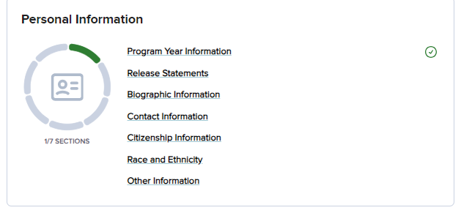
Personal Information
This section of the application only needs to be completed once and is saved for all programs you submit to
Collects important Demographics including address, phone, email, citizenship information, etc.
Notes:
As part of your application materials, you will be asked the following information:
Input your demographic information. This information is saved to your profile and will be submitted to each program to which you apply. As this is the only time you may be asked to input this information, you want to make sure the contact information is up to date, specifically email as most communication will come to the email provided. Make sure you select an email you check daily.

Slide 15
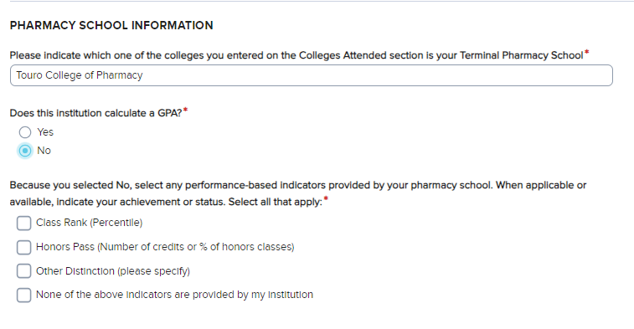
Academic Information
This section of the application will collect your Colleges Attended information
  You'll be able to request transcripts to be sent to PhORCAS under this section as well.
Additional Pharmacy School Information
  You'll be required to list your terminal Pharmacy School
  Report if your school collected a GPA, Class Rank, Honor Percentile, etc.
TIP: Do not wait for the end of the fall semester to request transcripts. Send current transcripts, then at the end of the semester you can request a newer version of the transcripts. This way, you meet the requirement of PhORCAS before offices close for holidays. Request transcripts in early November if possible!
Notes:
In a change from previous years, you can request a copy of your transcripts be sent directly to PhorCAS through the application process. If your Pharmacy College is from a foreign program, you will be contacted by PhORCAS to submit that information.
Only pharmacy transcripts are required
If your program has special requirements or a master’s component, please check and send in ALL of the transcripts they are looking for. For example, many programs combined with a masters may require all undergraduate transcripts.
TIP: Do not wait to request your transcripts, as this may impact the timing of your application.
Colleges may take a while to get transcripts in by due dates, and the holidays may affect this, so make sure you are on top of asking your college for your transcripts.
The emphasis on this tip is to be proactive; you don't want to delay your application b/c you are waiting for the College or University to send transcripts.
Also, applicants are in APPE rotations, so the didactic coursework & grades are posted to your transcript. If an updated transcript is requested by the program, you can do so.

Slide 16
Supporting Information
Achievements you wish to share with your programs
  Publications
  Scholarship
  Awards
  Presentations
Experiences you would like to share with your programs
  Internship
  Leadership Experiences
  Pharmacy Work Experiences
  Volunteer
Entering this data allows programs to search through candidates easily
Use your CV to complete this section!
Notes:
Supporting information: Here is where you want to add any additional information that you want programs to see. These include achievements and experiences that you worked on in pharmacy school.
Extracurricular and Professional activities can include - awards, leadership roles, presentations, publications, pharmacy related work experience, and community service.
Make sure to fill out all the extracurricular and professional activities sections → they might be looking for something specific and may skip over you even though it is included in your CV and not in this section of PhORCAS
Programs use this data to sort through applications

Slide 17
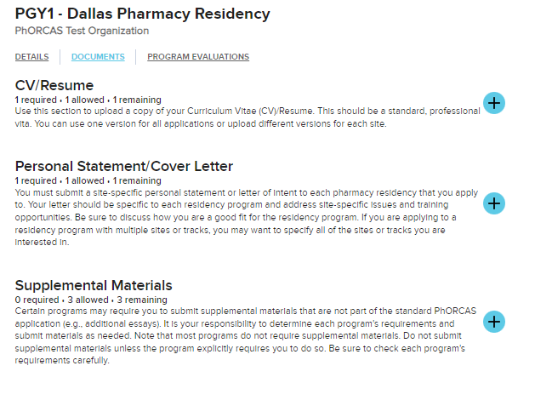
Program Materials - Documents
Any programs of interest that you add from the “Add Programs” tab will appear in this section
Upload your CV/Resume, Personal Statement/Cover Letter, and up to 3 supplemental Materials
  Supplemental materials are not required! If your program requires any additional uploads outside of what is collected in PhORCAS, this is to the place to upload that document!
Notes:
The Program Materials section in PhORCAS is available for you to upload any additional site-specific requirements of each program
Supplemental material is optional, and you should only include it when a program asks for it (only give the program what they want… they may not appreciate extra materials to review)
Make sure forms are shared in PDF format
PhoRCAS can handle all PDF uploads except for dynamic PDFs, password protected ones, or PDF portfolios
Generally, traditional PDF or Word documents are preferred
Also, you can customize your CV for each program that you are applying to if you like

Slide 18

Program Materials (cont.)
Personal Statement or Letter of Intent
  Should be customized to each program
  Identify if special questions need to be answered
  Create separate personal statements for each program you apply to
Image courtesy of adamr / FreeDigitalPhotos.net".
Notes:
As each program is unique in what it may offer, you may want to customize your LOI to that specific program. Its often a good idea to have multiple letters of intent that are specific to each program. You may wish to save each LOI with the program information included. For example, your letter could be named: edevangelistaABCresidencyprogram. This will make it easier to locate and upload the correct LOI to each program.
The programs will be able to download those files – so be sure to keep the identifiable file names professional… and include the program title as well

Slide 19
Reference Writer Communication
Three references per program are required in PhORCAS
  Some programs may require an additional reference
Notify References Before Selecting Them in PhORCAS
  Communicate what programs you are applying to
  Discuss the following scenarios:
    Reference writer is familiar with program and wants to send a personalized reference to them
    You are applying to uniquely different programs and want the reference letters to have a different emphasis (ex. PGY1 and admin program)
  Let the reference writer determine if they want to write program-specific or unique letter vs. the standard letter that goes to all programs
Notes:
3 references are required for each program you apply to. You can select different references for each program, or use the same references for all programs, it is your choice. PhORCAS can accept up to 4 references, but this should only be used by those program that require 4 references. Only send the amount of references the program has asked for.
You should notify the individual that you would like them to be a reference prior to sending them information in PhORCAS. In PhORCAS make sure you let them know the deadline and if they need to provide any additional information for a program.
Notify each reference writer in a timely manner​. Be sure to ask them before selecting them in phorcas as they will receive a notification
You will only be able to see that they uploaded the reference, NOT what it actually says
Make sure to ask them specifically what you want them to include or focus on such as leadership in an organization or clinical skills on a rotation
You are not limited on the number of reference writers you can request through PhORCAS for different programs​
However, you may only have up to 4 reference writers for each program application​
Requesting References
References will be asked to answer questions using a scale and open comments
Provide your reference writer a CV for reference
Follow up appropriately and provide the deadline date
Don’t forget to thank them!
The reference writers will not be allowed to upload a letter. They will have a small field where they can elaborate on an applicant but will not be able to put a letter in the field due to the character limit of the field.
You can select different references for each program, or use the same references for all programs, it is your choice. However, you may only have up to 4 reference writers for each program application

Slide 20
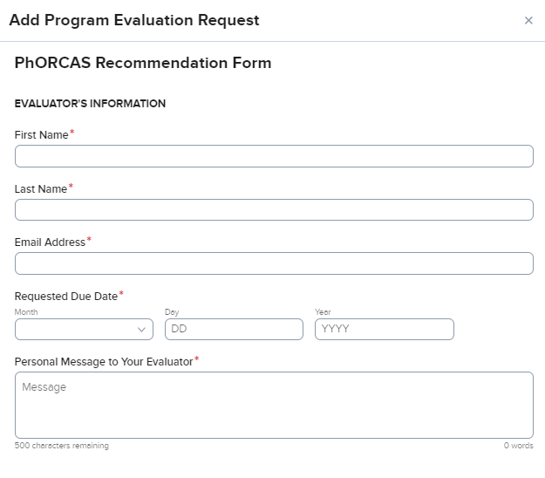
Requesting References in PhORCAS
Notify Reference Writer prior to requesting through PhORCAS
Make sure to communicate a deadline for the reference to be submitted
Include any personal messages you wish to share with your reference writer
Notes:
This is a screenshot of what the page looks like when you set up the reference request. You have the opportunity to send a personal message to your evaluator which will save time on having to send them a separate email.
As discussed on the last slide, you should notify the individual that you would like them to be a reference prior to sending them information through PhORCAS. Once they have confirmed, you can send them a request. Make sure you let them know the deadline and if they need to provide any additional information for a program. You can send multiple requests to each letter writer based on the specifications of each program.
This reference form is delivered electronically to your LOR writers. The Personal Message section would be the place to insert deadlines, specific information about the program, or items you want the reference writer to be aware of. The “Personal Message” is only seen by your identified LOR writers. It is designed to keep the info in one place instead of you sending a separate email.

Slide 21
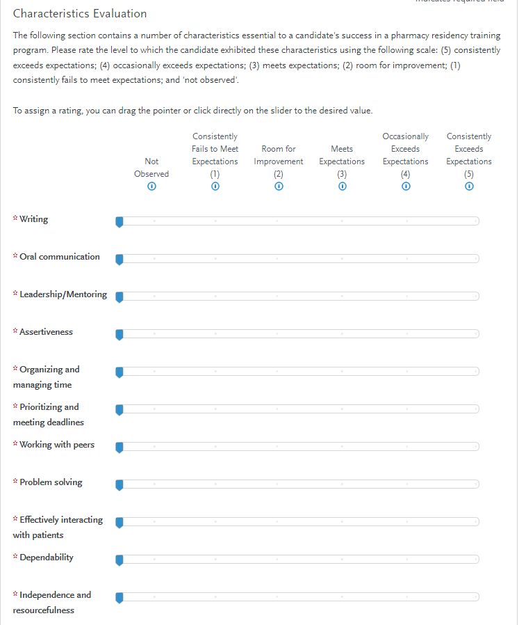
Sample Recommendation Form
Note that some programs may request a traditional reference letter in addition to this recommendation form.
Notes:
This is an example of the Recommendation Form
This form gives reference writers the ability to promote you in a variety of areas
Note that some programs may request a traditional reference letter in addition to this recommendation form
-Areas that reference writers may promote:
-Writing skills
-Oral communication skills
And others

Slide 22
Application Materials (cont.)
Application Deadline
  Unique to each program
  All materials must be submitted to program by that date
  Take care of all aspects of the applications that is under your control as early as possible
  No new application will go through after 11:59PM EST on application deadline
  PhORCAS will allow transcripts and reference to go through late as long as the application is in by the deadline
    Programs may or may not honor these late deliveries
  Can be controlled by program
    Can open and close window
Notes:
The portal to accept applications is controlled by the program and each program may have a different deadline requirement
Make sure to do your research beforehand
Deadlines are important, be cognizant
No new applications will go through after 11:59 PM EST on the application deadline
Don’t wait until last minute → If you wait until last minute and have trouble uploading… you may miss the program’s deadline
The things you cannot control can come in later- transcript and references.
You can still e-submit your application if your transcripts and reference are not uploaded yet
Programs can open and close their application window at any point

Slide 23
The Match
Notes:
Now that we’ve discussed the application process, we will go over the match process

Slide 24
2024 Match Conducted in Two Phases
Phase I:
All applicants and programs submit their Rank Order Lists by the Rank Order List deadline for Phase I of the Match.
The matching algorithm will be processed using those Rank Order Lists to place applicants into positions. The results of Phase I of the Match will then be distributed to applicants and programs.
Notes:
We will go over important dates for Phase I later.

Slide 25
2024 Match Conducted in Two Phases
Phase II:
Programs with unfilled positions in Phase I of the Match will offer those positions to unmatched applicants in Phase II of the Match.
All applicants seeking positions after Phase I and all programs with available positions after Phase I submit their Rank Order Lists by the Rank Order List deadline for Phase II of the Match. A second match will be carried out using those Rank Order Lists, and the results of Phase II of the Match will then be distributed.
Notes:
New programs or positions that receive funding after Phase I of the Match may also be added into Phase II of the Match, and applicants who did not participate in Phase I of the Match may participate in Phase II.

Slide 26
Post Match: The Scramble
After the results of Phase II of the Match are released, a Post-Match process will be implemented, in accordance with ASHP Match Rules, to assist applicants who are still seeking a residency to be placed into programs with positions available.
PhORCAS Adds Structure to the Scramble
  List of programs with available positions after Phase II of the Match will be provided on the Match web site beginning at 12:00 p.m. Eastern Time. Applicants who do not obtain a position in the Match will be able to use PhORCAS to prepare applications to programs that have positions available
  Programs will be able to update information on positions available after the Match on the Match website
Notes:
The unofficial third part of the Match

Slide 27
Timeline 2023-2024
November 1st, 2023 | Applicants can register in PhORCAS and sign up for NMS
March 1st, 2024 | Phase I MATCH: Rank order list due to NMS directly by 11:59 pm EST
March 13th | Phase I MATCH: Results released Available positions for Phase II are posted beginning at 12:00 p.m. Eastern Time
March 18th | Phase II MATCH: Applicants still seeking positions can submit applications
March 25th | Phase II MATCH: Rank order list can be submitted to NMS directly
April 3rd | Phase II MATCH: Rank order list due to NMS directly (Rank Order Lists for Phase II MATCH cannot be accepted after this date.)
April 10th | Phase II MATCH: Results released List of programs with available positions after Phase II of the Match will be provided on the Match web site beginning at 12:00 p.m. Eastern Time. Applicants who do not obtain a position in the Match will be able to use PhORCAS to prepare applications to programs that have positions available.
April 11th | Applicants can submit for post-match positions starting at 12pm EST, and sites can review these applications.
Source: https://natmatch.com/ashprmp/schedule.html
Notes:
Now I will go over the timeline for the upcoming Match. Please note this list does not have any information for specific program or deadlines. Please refer to the individual programs for final dates.
National matching service and PhORCAS opens for applicants on November 1st

Slide 28

2023 Statistics
6,895 registered for the match
6,019 participated in the match
Each applicant applied to an average of 10 programs
95.1% position fill rate (PGY1 and PGY2 combined data)
This Photo by Unknown Author is licensed under CC BY-NC-ND
Notes:
Here are some of the statistics for 2023’s match.
If you are looking for more broken-down statistics from the past few years, please visit the ASHP Resident Matching Program portion of the National Matching Service website (https://natmatch.com/ashprmp/stats.html) for additional information

Slide 29
2023 Statistics
16,781 individual reference writers
47,750 references submitted
2,362 programs (1,525 PGY1, 837 PGY2)
5,192 available positions (4,213 PGY1, 979 PGY2)
This Photo by Unknown Author is licensed under CC BY-NC-ND
Notes:
Here are some of the statistics for 2023’s match.
If you are looking for more broken-down statistics from the past few years, please visit the ASHP Resident Matching Program portion of the National Matching Service website (https://natmatch.com/ashprmp/stats.html) for additional information

Slide 30

Tips and Tricks
Trouble Logging In?
  Make sure you are using the 2023 – 2024 ‘applicant’ portal
  There are other portals for reference writers and programs to log in from
Do NOT create more than one account
  Contact PhORCAS Customer Service if you are having issues
Avoid special fonts and symbols when uploading documents
  Stick with Times New Roman or Arial
This Photo by Unknown Author is licensed under CC BY-NC-ND
Notes:
I will now go over tips for the application process
It’s the content that counts, not the special fonts and symbols in the document
Keep it simple

Slide 31
Tips and Tricks (cont.)
Unaccredited residency programs and fellowship programs are not in PhORCAS
  Clarification: Those that are in the process of ASHP accreditation status (such as pre-candidate and candidate) use PhORCAS
Reference writers use the standard PhORCAS form to submit their support
  No document uploading required
Foreign graduates
  New Visa
  Must be pre-approved
  Need proof of either RPh license or FPGEC from the NABP
Notes:
Remember that PhORCAS does not take into account unaccredited residency programs and fellowship programs. Those that are in the process of ASHP accreditation status will use PhORCAS.
Reference writers use the standard PhORCAS form to submit their support
No document uploading required
Foreign graduates, you must be preapproved to apply to PGY1 residency programs. You must upload proof of either a Pharmacist License (RPh) from the United States or a Foreign Pharmacy Graduate Equivalency Committee Certificate (FPGEC) from the National Association of Boards of Pharmacy (NABP)

Slide 32
Tips and Tricks (cont.)
Do not wait until the night of the deadline to e-submit your application
  If you have trouble uploading last minute, you may miss the program’s deadline
  Consider getting applications in early to allow sites to review your application in more detail
Register for 2023 ASHP Midyear
  Anaheim, California
  Residency showcase
Notes:
Submitting early will allow programs to start reviewing your application early and avoid any technical difficulties that may come up closer to the deadline
Go to Midyear! The residency showcase will be a great chance to get in front of a RPD or pharmacist at the site or current resident at the program you are interested in matching to!

Slide 33
Need More Information?
Website
  https://www.ashp.org/phorcas
  Includes a document covering frequently-asked questions
PhORCAS Help Center
  https://help.liaisonedu.com/PhORCAS_Applicant_Help_Center
Student Residency Guide
  https://www.ashp.org/Professional-Development/Residency-Information/Student-Residency-Guide
  Log in to view a residency timeline, FAQs, interview skills packet, and more!
Follow Us on Social Media
  Facebook → https://www.facebook.com/ASHPofficial
  Twitter → https://mobile.twitter.com/ashpofficial
  Instagram → @ASHPOfficial
  LinkedIn → http://www.linkedin.com/company/ashp
Notes:
We went over a lot of information in this presentation. If you have any questions or need more information, please go to X…

Slide 34
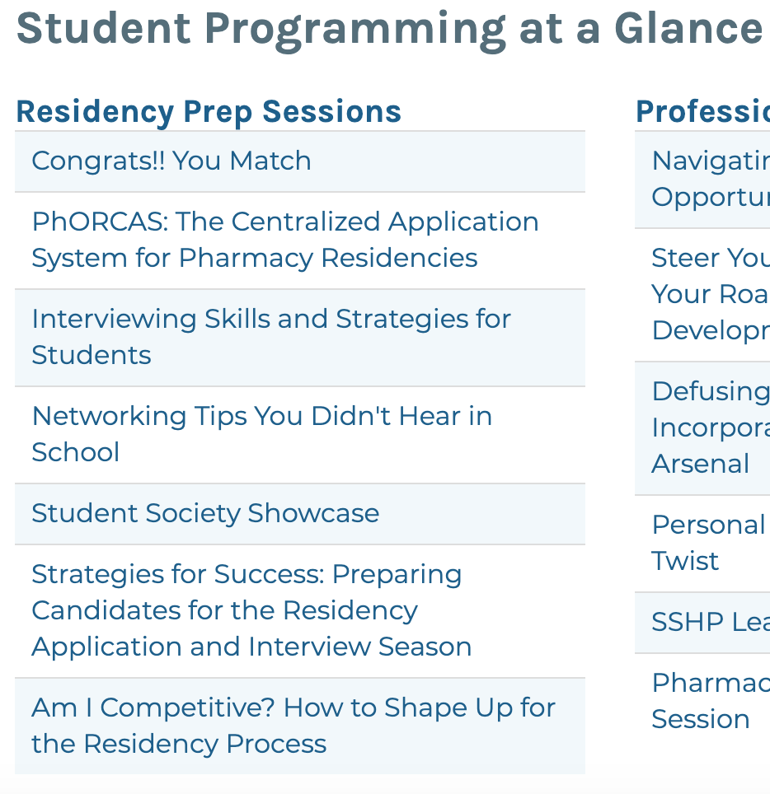
More Information
PhORCAS Customer Service
  Email: PhORCASinfo@PhORCAS.org
  Call: (617) 612–2868
  Hours: M – F, 9:00 a.m. – 5:00 p.m. EST
Continue the PhORCAS Discussion on ASHP Connect and Share Your Tips and Tricks
Source: https://midyear.ashp.org/Information-by-Audience/Student-Programming?loginreturnUrl=SSOCheckOnly
Notes:
-If you have any additional questions about PhORCAS or the residency application process, please participate in the PhORCAS discussion on ASHP Connect.

Slide 35
Questions about the platform?
Contact PhORCAS at phorcasinfo@phorcas.org or call them at (617) 612-2868
Notes:
If you have specific questions for phorcas, contact their customer service team directly!

Slide 36
Notes:
Thank you for your time and good luck!

