Slide 1

ASHP/ACPE Accreditation for Pharmacy Technician Training Programs
Notes:
September 2016

Slide 2
What is accreditation?
Accreditation is a system for declaring that a program or institution meets established quality standards to provide assurance and confidence to the public.
Notes:
Accreditation requires training programs to meet a nationally recognized standard of excellence.
It ensures that a program is contemporary and meets current needs of the pharmacy profession.

Slide 3
What is ASHP/ACPE accreditation?
The American Society of Health-System Pharmacists (ASHP)/Accreditation Council for Pharmacy Education (ACPE) is the only nationally-recognized, non-governmental, non-profit pharmacy association that accredits pharmacy residencies and pharmacy technician training programs in the United States.

Slide 4
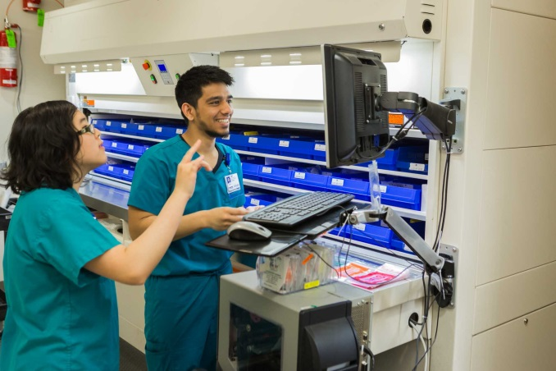
Who is involved?
Pharmacy Technician Accreditation Commission (PTAC)
  PTAC appointed by ASHP and ACPE to ensure quality of pharmacy technician training programs
  Representation from experienced leaders in the pharmacy profession appointed by ASHP and ACPE to ensure quality
    Standard development and revision
    Onsite peer review of programs against standards
    Vote to recommend accreditation status for final approval by the boards of ASHP and ACPE

Slide 5
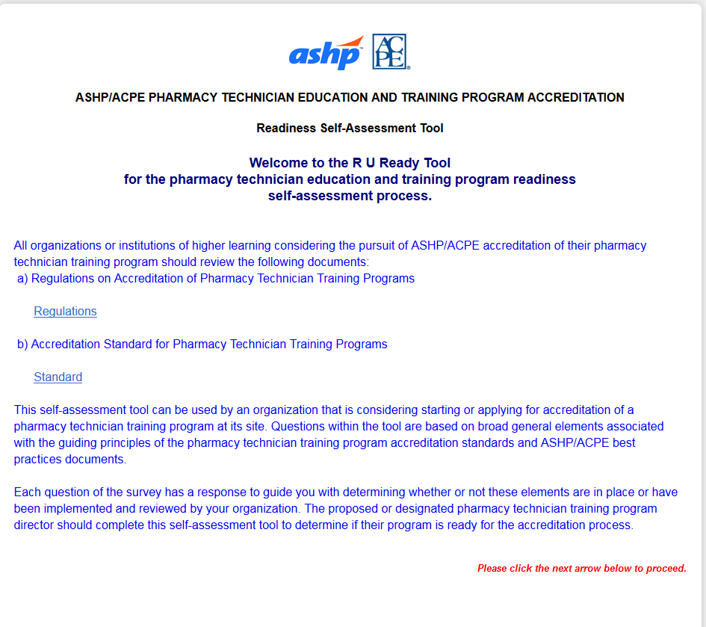
How do I get started?
Readiness Self-Assessment
  A self-assessment tool that will walk you through a series of questions related to pharmacy technician education and training program accreditation readiness
  Assess how close you may or may not be to initiating the formal accreditation process
  Available online at
  http://ashp.az1.qualtrics.com/jfe/form/SV_bPc0joPXJTIlGzr
Notes:
This is a self-assessment tool that will help you maximize the effectiveness of your future program.

Slide 6
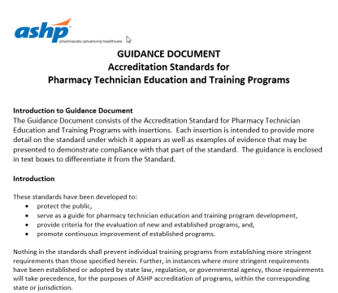
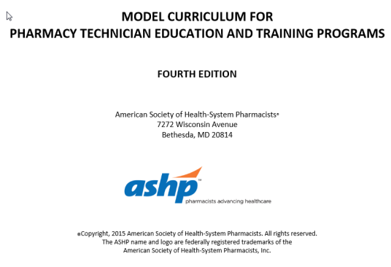
How do I get started?
  Other important tools when developing a program for accreditation
  Model Curriculum for Pharmacy Technician Education and Training Programs
    Available online at http://www.ashp.org/DocLibrary/Technicians/Model-Curriculum.pdf
  Guidance Document on Accreditation Standards for Pharmacy Technician Education and Training Programs
    Available online at http://www.ashp.org/doclibrary/accreditation/guidance-document.pdf

Slide 7
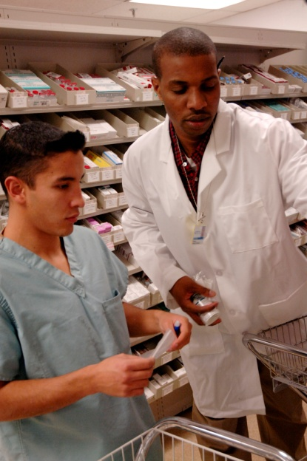
Why is ASHP/ACPE accreditation increasingly important?
Many state boards of pharmacy require completion of an ASHP/ACPE accredited pharmacy technician education and training program to practice as a pharmacy technician in their state
The accreditation process is designed to protect the public
Pharmacy technicians play an
increasingly important role
in public safety
    Expanding and evolving responsibilities
    Knowledge of new medications, new technologies
    Increasing expectations
    Expanding roles in medication safety
Notes:
The overarching goal of accreditation is to ensure public safety. There is growing complexity in medication use, with a continued focus on medication safety and quality. There is a need TODAY for well-qualified, competent pharmacy technicians for the safe provision of medications in all settings.
The role of the pharmacist and pharmacist technician continues to evolve. Pharmacists require a well-trained pharmacy technician to support them with the distribution process. Technicians’ roles can be expanded further from distributive functions when technicians undergo appropriate training. For example: technicians may be involved in tele-pharmacy, managing automation, and assisting as ‘clinical technicians’ (who obtain values for pharmacists in in clinics and rounds). Therefore, we need to ensure that both pharmacists and technicians are appropriately educated, adequately trained, and meet a minimum standard of ability before they face the public.

Slide 8
Other Benefits of ASHP/ACPE Accreditation
Expert guidance and advice from leading pharmacists and pharmacy technician educators
Standards are developed and updated with an onsite peer review process
Networking opportunities with the accrediting team and the community of ASHP/ACPE-accredited programs
Online listing on for national recruitment opportunities
Notes:
Accredited programs are provided expert guidance and advice from pharmacists and technician educators , especially those that comprise the on-site survey teams.
Not only are the accreditation standards established using a peer review process, but the actual on-site surveys are as well.
Surveys and other aspects of the accreditation process provide numerous networking opportunities with the accreditation team and other members of ASHP. Members are always available to help technician training programs even after an on-site survey is conducted. Accredited programs are allowed the opportunity to establish relationships with the survey teams and connections with technician educators who may help a program throughout its development.

Slide 9
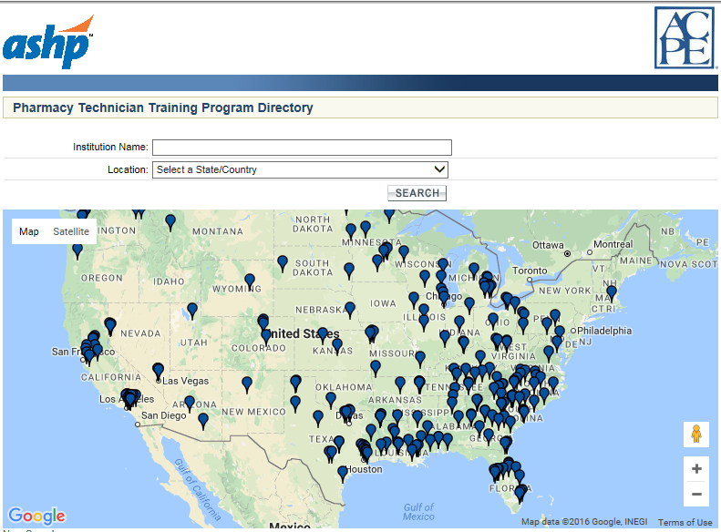

Why is ASHP/ACPE accreditation valuable?
National advertising of programs on the ASHP website site (No charge)
Access to educator materials, including curriculum guidelines
Link to Pharmacy Technician Training and Education Directory
https://accred.ashp.org/aps/pages/directory/technicianprogramdirectory.aspx

Slide 10


Why are students seeking accredited programs?
Required in some states, and the number is increasing, to practice as a pharmacy technician
Builds their resume
It gets them hired – many employers only hire technicians who have completed and ASHP/ACPE-accredited program
It prepares them for a successful and rewarding career!
Notes:
Accredited programs are of real value to those individuals considering choosing a program. Accreditation ensures that future technicians will be part of an educational experience that is of outstanding quality.
It may be a requirement – ASHP/ACPE-accredited pharmacy technician training is now required or strongly encouraged by several state Boards of Pharmacy. More and more students are looking to find programs that fulfill this requirement.
It builds their resume – Pharmacists prefer to have students from ASHP-accredited programs on experiential rotations. Being a student of an ASHP /ACPE -accredited program establishes credentials and provides a thorough and baseline understanding of the profession.
It gets them hired – Employers often prefer to have students from accredited ASHP/ACPE training programs.
It prepares them for a successful and rewarding career! – Being a student in an accredited program essentially reflects a career choice – it provides students long-term success in their role as technicians. Students are offered exposure to opportunities in all practice settings (community, hospital, long-term care, etc.), allowing them to be well-rounded members of the workforce.

Slide 11
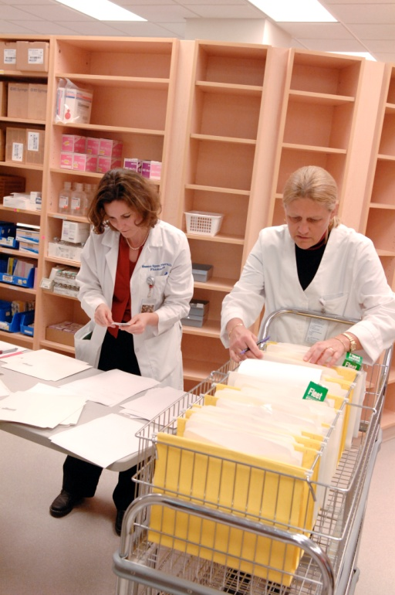

Ready for accreditation?
Application:
  Application for accreditation may be made as soon as a student has begun training, but not sooner
  ASHP and ACPE are here to help from start to finish!
Contact:
  ASHP Accreditation Services Division
    VISIT: http://www.ashp.org/menu/Technicians/Technician-Accreditation
    EMAIL: asd@ashp.org or llifshin@ashp.org
    CALL: 301-664-8835
Notes:
After an application is submitted, ASD will contact you to set up a survey and site visit.
Members of the ASD staff are always available to assist in helping with any questions or issues as programs are in any part of the development of their program: seeing if they are ready to apply for accreditation, the accreditation process itself, and beyond.
Please contact us, we are looking forward to hearing from you!
Any questions?

